Slide 1
Fighting Cancer with Your Fork
Jacqueline Stulb RD, CSO, LDN
Registered Dietitian Nutritionist

Slide 2
Importance of Nutrition

Slide 3
Benefits of Good Nutrition
Boost immune system
Feel better
Maintain energy and strength
Better tolerate side effects of treatment
Heal and recover faster
Improved quality of life

Slide 4
Important Points
Avoid rapid weight loss
  Can decrease immunity
  Typically muscle loss which can cause weakness
Don’t stress about food
  Stress increases cortisol levels and inflammation
If overweight, losing weight gradually to a healthy weight is beneficial
Every patient has different nutrition side effects

Slide 5
AICR Recommendations
Be a healthy weight
Be physically active as part of everyday life
Eat mostly plant based foods
Limit intake of “fast foods”
Limit intake of red meat and avoid processed meat
Limit consumption of sugar-sweetened beverages
Limit alcohol consumption
Aim to meet nutritional needs through diet alone

Slide 6
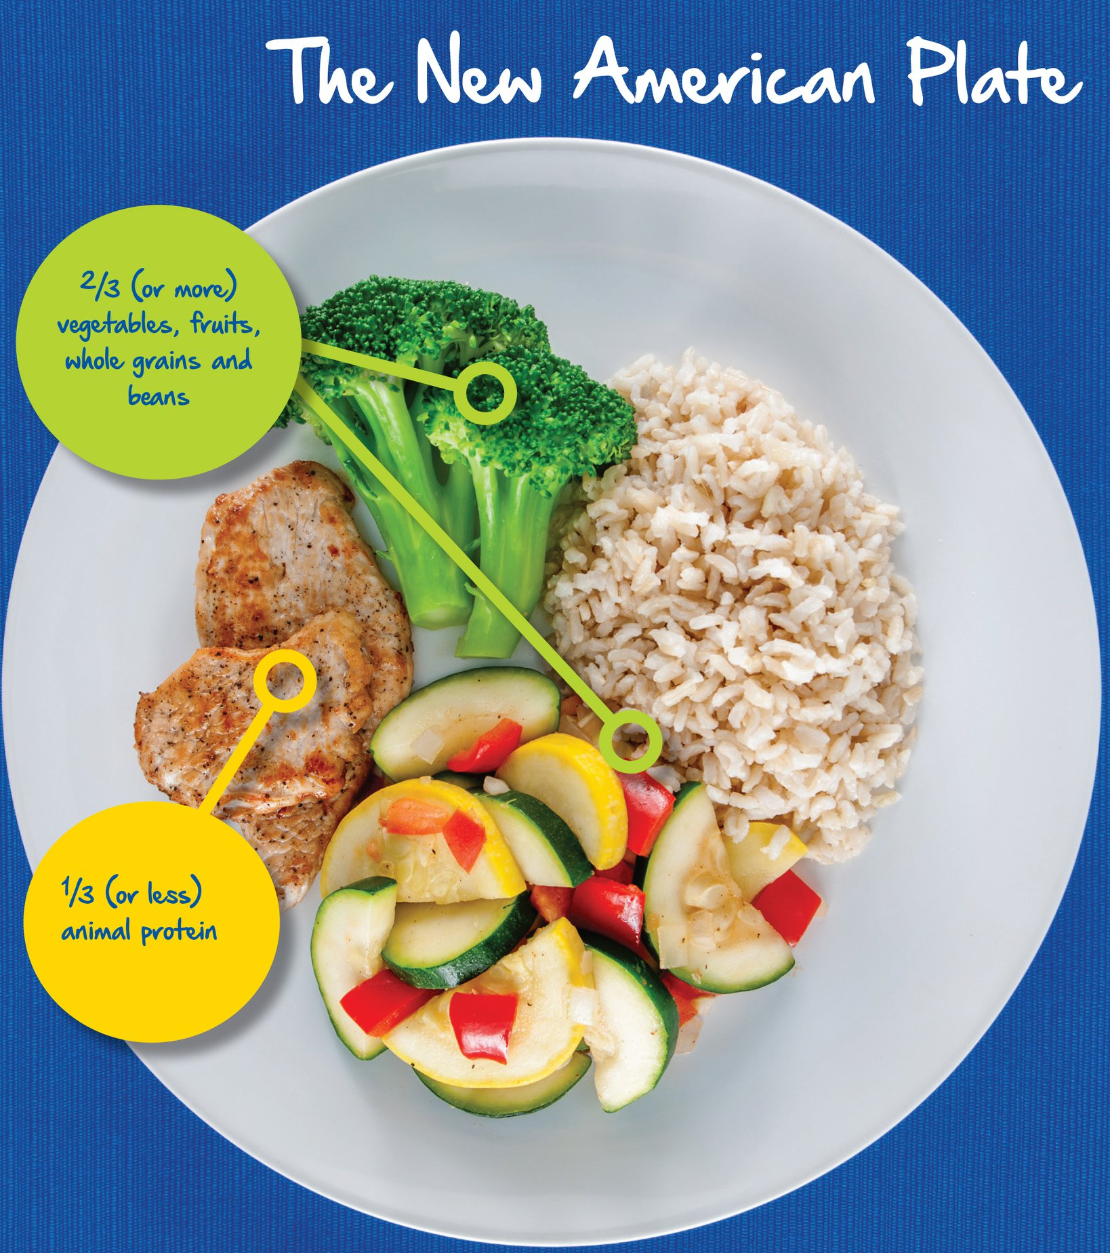
2/3 (or more) vegetables, fruits, whole grains and beans
1/3 (or less) animal protein

Slide 7
General Nutrition

Slide 8
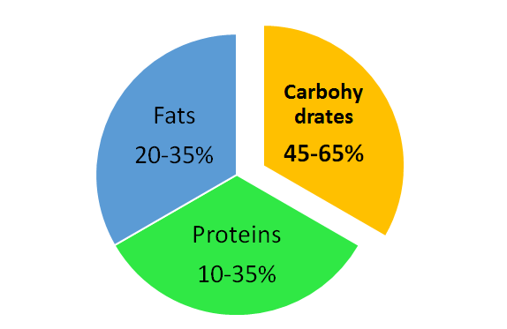
Nutrients
Carbohydrates (4kcals/g)
  Primary source of energy
Protein (4kcals/g)
  Tissue repair, boost immune system
Fat (9kcals/kg)
  Energy, absorption of vitamins and minerals, cell membranes, inflammation, blood clotting, muscle movement
Water, Vitamins, Minerals

Slide 9
Macronutrients- Carbohydrates
Made up of fiber, starch, and sugar
Simple Carbohydrates-digested quickly
  Sugar, honey, agave, juice, soda, desserts, breakfast foods, milk, white bread/pasta/rice
  Limit consumption as appropriate
Sugar does not feed cancer cells anymore than any other cell, however cancer cells do grow more rapidly and therefore use more glucose than normal growing cells

Slide 10
Macronutrients- Carbohydrates
Complex Carbohydrates- slower digestion, more nutrients – fiber, antioxidants, phytochemicals
  Fruits, vegetables, beans, potato
  Whole grains – oats, rice, whole wheat, quinoa, barley
  Aim for 2 ½ cups of vegetables and fruits daily
  Aim for 5 servings of whole grains
  Fiber
    Insoluble – pushes things through intestines
    Soluble – helps absorb water in intestines

Slide 11
Macronutrients- Protein
  Important for enzyme and hormones, building and repairing tissue, immunity
  Higher needs during treatment (1-1.5g/kg)
  Sources of Protein
    Plant sources - tofu, soy, nuts, seeds, beans, quinoa
    Poultry
    Eggs
    Dairy products- milk, yogurt, cheese, cottage cheese
    Red Meat- beef, pork, lamb (limit to 18oz weekly)
    Processed meat –sausage, bacon, hot dogs, cold cuts (avoid)
  Choose lean cuts, plant sources more often
  Avoid cooking at high heat

Slide 12
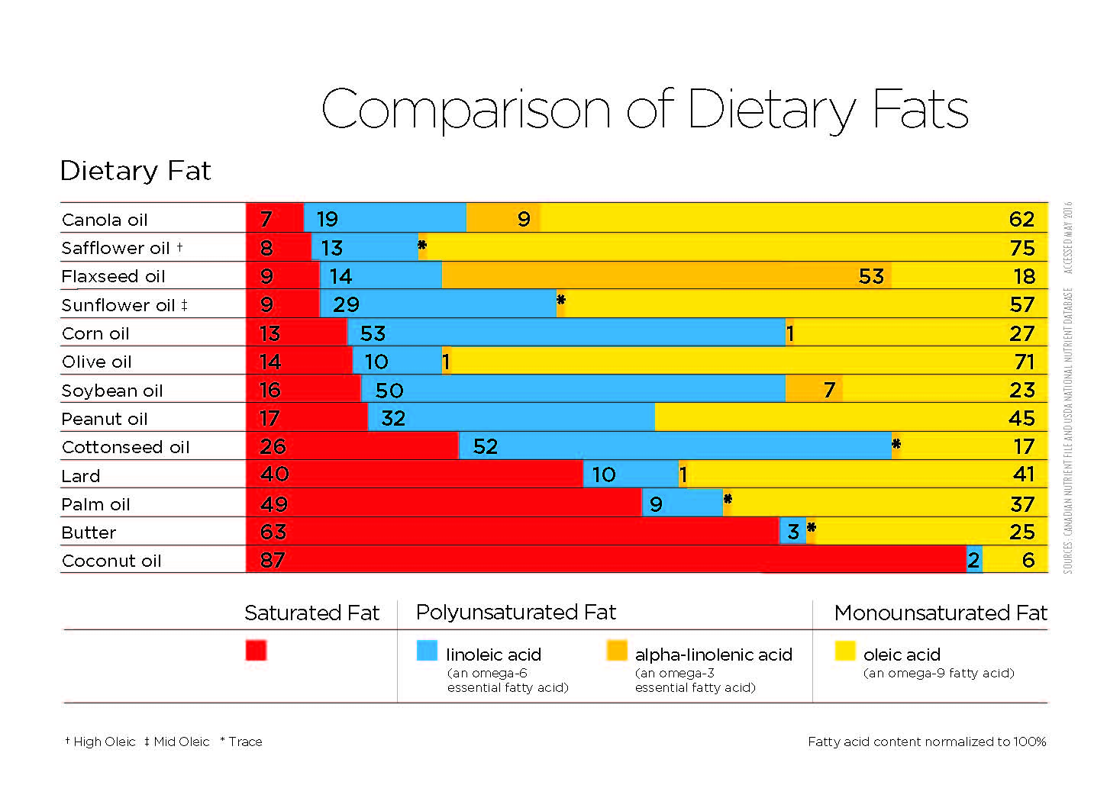
Macronutrients- Fats
  Helps absorb fat soluble vitamins
  Monounsaturated/Polyunsaturated fats- heart healthy fats
    Avocado, nuts, seeds, fish, olive oil
    Omega 3 – salmon, sardines, walnuts, flaxseeds, canola oil
    Omega 6 fats – safflower, soybean, sunflower, corn oils
  Saturated fats
    Red meat, coconut oil, whole milk, cheese, commercially prepared baked goods
    Limit to 10% of total fats

Slide 13
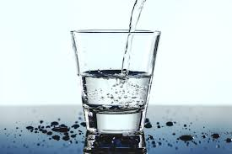
Water
  Hydration is important for cells to function properly
  Aim for at least 64 oz or 2 liters daily
  Increase fluids if diarrhea or vomiting to prevent dehydration
    Add electrolyte rich beverages to prevent low levels
  Increase fluids if constipated to help facilitate bowel movement
  Water isn’t the only source of hydration
    Moist foods will provide fluids as well
      Soups, juice, milk, ice cream, gelatin

Slide 14
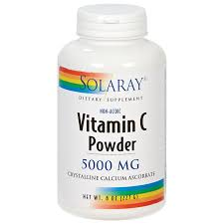
Vitamins/Mineral/Antioxidants
Taking supplements is not recommended during treatment
  Most haven’t been studied enough to determine if there are interactions with medications
  Some high doses have been shown to be harmful
Antioxidants:
  Protect cells from oxidative damage
    May protect cancer cells as well as healthy cells
  Vitamins A, C, E, selenium, zinc, and some enzymes
Bottom Line: Go for the whole foods!

Slide 15
Water Soluble Vitamins
Dissolved in water and readily available in tissues for immediate use
Includes B Complex group and Vitamin C
  B1 (Thiamine): helps to release energy from foods. Sources: legumes, whole grains, salmon
  B2 (Riboflavin): Helps promote good vision/healthy skin. Sources: nuts, dairy products, broccoli, green leafy vegetables
  B3 (Niacin): aids in digestion, metabolism and enzyme function. Sources: Liver, chicken, tuna, salmon, peanuts, avocado
  B5 (Pantothenic acid): Aids in metabolism and formation of hormones. Sources: Fortified breakfast cereals, shitake mushrooms, sunflower seeds, avocado, eggs, Greek yogurt

Slide 16
Water Soluble Vitamins
B6 (Pyridoxine): Aids in protein metabolism and production of RBC and hemoglobin. Sources: nuts, whole grains, bananas, poultry
B7 (Biotin): helps release energy from carbohydrates and aids in metabolism. Sources: eggs, salmon, nuts and seeds, sweet potato
B9 (Folic Acid): Aids in protein metabolism and RBC formation. Sources: leafy green vegetables, chickpeas, fortified breakfast cereals
B12: Aids in production of RBC and DNA. Sources: meat, eggs, dairy, poultry
Vitamin C (Ascorbic acid): Aids in iron production, collagen synthesis and wound healing. Sources: citrus fruits, peppers, strawberries
Notes:
If Vegan/Vegetrian, may be deficient. B12 deficiency is common.

Slide 17
Fat Soluble Vitamins
Dissolved in fats
Vitamin A: Contributes to immune and cellular function and bone and tooth formation. Sources: butter, whole milk, egg yolks, fortified cereals
Vitamin D: Promotes intestinal absorption of Calcium and Phosphorus and influences bone mineralization. Sources: sunlight, egg yolks, fatty fish, fortified milk and cereal
Vitamin E: Antioxidant to help fight infection and keep RBC s healthy. Sources: vegetable oil, nuts, seeds
Vitamin K: Important for blood clotting. Sources: green, leafy vegetables, dairy products, meat

Slide 18
Iron
Mineral in the body
Component of hemoglobin
Heme Iron: Better absorbed than non heme iron. Animal sources (claims, liver, red meat, sardines)
Non Heme Iron: Plant sources (spinach, green leafy vegetables, nuts, legumes, chickpeas)

Slide 19
Phytochemicals
Phytochemicals
  Compounds with health protecting qualities
  Carotenoids, lycopene, resveratrol, phytoestrogens
  Found in fruits, vegetables, tea, soy foods, herbs
Cruciferous Vegetables: contain sulforaphane, isothiocyanates, organo-sulfides, indoles
  Broccoli, broccoli sprouts, cauliflower, Brussel sprouts, cabbage, kale, bok choy, mustard greens
Isoflavones: Soy, flaxseeds, legumes
Allium: Garlic, onions, leeks, shallots
Notes:
There is evidence that cruciferous vegetables exert anticarcinogenic effects against urothelial cancer

Slide 20
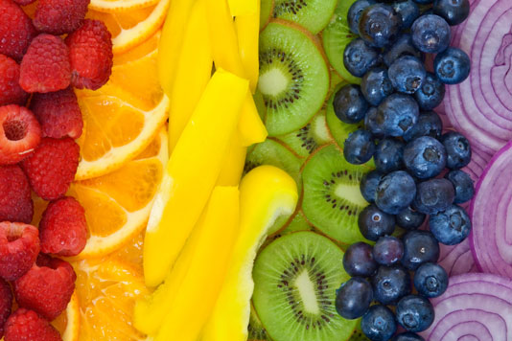
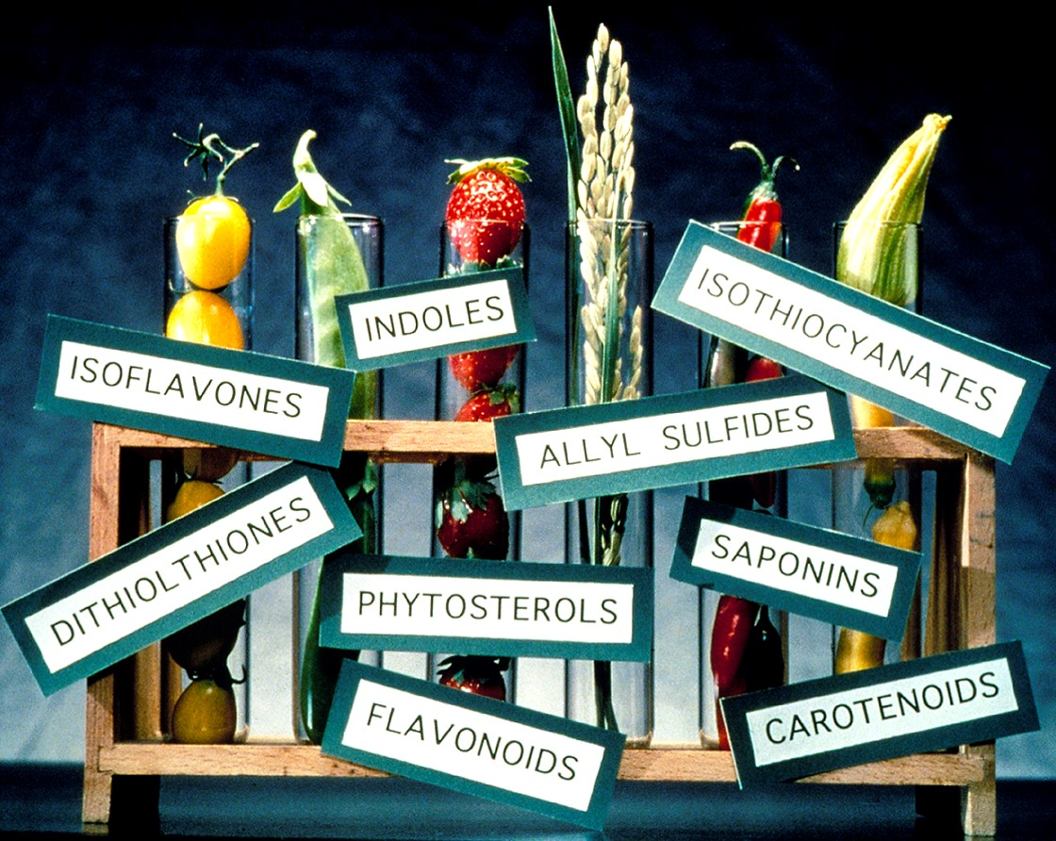
Add Color to Your Plate
Variety of Phytochemicals and Nutrients
Notes:
Red: A and C. polyphenols, lycopene, anthocyanins. Orange: beta carotene, a and c. yellow; c fiber magnesium, leutoein. Green: folate, C, fiber, magnesium, indoles, leuteins. Blue/Purple: antioxidants, C, Fiber,polyphenols.
White/tan/brown: C, potassium allyl sulphides

Slide 21
Herbs
  Always discuss with oncologist and/or dietitian
  Some are safe, others may have medication interactions
  May increase or decrease effectiveness of treatment
https://www.mskcc.org/cancer-care/diagnosis-treatment/symptom-management/integrative-medicine/herbs/search

Slide 22
Common Questions

Slide 23
Alcohol
Alcohol, regardless of the source, is a carcinogen
Resveratrol is found in wine, grapes, blueberries, and even cocoa.
Rec no more than 2 servings for men, 1 serving for women daily

Slide 24
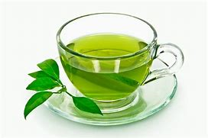
Green Tea
Contain EGCG
Antioxidant activity
Stimulates enzymes to:
  Deactivate carcinogens
  Decrease tumor growth
  Restrain ability of cancer cells to spread
*Contraindicated for patients receiving Velcade*
Notes:
EGCG: epigollacatechin gallate. A polyphenol with strong antioxidant activtiy

Slide 25

Processed Foods
“Processed” has a negative connotation but there are plenty of processed foods that make healthy meals easier.
  Frozen veggies, canned fruit, or healthy soups are what we call minimally processed.
Choose processed foods that are low in added salt, sugar and fat.
Processed foods that are high in sugar, fat, and/or sodium and often loaded with calories.
  Eating too many of those foods can lead to weight gain which increases cancer risk and can cause a host of other health problem

Slide 26
Tumeric
Active substance is Curcumin
Powerful antioxidant
Consume with fat or black pepper to increase bioavailability
May help prevent and slow the spread of cancer
May help make chemotherapy more effective and prevent healthy cells from radiation

Slide 27

Organic
The term “organic” is defined as foods grown on contaminant-free land without pesticides or herbicides.
There are many reasons why people choose organic foods, but at this time it is not known whether organic foods help reduce cancer risk more than non-organic counterparts.
If you do opt for organic, remember that organic cookies, chips, and other snacks can contain exactly the same amount of calories, fat, and sugar as conventional brands and are not deemed “healthy” simply because they are organic.

Slide 28
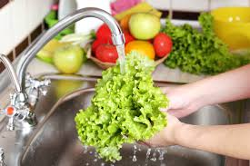
Food Safety
Cook meats well, avoid rare and sushi
Make sure to wash fruits and vegetables.
  Under running water
  Use vegetable brush for tough skins
  Throw away if slimy or visible mold
Rinse tops of cans
If it smells strange do not eat it
Avoid cross-contamination

Slide 29
Popular Diets
Keto diet – high fat, low carb and lower protein
  May be beneficial for neurological cancers
Alkaline diet- 80% plant based, 20% animal/sugar based
  No benefit for cancer has been shown
Vegan/Vegetarian diet- overall healthy, but can be lacking in nutrients if not planned correctly. Takes prep and planning.
Mediterranean diet- consistently ranked in top diet. Plant based with emphasis on plant, lean fish, chicken for proteins

Slide 30
Managing Side Effects

Slide 31
Managing Decreased Appetite
Eat 6 small meals/snack daily
Add high calorie, high protein foods
Keep easy to prep snacks available
  Greek yogurt, nuts, fruit, muffins, hard boiled eggs, peanut butter crackers
Set a timer to remind you to eat
Drink fluids in between meals
Add milkshakes, smoothies, juices, soups if drinking is easier
Eat larger meals in morning

Slide 32
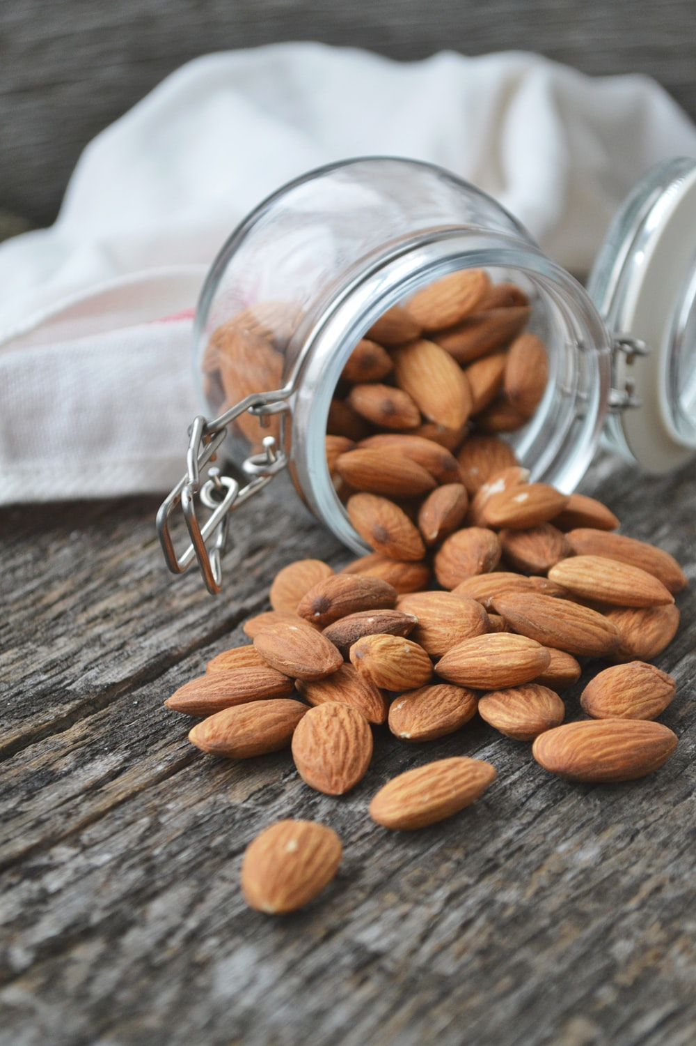
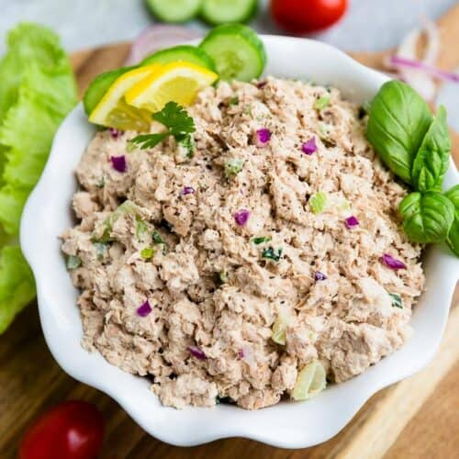
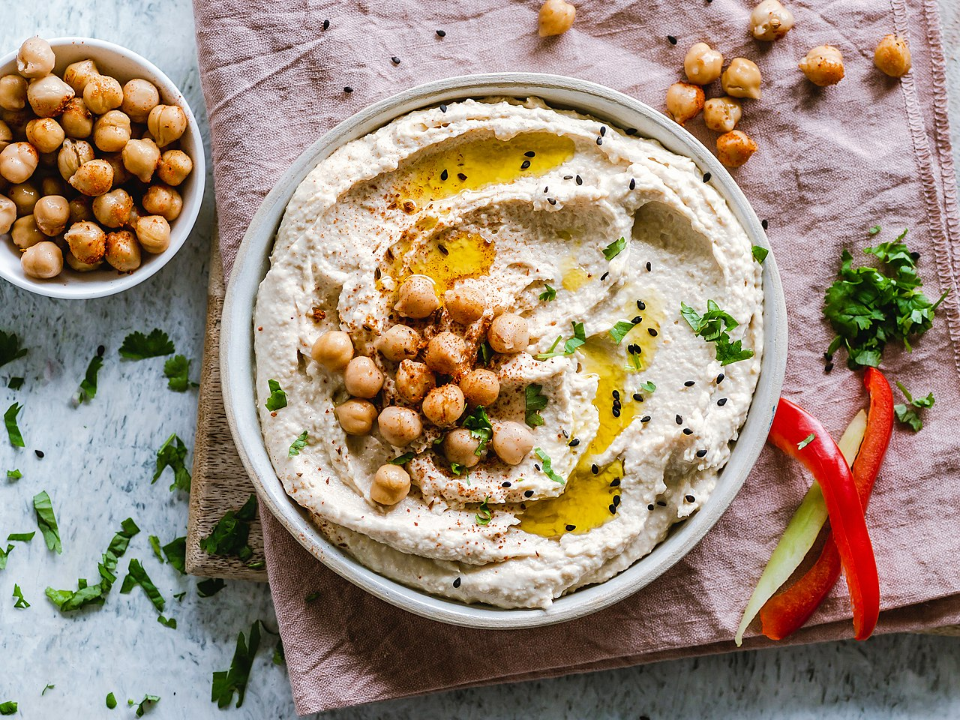
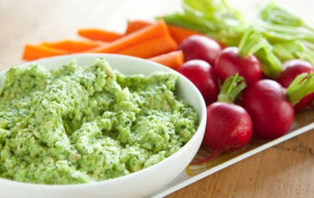
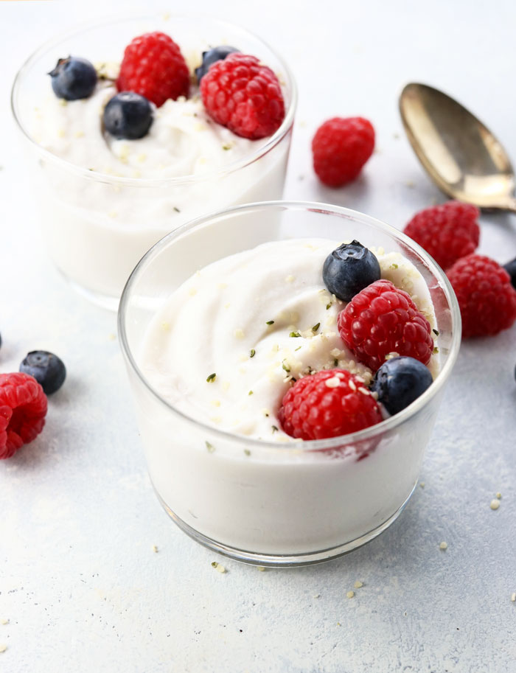
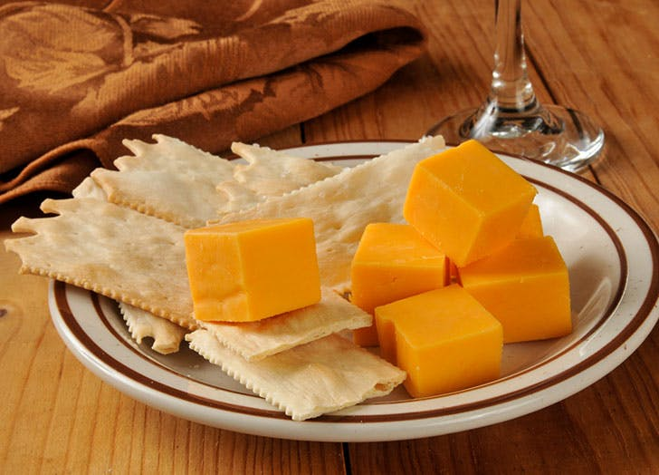
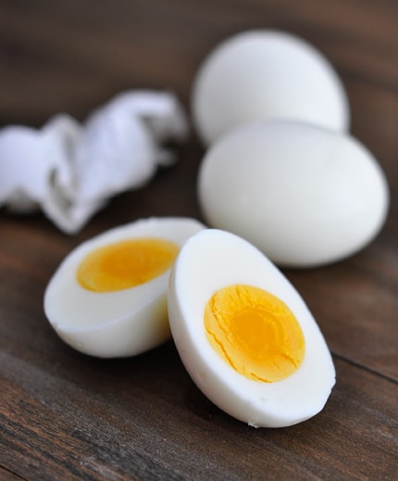
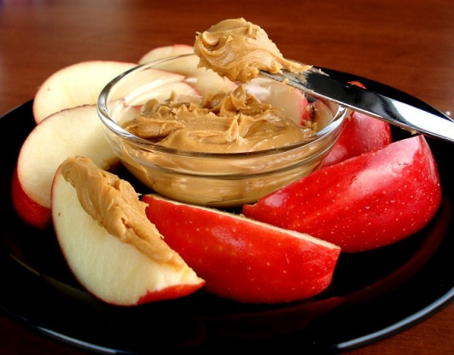
Nutrient Dense Snacks

Slide 33
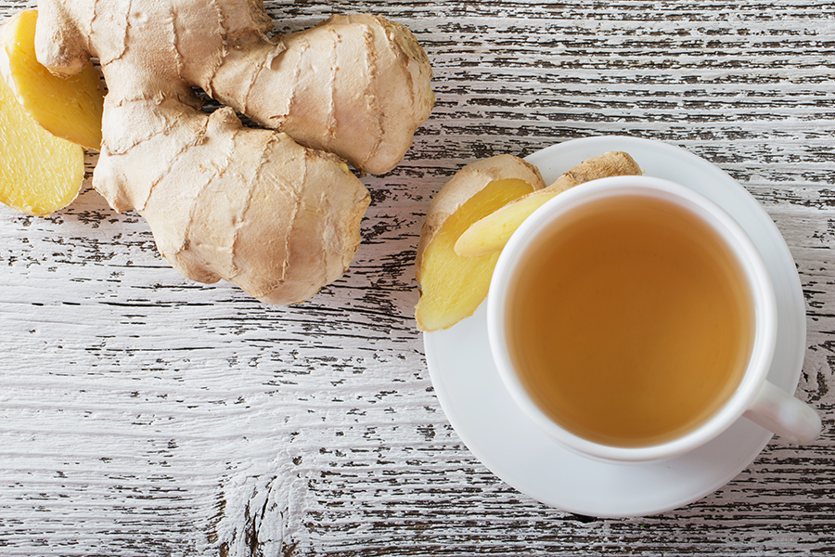
Nausea/Vomiting
Small, frequent meals/frequent snacking
Bland foods
Avoiding offending odors
Ginger
Oral nutrition supplements
Medications

Slide 34
Managing Taste Changes
Try new foods that have no prior taste expectations
Zinc supplement may help with decreased taste
  (mixed results in multiple studies)
  50mg zinc gluconate 3 x daily for 2 weeks
Swish mouth with seltzer or club soda
Acidic foods may activate taste buds
Perform adequate oral hygiene
Choose bland foods

Slide 35
Taste Changes
Plastic ware vs. silver ware
Add marinades/sauces
Spices/flavors
Lemon drops/mints
Baking soda/salt rinse
Experiment!

Slide 36
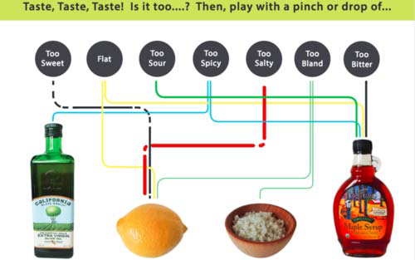

Slide 37
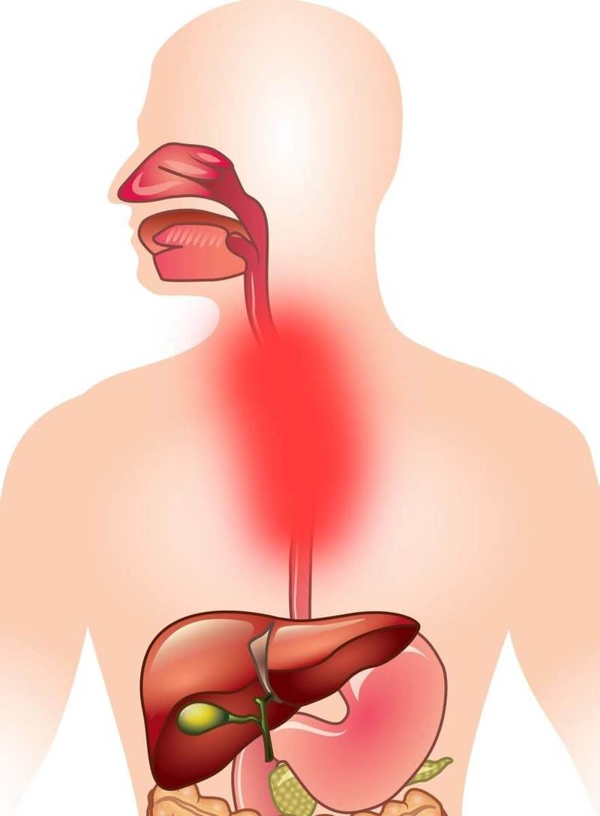
Mucositis/Esophagitis
Avoid spicy foods
Avoid citrus foods
Avoid acidic foods
Avoid alcohol
Choose moist/soft foods
Liquid nutrition may be helpful
Mouth rinses

Slide 38
Managing Diarrhea
Fiber intake – increase soluble fiber
Drink plenty of fluids
Eat bland foods, avoid spicy foods
Foods high in pectin tend to slow transit
  Banana, sweet potato, pumpkin
  Make a shake with soy milk, banana, sweet potato
Rice water
  Make rice according to package directions, add an additional 1 ½ cups water. Once rice is cooked, pour off access water to drink
Yogurt has beneficial bacteria which may help
Notes:
Soluble fiber = dissolves in water. Helps bulk your stool. Turns to gel to slow digestion Oatmeal, nuts, beans, apples, blueberries.

Slide 39
Managing Constipation
Fiber intake- increase insoluble fiber intakes
Drink plenty of fluids
Avoid gas forming foods
  Cabbage, broccoli, cauliflower, Brussel sprouts
Decrease intake of “binding” foods
  Cheese, banana, sweet potato
Notes:
Insoluble fiber does not dissolve in water and its presence speeds up the movement and processing of waste, preventing constipation. Sources: whole grains, fruit with seeds, beans

Slide 40
Nutrition and Kidney Damage
Discuss with your doctor if you have kidney damage and which stage
There is not one diet plan that is right for people with kidney damage (ask to meet with RD for individualized counseling)
May need to follow a diet low in sodium, potassium, phosphorus

Slide 41
Tips to Limit Sodium
Eat home-cooked meals made from fresh ingredients.
Choose foods and condiments with 200 milligrams of sodium or less per serving.
Use frozen or packaged meals with 600 milligrams or less sodium per serving if you are too tired to cook.
Check labels to avoid foods that have more than 200 milligrams of sodium per serving. These foods may include canned soups or soup mixes, packaged foods, pickled foods, sauces, and seasonings.
Limit how much salt you add to foods or avoid it altogether. Salt-free seasonings like herbs, spices, lemon juice, and vinegar will flavor to your food without adding salt.

Slide 42
Potassium in Foods
Discuss with your doctor and RD your specific requirements
Foods higher in potassium: bananas, potatoes, pumpkin, milk, nuts, beef, brussell sprouts, spinach
Foods lower in potassium: cauliflower, mushrooms, almond milk, hummus, grapes, eggplant, grapes

Slide 43
Phosphorus in Foods
Discuss with doctor and your RD on your specific requirements
Foods higher in phosphorus: biscuits, pancakes, processed meats and cheese, battered or fried fish
Foods lower in phosphorus: fresh breads, plain cereals, all natural chicken and fish, tofu, milk, eggs

Slide 44
Survivorship

Slide 45
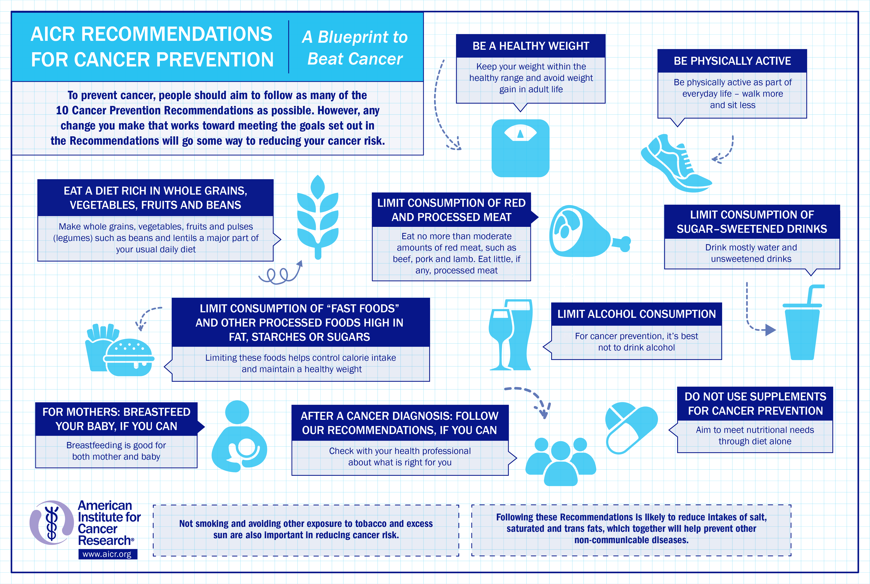

Slide 46
Your questions

Slide 47
Jacqueline Stulb
267-240-0576
Jacqueline.Stulb@Jefferson.edu

