Slide 1
Advances in myeloma therapy
What’s new in 2021
Dan Vogl, MD MSCE
Associate Professor of Medicine
Hematology/Oncology Division
Abramson Cancer Center
February 13, 2021

Slide 2
Disclosures
Consulting:
  Karyopharm
  Takeda Oncology
  GSK
  Oncopeptides
  Active Biotech
  Janssen
  Celgene Corporation
Research support:
  Active Biotech
  Takeda Oncology

Slide 3
Topics
Overview of myeloma and therapy
Therapy for relapsed myeloma
Recent advances in myeloma therapy
  subcutaneous daratumumab (Darzalex Faspro)
  Isatuximab (Sarclissa)
  belantamab mafodotin (Blenrep)
  selinexor (Xpovio)
  venetoclax (Venclexta)
Experimental therapies for relapsed myeloma
  BiTEs and CARs
  TAK-573 and tasquinimod
Clinical trials available at Penn

Slide 4
Overview of myeloma and therapy

Slide 5
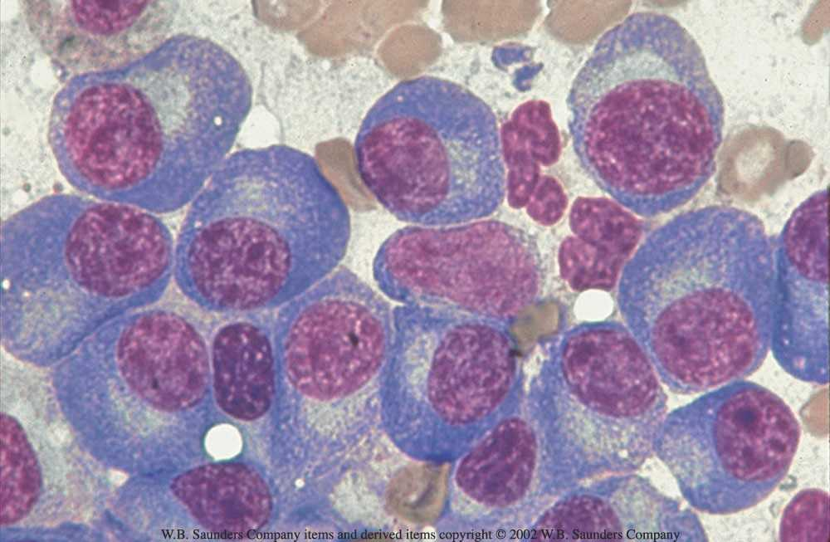
Myeloma = Cancer of malignant plasma cells

Slide 6
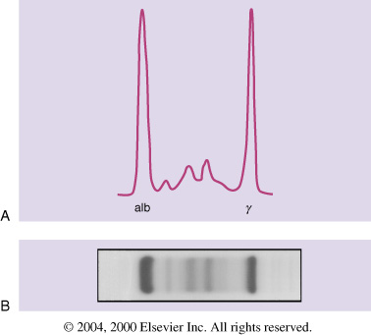
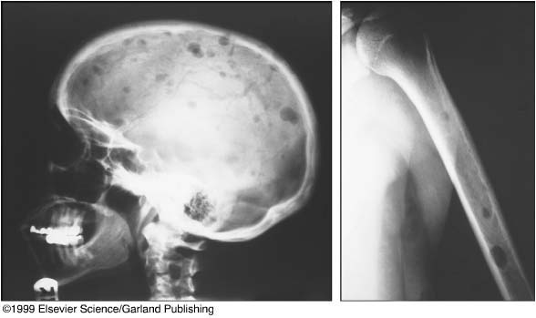
Multiple Myeloma – Clinical Features
Abnormal protein in blood and/or urine
  “M-spike” = “Myeloma protein,” “M-protein,” “monoclonal protein”
  Free light chains
Plasma cells in the bone marrow
CRAB criteria
  High calcium levels
  Kidney (renal) injury
  Anemia (low red blood cells)
  Bone destruction (“lytic bone lesions”)
Increased risk of infection
Neurologic Injury
  Spinal Cord Compression
  Peripheral Neuropathy
Increased blood viscosity

Slide 7
Management of Disease Symptoms
Radiation and pain medication for bony pain
denosumab (Xgeva) or bisphosphonates, such as zoledronate (Zometa), for bone pain or fractures
  Risk of jaw osteonecrosis (area of dead bone, sometimes requiring surgery)
Red blood cell growth factors for anemia
Kidney Protection
  Hydration (drink plenty of fluids)
  Avoid NSAIDs (ibuprofen, Advil, Alleve, etc.)
  Avoid contrast for x-rays
Prevent and Treat Infections
  Antibiotics
  Vaccinations
    influenza,
    Pneumococcus (Prevnar, Pneumovax)
    Shingrix
    COVID-19
Treatment should be individualized

Slide 8
COVID-19 recommendations for myeloma patients
Masks and social distancing
  Avoid being indoors with people who are not part of your household and who are not wearing masks
  Mostly safe
    Medical buildings
    Dentist’s offices
    Grocery stores
    Schools
  Not so safe
    Bars
    Restaurants
    Weddings
    Family gatherings with meals
    Grandkids
Treat COVID Infections
  Antibody therapies (e.g. bamlanivimab)
  Convalescent plasma
  Remdesivir
  Dexamethasone
Vaccination
  Get vaccinated wherever you can, ASAP
  Pfizer and Moderna vaccines have been shown to be safe in thousands of recipients
  Probably not as effective in myeloma patients
  No reason to think less safe
  Hold off?:
    Recent COVID infection
    Profoundly immunosuppressive therapy
Return to normal?
  When case numbers are low
  Maybe Summer/Fall 2021

Slide 9
Myeloma – Treatment and Progression
100
Asymptomatic
Symptomatic
Active Myeloma
Relapse
50
M Protein (g/l)
Refractory Relapse
MGUS or Smoldering
Myeloma
20
Plateau Remission
Therapy
Therapy
Therapy
~20,000
New cases in U.S.
~60,000
~11,000 Annual deaths in U.S.
Annual patients in the U.S.³
1. Adapted from International Myeloma Foundation; 2001. Reprinted with permission.
2. American Cancer Society. Cancer Facts & Figures; 2003. 3. Millennium Pharmaceuticals, Inc., 2003.

Slide 10
Imids
thalidomide
lenalidomide
pomalidomide
PIs
bortezomib
carfilzomib
ixazomib
Bcl2i
venetoclax
Cytotoxics
melphalan
cyclophosphamide
doxorubicin
bendamustine
Steroids
dexamethasone
prednisone
ADC
belantamab mafodotin
HDACi
panobinostat
XPO1i
selinexor
MoAbs
elotuzumab
daratumumab
isatuximab

Slide 11
Initial therapy paradigm
TRANSPLANT ELIGIBLE
TRANSPLANT INELIGIBLE
Induction
Transplant
Maintenance
Induction
Maintenance
Rd
Vd
RVd
VTd
CyBorD
Rd
Vd
RVd
VTd
CyBorD
MP
MPT
VMP
MPR
Lenalidomide
Thalidomide
Bortezomib
Observation
Lenalidomide
Thalidomide
Bortezomib
Observation
MEL200 x1
MEL200 x2
RVd
MEL200 x1
Lenalidomide
RVd
Lenalidomide
RVd
KRd
Dara/RVd
MEL200 x1
Lenalidomide
RVd
Dara/RVd
Dara/Rd
Lenalidomide
Dara/Len

Slide 12
Therapy for relapsed myeloma

Slide 13
Doublet Triplet therapies for myeloma
melphalan/prednisone/thalidomide
melphalan/prednisone/lenalidomide
cyclophosphamide/prednisone/thalidomide
pomalidomide/cyclophosphamide/prednisone
bortezomib/melphalan/prednisone
cyclophosphamide/bortezomib/dexamethasone
cyclophosphamide/carfilzomib/dexamethasone
PLD/bortezomib/dexamethasone
bendamustine/bortezomib/dexamethasone
bortezomib/thalidomide/dexamethasone
bortezomib/lenalidomide/dexamethasone
bortezomib/pomalidomide/dexamethasone
carfilzomib/lenalidomide/dexamethasone
carfilzomib/pomalidomide/dexamethasone
ixazomib/lenalidomide/dexamethasone
ixazomib/pomalidomide/dexamethasone
bortezomib/panobinostat/dexamethasone
carfilzomib/panobinostat/dexamethasone
daratumumab/bortezomib/dexamethasone
daratumumab/lenalidomide/dexamethasone
daratumumab/pomalidomide/dexamethasone
elotuzumab/lenalidomide/dexamethasone
elotuzumab/bortezomib/dexamethasone
elotuzumab/pomalidomide/dexamethasone
Quadruplets
cyclophosphamide, bortezomib, lenalidomide, dexamethasone
cyclophosphamide, carfilzomib, thalidomide, dexamethasone
daratumumab, bortezomib, lenalidomide, dexamethasone
daratumumab, carfilzomib, lenalidomide, dexamethasone
Quintuplets?
(D-PACE)
Octuplets?
(M-VTD-PACE)

Slide 14
Choosing wisely – triplets for relapsed myeloma
No data comparing triplets or sequencing
General principles
  Most patients should receive triplets
  Carefully assess treatment history
    What worked?
    What caused side effects?
  Consider pace of progression and symptom burden
  Include cost and convenience in the decision
My favorite triplets
  Any proteasome inhibitor / Imid combination
  Cyclophosphamide / proteasome inhibitor combinations
  Daratumumab combinations

Slide 15
Recent advances in myeloma therapy

Slide 16
subcutaneous daratumumab (Darzalex Faspro)
New formulation that allows for subQ injection
More convenient: 5 minute infusion
Less side effects: First dose reactions in 13% vs 35%
Equivalent efficacy
Penn practice:
  Oral pre-medications
  Observation after dosing: 2 hours, 1 hour, none
  No observation for patients who have been tolerating IV infusions
  No need to start with IV dosing

Slide 17
isatuximab (Sarclissa)
Anti-CD38 monoclonal antibody
Same target as daratumumab (Darzalex, Darzalex Faspro)
Given IV
  Faster than IV daratumumab (initial infusion 3+ hours, subsequent infusions 75 min)
  Slower than subQ daratumumab
Excellent efficacy, but not clearly different than daratumumab
No data on isatuximab vs. daratumumab

Slide 18
Belantamab mafodotin (BLENREP, GSK2857916)
Antibody-drug conjugate targeting BCMA (B cell maturation antigen)
Approved August 2020 based on data from the phase 2 DREAMM-2 trial
Response rate of 31-34% in very refractory myeloma
Given IV every 3 weeks
1 hour infusion
Side effects:
  infusion reactions (first dose)
  low platelets
  low risk of liver or kidney injury
  eye problems

Slide 19
Belantamab: eye problems and practical considerations
Eye problems (ocular toxicity)
  ~70% of patients
    Microcystic changes in the cornea
    Blurry vision
    Discomfort (gritty sensation)
    Light sensitivity
  Reversible over time
  Mostly annoying, sometimes interferes with daily tasks
Plan
  REMS program / enrollment
  Eye exam before every dose
  Preservative-free eye drops
  Hold dose for even moderate toxicity
  Almost all patients need a dose reduction and regular dose interruptions

Slide 20
Belantamab: Penn experience and practice
Re-evaluate every 3 weeks
Hold doses when needed
Restart even after recurrent toxicity
Patients often skip 2+ doses
Responses tend to continue despite dose holds
Patients generally feel well

Slide 21
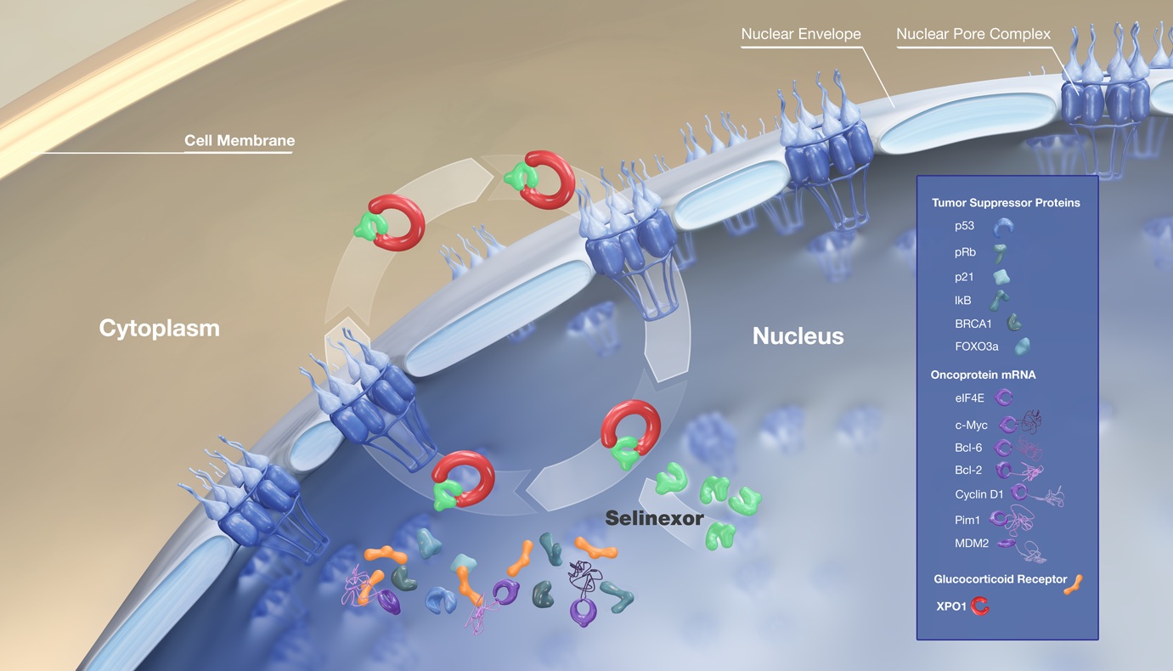
Selinexor (Xpovio)
Selinexor is an inhibitor of XPO1, a nuclear export protein
Approved July 2019 based on the phase 2 STORM trial
Overall response rate 26% in patients with highly refractory myeloma
Oral pills: Selinexor 80 mg / dexamethasone 20 mg, twice weekly (Days 1 and 3)
Often given weekly at 60-100 mg with dex 20
Often given in triplet combinations with other effective medicines
Side effects:
  low blood counts
  fatigue
  nausea/vomiting, decreased appetite and weight, diarrhea

Slide 22
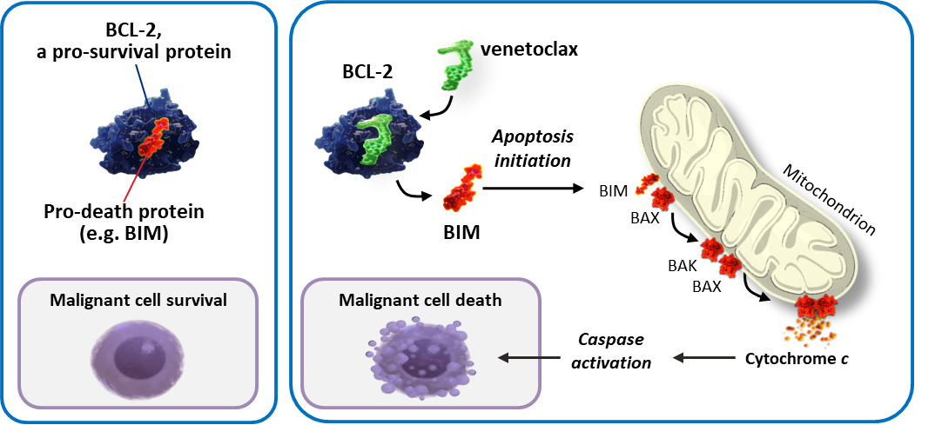
Venetoclax (Venclexta)
inhibitor of BCL-2, a prosurvival protein
Oral pill, given daily at 400-800 mg (4-8 pills)
Responses correlate with t(11;14)
In randomized trials combined with bortezomib (Velcade)
  Worse overall survival in patients in general
  Higher risk of infection
  Ongoing trials only in patients with t(11;14)
Currently used off label
Combinations with bortezomib (Velcade), carfilzomb (Kyprolis), and daratumumab (Darzalex)
Kumar, ASH 2016, Abstract 488

Slide 23
Experimental therapies for myeloma

Slide 24
Why do multiple myeloma cells still grow and survive if the immune system is ready to attack?
Myeloma cells arise from normal plasma cells and therefore they may not look like invaders.
Myeloma cells can fool the immune system by disguising themselves in a way that lets them go unnoticed by immune cells.
They can actively resist the immune system; myeloma cells are able to produce substances that inactivate existing immune cells.
Immunotherapy is a therapeutic strategy that
is specifically designed to overcome these defensive tactics used by myeloma cells!

Slide 25
Types of Immunotherapy
Directly targeting myeloma cell markers
Monoclonal
antibodies
Immune stimulators
(IMiDs, checkpoint
inhibitors)
Overcoming immune suppression
CAR T cells
BiTEs
Vaccines
Activating myeloma-specific immunity
Boosting myeloma-fighting T cells
Rodriguez-Otero P et al. Haematologica. 2017;102:423.

Slide 26
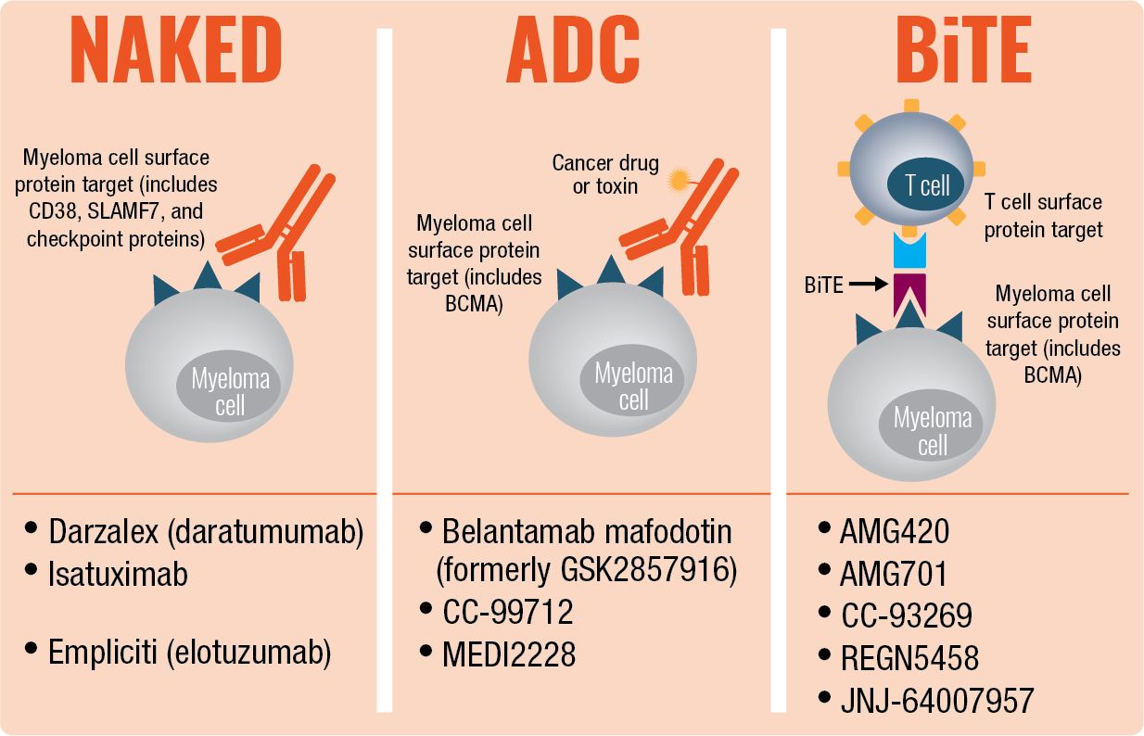
Types of Antibodies

Slide 27
Bringing Together T Cells and Myeloma Cells With BiTEs
AMG 420^{[1]*}
AMG 701^{[2]*}
Others
  Binds to the CD3 molecule on T cells and the BCMA molecule on myeloma cells
  Initial analysis¹
  42 relapsed myeloma patients
  70% of patients responded
  at 400 μg/d dose (the recommended dose for further investigation)
  Therapy was associated with infections
  Updated analysis²
  Five of the seven responding patients achieved MRD negativity
  Similar to AMG 420 but has an extended half-life (longer time in the bloodstream)
  Preclinical analysis
  Kills MM cells (and is enhanced by Revlimid)
  Promotes the activation of T cells
  BCMA targets
  BI 836909
  PF-06863135
  CC-93269
  teclistamab
  Other targets
  Blinatumomab (CD19)
  GBR1342-101 (CD38)
  talquetamab (GPRC5D)
  cevostamab (FcRH5)
*All are investigational agents; not yet approved by the FDA
1. Topp MS et al. J Clin Oncol. 2019;37: Abstract 8007. 2. Einsele H et al. Presented at the 17th International Myeloma Workshop; September 12–15, 2019. Abstract OAB-025; 3. Cho S-F et al. Presented at the 17th International Myeloma Workshop; September 12–15, 2019. Abstract OAB-081.

Slide 28
Immunotherapy strategies for myeloma – CAR T cells
Immune System
Cell (T cell)
Status Quo
🤓
Immune
System
Cells
😳
Genetic
Engineering
T-cell
activator
♿️
😴
Chimeric Antigen
Receptor
(CAR)
😍
Antibody on surface of T cell
Immune
Evasion
Mechanisms
🔫
💣
☂
Further stimulation and growth in laboratory
Myeloma cell
🤓
🤓
Infuse
to patient
🤓
🤓
Cell-surface
target
😡
😡
😡
😡
💪👊😍⚔♿️

Slide 29
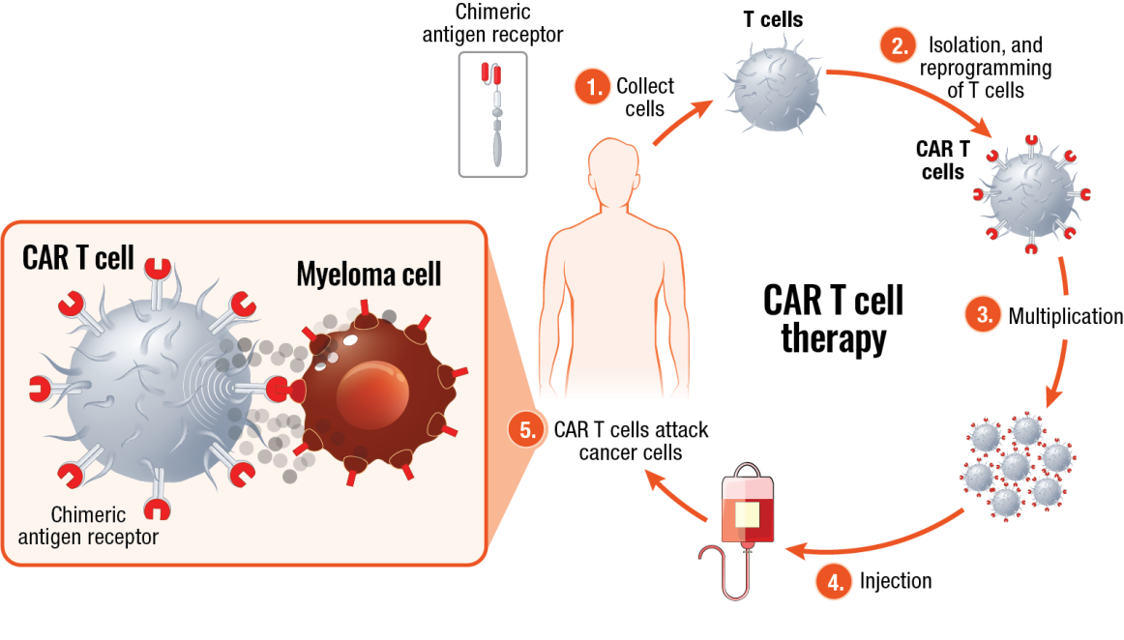
CAR T-Cell Therapy

Slide 30
Main Adverse Events of CAR T-Cell Therapy
Cytokine release syndrome (CRS)
Inflammatory syndrome
fevers, chills, fatigue
low blood pressure
low oxygen levels
Treated with
Hospital observation
acetaminophen (Tylenol)
tocilizumab (Actemris)
Neurotoxicity
Confusion, word finding difficulties
Treated with steroids
bb2121 Treatment-Emergent Adverse Events (N=33)
 | Overall (%) | Grade ≥3 (%)
Cytokine release syndrome | 76 | 6
Neurotoxicity | 42 | 3
Low neutrophils | 85 | 85
Low WBC | 61 | 57
Anemia | 58 | 45
Low platelets | 58 | 45
No grade 4 CRS events
No fatal CRS or neurotoxicity events
Raje N et al. N Engl J Med. 2019;380:1726.

Slide 31
CAR T-Cell Therapy
Future Directions
Race to FDA Approval
Improving
Efficacy
Improving
Safety
Improving
Access
  ide-cel
  (idecabtagene vicleucel, bb2121) Bluebird/Celgene/BMS
  cilta-cel
  (ciltacabtagene autoleucel) Legend/Janssen
  Others not far behind
  Understand why CAR T cells fail or stop working
  Next-generation or “armored” CAR T cells
  Identify correlates to predict and reduce rates of cytokine release syndrome and neurotoxicity
  Safety switches to induce suicide or eliminate CAR T cells
  Allogeneic off-the-shelf CAR T cells
  CAR T-cell therapy for other stages of disease, new disease targets

Slide 32
Summary: Immunotherapy
Immunotherapies, including BiTEs and ADCs, are showing promise, but we need to better understand how to incorporate them to the patient’s course.
CAR T-cell therapy is still producing impressive responses, but the true efficacy will be determined by duration of response.
Clinical trials are the optimal way to answer any questions!
Next-generation clinical trials should focus on rational combinations of immunotherapies and chemotherapy agents.

Slide 33
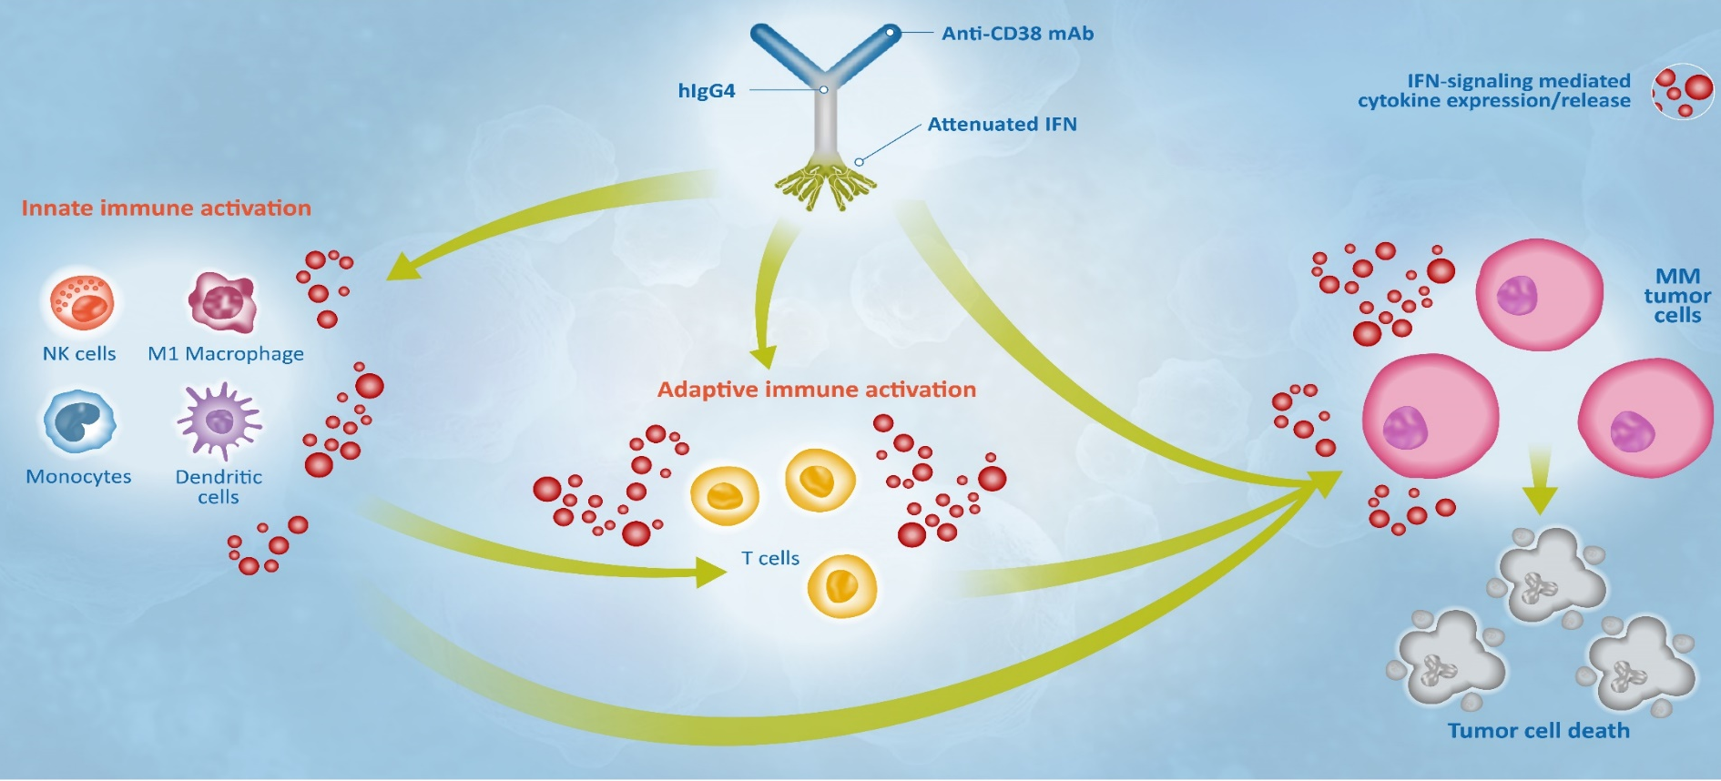
TAK-573
Anti-CD38 antibody genetically fused to two attenuated interferon molecules
Direct effect on myeloma cells
Broad immune stimulation through IFN signaling to CD38+ immune cells
Responses in very refractory myeloma
Now dosing monthly, IV over 1-2 hours
Side effects: low blood counts, infusion reactions

Slide 34
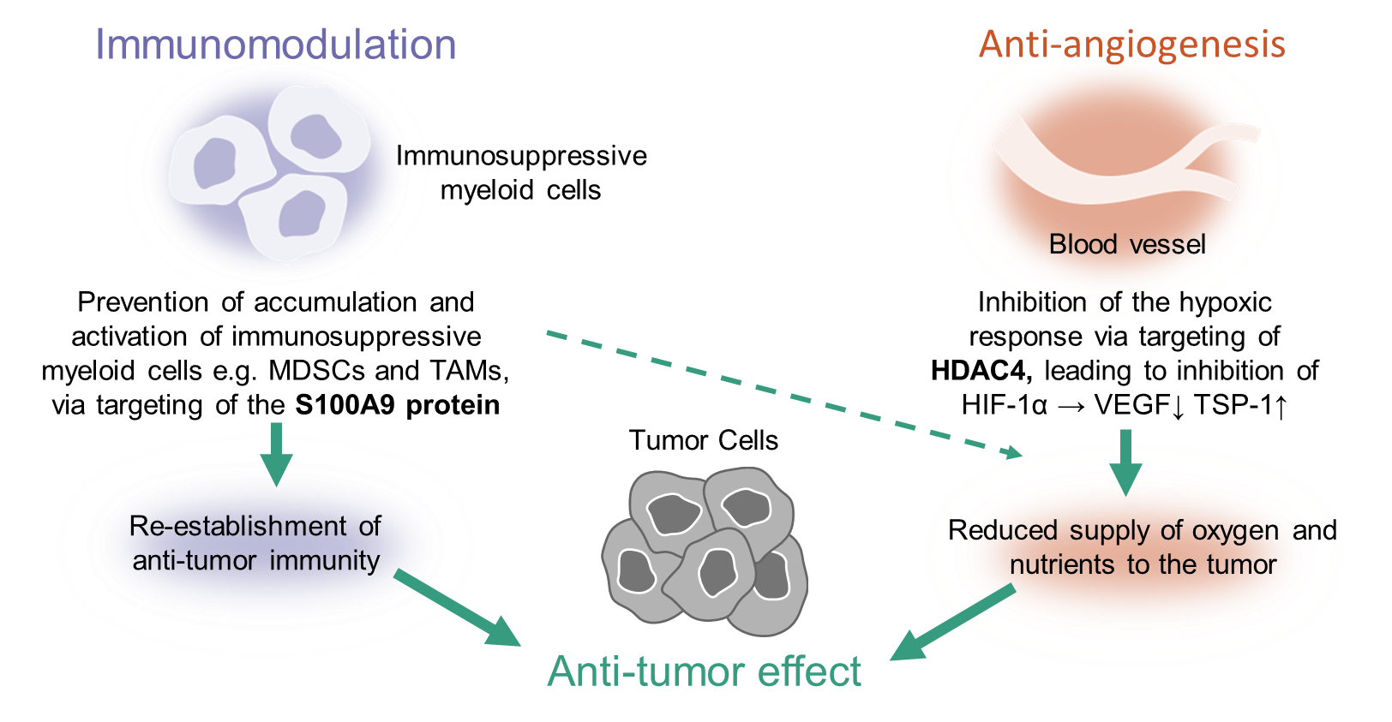
Tasquinimod
Small molecular inhibitor of S100A9
Blocks pro-survival signals from other cells in the bone marrow
Oral once-daily dosing
Safety data from more than
650 person-years of exposure
Efficacy in patients with prostate cancer
Efficacy in mouse models of myeloma
Phase 1 trial in myeloma patients
  Single agent
  In combination with IRD (ixazomib, lenalidomide, dexamethasone)

Slide 35
Trials at Penn
Myeloma, relapsed/refractory
  Phase 3 carfilzomib and dexamethasone +/- venetoclax
  Phase 1 TAK-573 (anti-CD38 / attenuated interferon fusion)
  Phase 1 tasquinimod
  Phase 1/2 iberdomide (novel Imid)
  Phase 1 cevostamab (anti-FcRH5 bispecific T cell engager)
  Phase 2 teclistamab (anti-BCMA bispecific T cell engager)
  Phase 1 teclistamab or talquetamab (anti-GPRC5D bispecific) with dara
  Phase 1 tiragolumab (anti-TIGIT antibody)
  Phase 2 cilta-cel (BCMA CAR T cells)
  Phase 1 P-BCMA-101 (BCMA CAR memory T cells)
  Phase 1 CRISPR-edited allogeneic CAR T cells

Slide 36
Penn’s Myeloma Program
Physicians
Edward Stadtmauer
Dan Vogl
Adam Cohen
Alfred Garfall
Adam Waxman
Sandra Susanibar
Advanced Practice Practitioners
Patricia Mangan, CRNP
Mary Sanchez, CRNP
Jessica Heaven, PA
Nurses
Bree Vaotogo
Theresa Sabato
Kelly Kraus
Keri McDevitt

