Slide 1
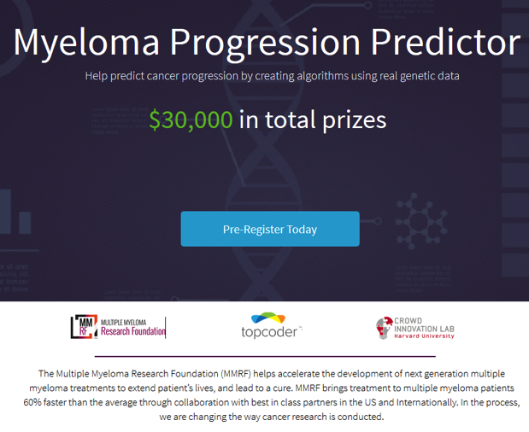
Crowdsourcing Initiatives
http://crowdsourcing.topcoder.com/myeloma_predictor

Slide 2
IMW 2017 New Delhi
MM “Achilles Heels”
  Cell survival
  Immune checkpoints
  Precision meds: venetoclax t(11:14)+overexpr BCL-2
MRD
Clinical trials:
  Selinexor in RRMM
  Denosumab vs Zometa PFS, tox
  ENDEAVOR trial: Kd>Vd OS

Slide 3
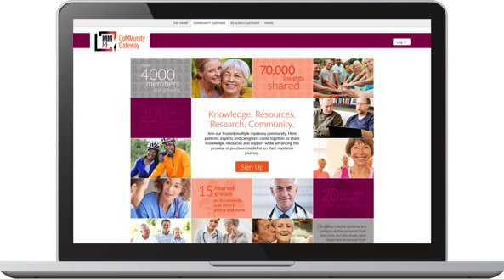

Supporting Patients
MMRF
nurse specialist
MMRF
CoMMunity Gateway
Have questions about the trials or information you heard today?
Call our MMRF nurse specialists.
Accelerator Magazine
An MMRF nurse specialist can guide you through your multiple myeloma journey every step of the way. Call Monday–Friday, 9–7 ET
Call now
1-866-603-MMCT(6628)
Knowledge. Resources. Research. Community.
Join our trusted multiple myeloma community! Continue the conversation with other
patients, caregivers, and experts!
Join today www.MMRFCommunityGateway.org

Slide 4

Finding Clinical Trials
The MMRF Myeloma Trial Finder makes it easier to find clinical trials most appropriate for YOU.
Visit www.myelomatrials.org

Slide 5
The MMRF Vision for 2017
Capturing Data on a Wide Range of Myeloma Patients
  Combine CoMMpass data with other large datasets to provide the most complete picture of the disease
Design Smarter and Faster Clinical Trials
  Design trials around each patient’s unique immune and genomic profile using new endpoints
Engage and Empower Every Patient
  Provide knowledge and resources to enable each patient to know about clinical trials, and receive the right treatment at the right time for their disease

Slide 6
How can you become involved in the MMRF mission?
Attend MMRF events
  Patient Summits
  Webinars
  5K Races
Visit our website and read our newsletters
Join the CoMMunity Gateway and connect with other patients
Donate your data – sequencing, tissue samples, clinical information
Enroll in a clinical trial

Slide 7

MMRF 2017
Multiple Myeloma Summits
Saturday, March 25, 2017
Denver, Colorado
Robert M. Rifkin, MD–Chair
University of Colorado Denver
Rocky Mountain Cancer Centers
Saturday, April 8, 2017
Atlanta, Georgia
Sagar Lonial, MD–Chair
Emory University
Saturday, April 29, 2017
Boston, Massachusetts
Paul G. Richardson, MD–Chair
Harvard Medical School
Dana-Farber Cancer Institute
Saturday, May 6, 2017
Dallas, Texas
Larry Anderson, MD, PhD–Chair
University of Texas Southwestern Medical Center
Saturday, September 16, 2017
Chicago, Illinois
Andrzej Jakubowiak, MD–Co-Chair
University of Chicago Medical Center
Todd Zimmerman, MD–Co-Chair
University of Chicago Medical Center
Saturday, October 14, 2017
Charlotte, North Carolina
Saad Z. Usmani, MD−Chair
Levine Cancer Institute
Friday, November 3, 2017
New York City, New York
Sundar Jagannath, MD–Chair
The Mount Sinai Medical Center
Tisch Cancer Institute
Mount Sinai School of Medicine
Saturday, November 18, 2017
Los Angeles, California
James Berenson, MD–Co-Chair
Institute for Myeloma and Bone
Cancer Research
Amrita Y. Krishnan, MD–Co-Chair
Judy and Bernard Briskin Center for
Multiple Myeloma Research
City of Hope Medical Center
https://www.themmrf.org/living-with-multiple-myeloma/education-programs/patient-education/

Slide 8
A Caregiver’s Guide to Helping Myeloma Patients
Webinar 2, March 16, 2017
Managing the Ups and Downs of Caring for Multiple Myeloma Patients: Including Stem Cell Transplantation and Other Facets of the Treatment Journey

Slide 9
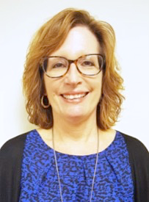
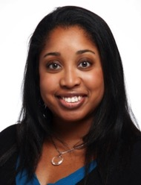
Speakers
Moderator:
Mary DeRome
Multiple Myeloma Research Foundation
Norwalk, Connecticut
Faculty:
Amy Pierre, RN, MSN, ANP-BC
Hackensack University Medical Center
Hackensack, New Jersey

Slide 10
A Caregiver’s Guide to Helping Myeloma Patients
Webinar 2, 1PM March 16, 2017
Managing the Ups and Downs of Caring for Multiple Myeloma Patients: Including Stem Cell Transplantation and Other Facets of the Treatment Journey

Slide 11
Thank you!
www.theMMRF.org

