Slide 1
Support Group
A presentation by the Patient Navigation Center Nurses at
the Multiple Myeloma Research Foundation (The MMRF)
1-888-841-MMRF(6673)
patientnavigator@themmrf.org

Slide 2
MMRF Overview
In pursuit of our mission, the MMRF focuses our work around three pillars; diversity, inclusion, and equity considerations are at the center of everything we do. The MMRF invest $30M+ in research and programming annually.
Our Vision
Strategic Objectives
A world free of multiple myeloma.
Accelerate the development of novel therapies
Our Mission
Promote diversity, inclusion, and equity (DEI) and health equity
To accelerate a cure for each and every multiple myeloma patient.
Drive optimal and more personalized treatment approaches
Empower patients and the myeloma community

Slide 3
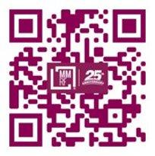
Unprecedented results
NOTE :: PLEASE DELETE
The MMRF is the largest nonprofit in the world solely focused on accelerating a cure for each and every multiple myeloma patient
15+
100 +
We’ve helped bring
15 different multiple
myeloma drugs into
the market.
We’ve opened over
80 clinical trials.
10+
90%
Visit The MMRF
Our work and collaboration has helped patient survival rates increase from 3 years to 10.
90% of our expenses
go to research and related programming.

Slide 4

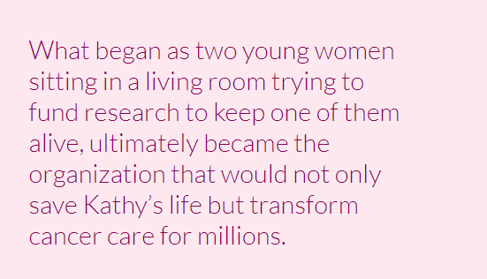
About our Founder of the MMRF: Kathy Guisti
We are a patient founded organization started in 1998 by a determined myeloma pioneer and her twin sister, for the myeloma community.
https://www.kathygiusti.com/

Slide 5
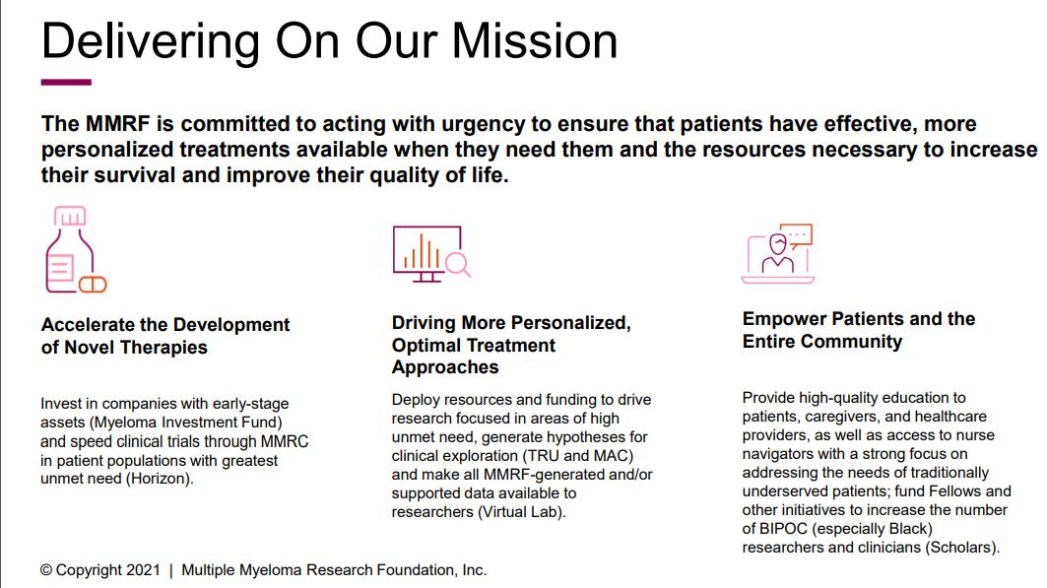

Slide 6





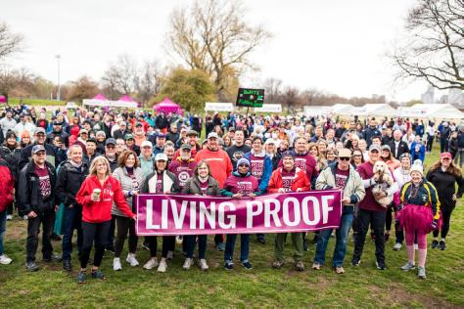

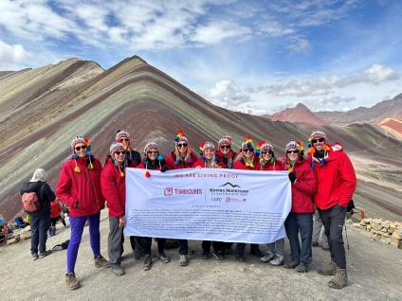

Join the MMRF Community!
Walk/Run Program
Hike Program
More MMRF Events
Atlanta | 10.25.25
Boston | 9.13.25
Charlotte | 5.31.25
Chicago | 9.7.25
Dallas | 5.3.25
Detroit | 5.17.25
Houston | TBD
Los Angeles | 11.15.25
National Virtual | 9.20.25
New York City | 10.4.25
Philadelphia | 10.18.25
San Francisco | 4.5.25
Scottsdale | 11.22.25
Tampa | 5.17.25
Twin Cities | 9.20.25
Washington D.C. | 9.27.25
Bhutan Trek
March 30th – April 9th
Dolomites Trek
September 5th – September 15th
New Hampshire White Mountains Trek
October 5th – October 9th
Half & Full Marathons
Bike/Road to Victories
Create Your Own
Fundraiser

Slide 7
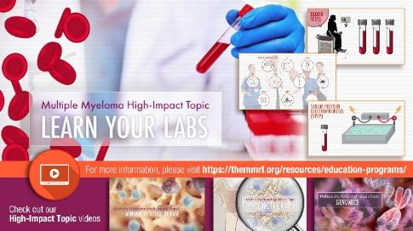
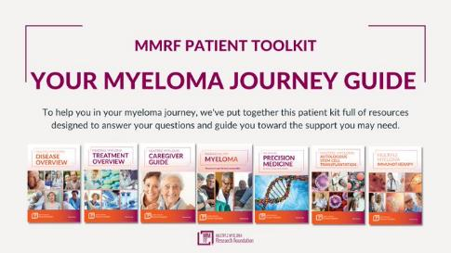
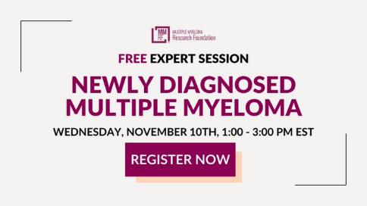

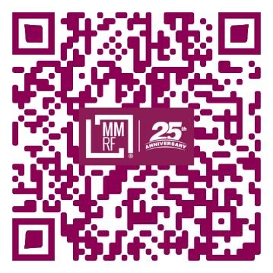
Patient Educational Resources
Patient Webinars, Livestreams
Nurse Fireside Chats
Expert Sessions
Summits
Live Facebook Events & Podcasts
For more information, please visit:
TheMMRF.org/resources/education-program

Slide 8
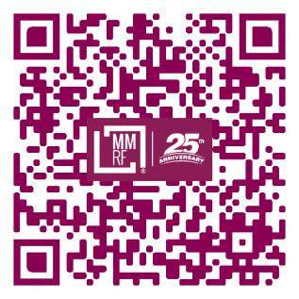



Myeloma Mentors
MMRF Myeloma Mentors are trained to inform, empower and support patients and caregivers one-on-one. Mentors are diverse in terms of age, race and ethnicity and disease and treatment experiences; patients select a Mentor based on their unique needs.
Carmen P. | 52, Little Silver, NJ
Initially Diagnosed: 2002
Current Diagnosis: Relapsed, Refractory
Treatment Received: Tandem SCT, Allogenic SCT, Clinical Trial, CAR-T
Evelyn H. | 62, from the Houston, TX Area
Initially Diagnosed: 2014
Current Diagnosis: Stringent Complete Response/Remission
Treatments Received: Radiation, 2 SCTs
Annamarie K. | 50, Norwalk, CT
Initially Diagnosed: Husband JP in 2014
Current Diagnosis: Relapsed, Refractory

Slide 9


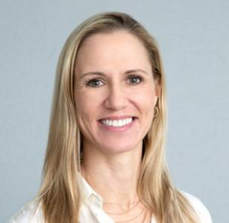
Oncology Nurse Staffed Patient Navigation Center
Grace Allison
RN, BSN, OCN, RN-BC
Erin Mensching
RN, BSN, BA, OCN
Brittany Hartman, RN, BSN
Grace has over 30 years of experience as a myeloma nurse and is very dedicated to navigating patients. She was nominated for the CURE Extraordinary Healer award in 2022.
Erin began with the PNC five years ago after working on an acute medical oncology floor. She is passionate about understanding patients' needs and how to best navigate them with the resources and tools that are available.
Brittany has great experience with myeloma patient's concerns after working in a busy top myeloma center. She is wonderful resource for empowering patients

Slide 10
Benefits of Nurse Navigator Role
The Oncology Nursing Society ([ONS] (2017) defines an oncology nurse navigator (ONN) as “a professional RN with oncology-specific clinical knowledge who offers individualized assistance to patients, families, and caregivers to help overcome healthcare system barriers. Using the nursing process, an ONN provides education and resources to facilitate informed decision making and timely access to quality health and psychosocial care throughout all phases of the cancer continuum” (p. 4).
Benefits of Oncology Nurse Navigator to Patients:
•Shorter time to diagnosis and start of treatment
•Increased patient and caregiver knowledge
•Better adherence to recommended care
•Improved quality of life
The goal of navigation is to reduce cancer morbidity and mortality by eliminating barriers to cancer care.
Resource: https://www.ons.org/make-difference/advocacy-and-policy/position-statements/ONN

Slide 11
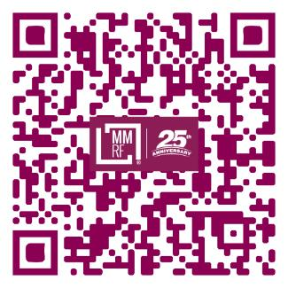
How does the Navigation Center help myeloma patients and families?
Offer emotional support
Connect with support groups
Navigate financial options
Recommend trustworthy resources
Provide myeloma education
Find a clinical trial
Pair with mentors
Locate a specialist
Contact Patient Navigation Center
Monday to Friday | 9 am to 7 pm ET
1-888-841-MMRF(6673)
patientnavigator@themmrf.org
Scan to connect with the team or visit
TheMMRF.org/resources/patient-navigator-center/

Slide 12

Right Track Best Outcome
You and your care team will have many decisions to make along your treatment journey. You can connect with a patient navigator via phone or email. Whatever questions you may have, our patient navigators are here to help.
Right Team | Right Tests | Right Treatment
Access experts and centers that have extensive experience treating multiple myeloma | Get information, tests and precise diagnoses to make the right treatment decisions | Work with your team to decide the best treatment plan and identify clinical trials that are right for you

Slide 13
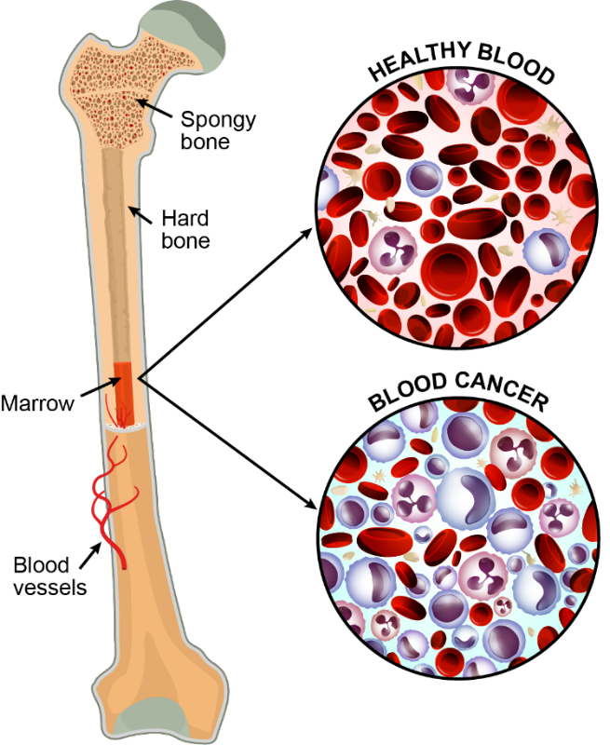
What is multiple myeloma?
Multiple myeloma is a blood cancer that starts in the bone marrow, the place where all blood cells are produced
Multiple myeloma is caused when a type of white blood cell called a plasma cell becomes cancerous and grows out of control

Slide 14
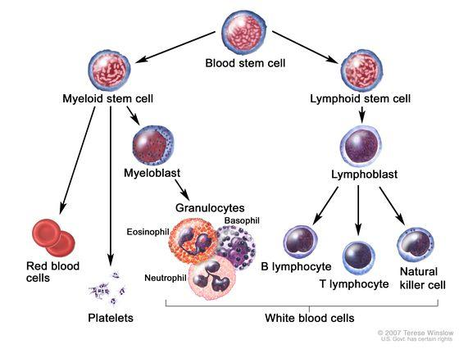
How does our bone marrow make our blood cells

Slide 15
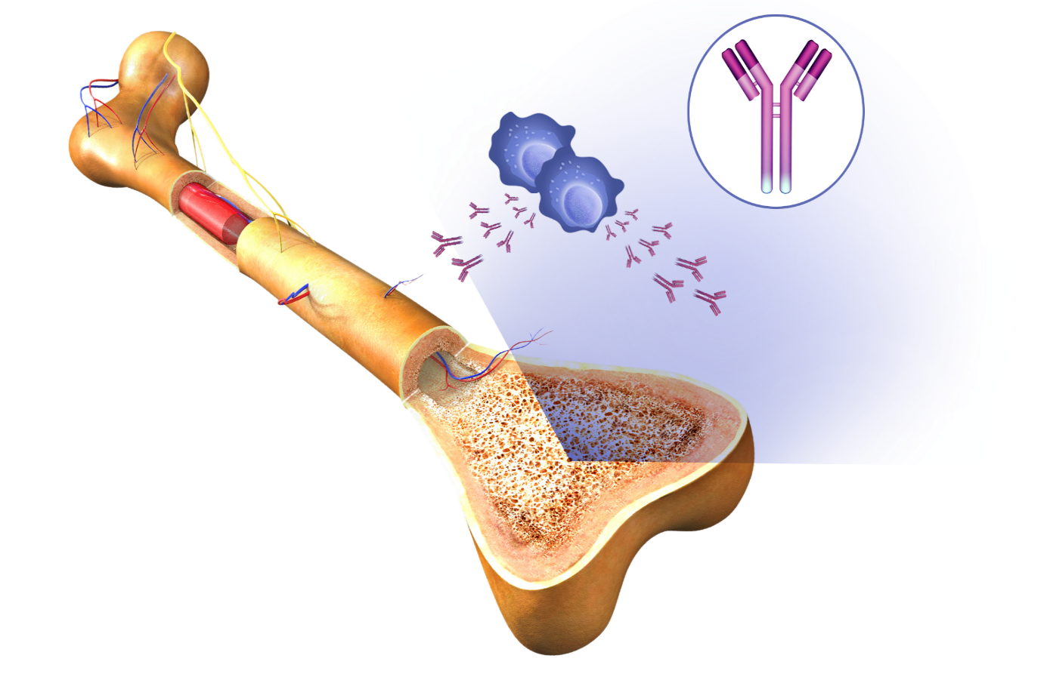
Normal Bone Marrow
Light
chain
Light chain
(kappa [κ] or lambda [λ])
Normal
plasma cells
Heavy chains
(IgG, IgA, IgM, IgD, IgE)
Antibodies
Bone
marrow
Bone

Slide 16
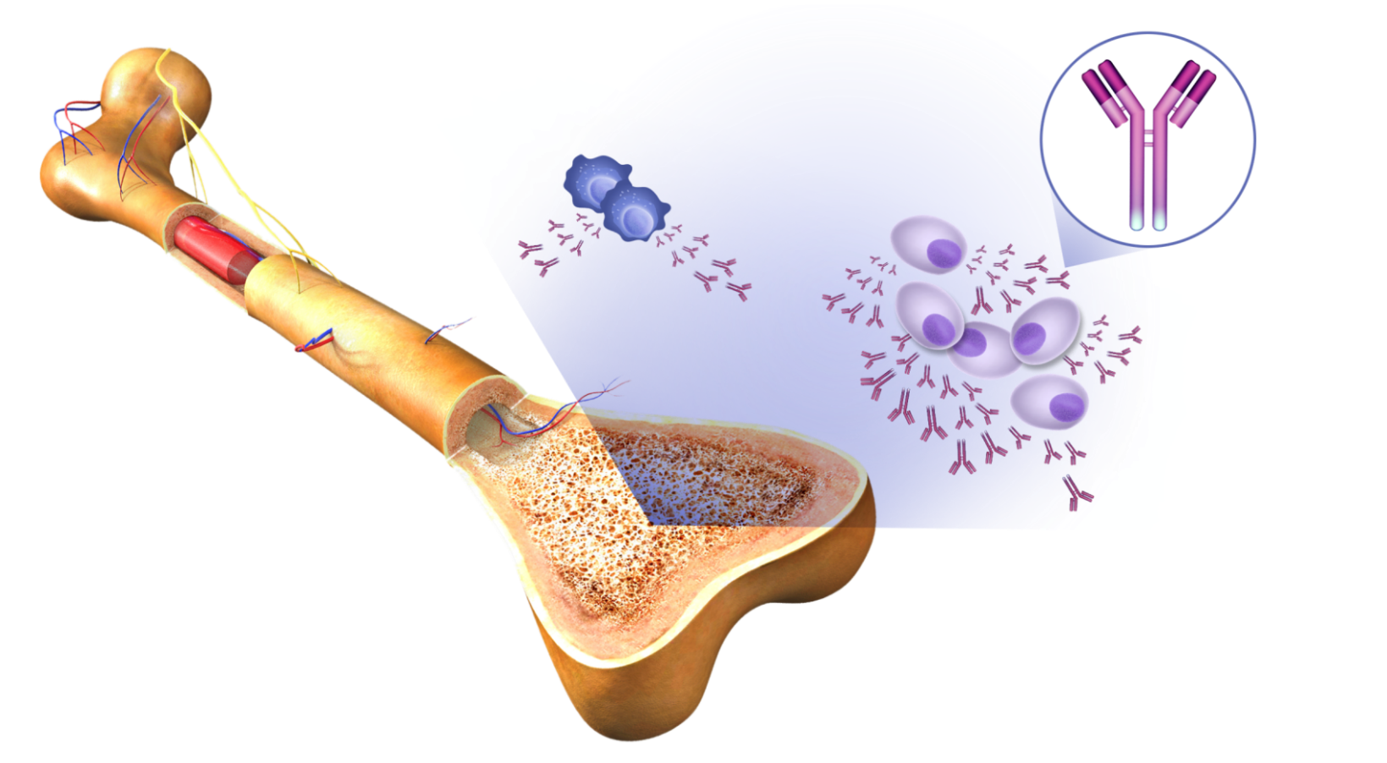
Multiple Myeloma Affects Your Bones, Blood, and Kidneys
BLOOD
Myeloma is a cancer of the blood
Myeloma crowds out normal blood cells
Light
chain
Light chain
(kappa [κ] or lambda [λ])
Heavy chains
(IgG, IgA, IgM, IgD, IgE)
M proteins
Multiple myeloma cells
BONES
Surrounding bone where myeloma cells grow is affected
Myeloma cells activate bone destruction
KIDNEYS
Large amounts of M protein can overwork or cause damage to the kidneys

Slide 17
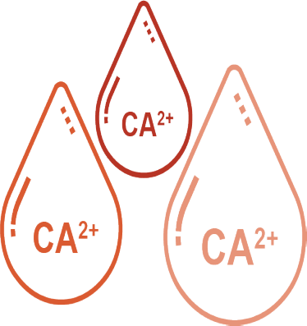



Multiple Myeloma Affects Your
Bones, Blood, and Kidneys
The clinical features that are characteristic of multiple myeloma
C
R
A
B
High levels of calcium in the blood
Decreased kidney (renal) function
Low amount of red blood cells (anemia)
Presence of bone damage

Slide 18
Multiple Myeloma Prognosis and Risk
Mayo Stratification of Myeloma and Risk-Adapted Therapy (mSMART) Consensus Guidelines
Revised International Staging System (R-ISS)
R-ISS stage | Laboratory measurements
I | Serum β2M level <3.5 mg/L Serum albumin level ≥3.5 g/dL No high-risk CA* Normal LDH level
II | All other possible combinations
III | Serum β2M level ≥5.5 mg/L High-risk CA* or high LDH level
High risk
High-risk genetic abnormalities
  t(4;14)
  t(14;16)
  t(14;20)
  del 17p
  p53 mutation
  gain 1q
R-ISS Stage 3
High plasma cell S phase
GEP: high-risk signature
Standard risk
All others including:
  Trisomies
  t(11;14)
  t(6;14)
Double-hit myeloma: any two high-risk genetic abnormalities
Triple-hit myeloma: three or more high-risk genetic abnormalities
*High-risk chromosomal abnormality (CA) by FISH: del(17p) and/or t(4;14) and/or t(14;16)
Currently cannot identify with great certainty all high-risk patients.

Slide 19
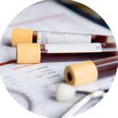
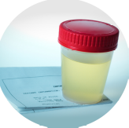
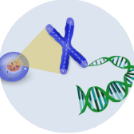
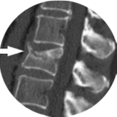
Diagnosis: Common Tests Conducted in Myeloma Patients
Confirms the type of myeloma or precursor condition
Blood tests
Urine tests
Determines how advanced the myeloma or precursor condition is
Bone marrow
biopsy
Detects the presence and extent of bone disease and the presence of myeloma outside of the bone marrow
Imaging tests

Slide 20

Learn Your Labs!
Blood Tests
CBC
Number of red blood cells, white blood cells, and platelets
Measure levels of albumin, calcium, lactate dehydrogenase (LDH), blood urea nitrogen (BUN), and creatinine. Assess function of kidney, liver, and bone status and the extent of disease
CMP
B2M
Determine the level of a protein that indicates the presence/extent of MM and kidney function
SPEP
Detect the presence and level of M protein
IFE
Identify the type of abnormal antibody proteins
SFLC
Freelite test measures light chains (kappa or lambda)

Slide 21
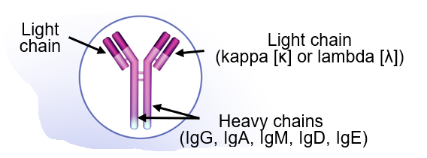

Learn Your Labs!
Urine Tests
UPEP
Detect Bence Jones proteins (otherwise known as myeloma light chains)
24-hr urine analysis
Determine the presence and levels of M protein and Bence Jones protein

Slide 22
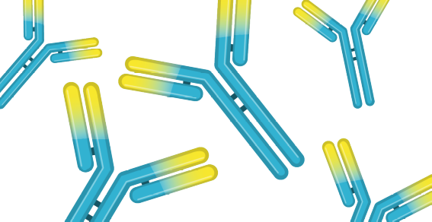

Types of Multiple Myeloma
Based on Blood or Urine Tests
Intact M protein
Light chain only
Non-secretory
Named for the type of immunoglobulin and light chain pair; for example, IgG kappa (κ) or IgG lambda (λ)
Also known as Bence Jones protein
Renal failure more common in light chain multiple myeloma
No M protein present
80%
20%
3%

Slide 23
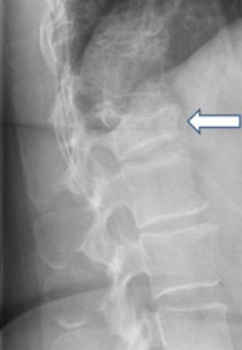
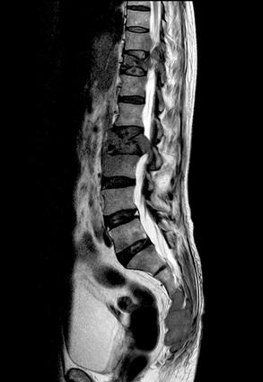
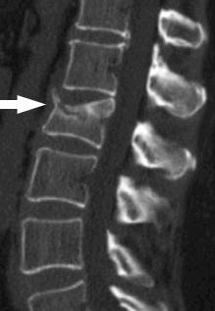
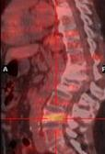
Know Your Imaging Tests!
Assess changes in the bone structure and determine
the number and size of tumors in the bone
X-ray
MRI
CT scan
PET scan

Slide 24
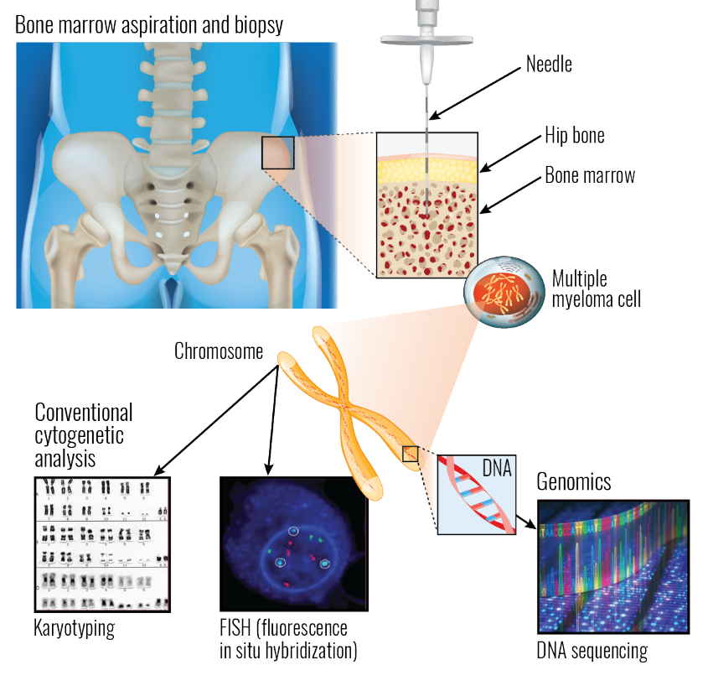
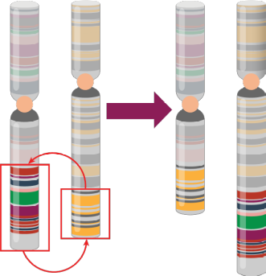
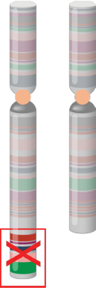
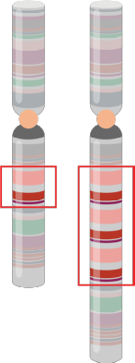
Know Your Bone Marrow Tests!
Types of chromosomal abnormalities
Translocation
Deletion
Gain or Amplification

Slide 25
The Multiple Myeloma Disease Spectrum
Almost all patients diagnosed with multiple myeloma have had a preceding phase of disease that is characterized by changes in the bone marrow.
Monoclonal gammopathy of
undetermined significance (MGUS)
Smoldering multiple myeloma (SMM)
Multiple myeloma
High-risk SMM

Slide 26
Blood, Urine, Bone Marrow, and Imaging Tests Used to Identify MGUS, SMM, or Active Multiple Myeloma
 | MGUS | SMM | Active MM
M protein | <3 g/dL in blood | ≥3 g/dL in blood or ≥500 mg/24 hrs in urine | ≥3 g/dL in blood or ≥500 mg/24 hrs in urine
Plasma cells in bone marrow | <10% | ≥10%−60% | ≥60%
Clinical features | No myeloma-defining events* | No myeloma-defining events* | ≥1 myeloma-defining event*, including either: ≥1 CRAB feature or ≥1 SLiM feature
*CRAB, calcium elevation, renal insufficiency, anemia, bone disease; SLiM, >60% plasma cells in bone marrow, free light chain involved to uninvolved ratio >100, >1 focal lesion on MRI

Slide 27





Getting the Right Treatment:
Goals of Multiple Myeloma Therapy
Reduce the amount of M protein (as measured by serum protein electrophoresis) or light chains (as measured via the free light chain test) to the lowest level possible.
Eliminate myeloma cells from the bone marrow (as measured via minimal residual disease [MRD] testing).
Improve quality of life with as few treatment side effects as possible.
Provide the longest possible period of response before first relapse.
Prolong overall survival.

Slide 28
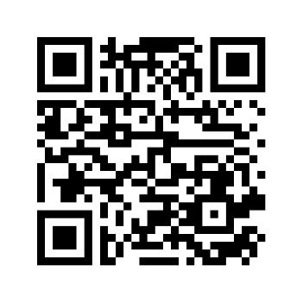
Questions?
Learn more about The MMRF
Scan the QR code and sign up through our webform to receive materials relevant to you and your loved ones about Multiple Myeloma through the Multiple Myeloma Research Foundation.

