Slide 1


Insurance & Financial Essentials for
Individuals with Multiple Myeloma
Christina Bach, MSW, MBE, LCSW, OSW-C, FAOSW
Psychosocial Content Editor, OncoLink.org
Financial Navigation Specialist, Cancer Support Community Helpline

Slide 2
Disclaimer
The information presented in this presentation is intended for educational purposes only and does not constitute professional advice.
It is not tailored to any specific individual or situation.
Participants are encouraged to consult with qualified professionals for guidance and resources related to their individual needs and circumstances.
Resources are provided at the end of this presentation.

Slide 3
Types of Health Insurance
Private (Individual) Plans
Employer/Union Provided Plans
Government Provided Plans
VA, Tricare, Medicare, Medicaid
ACA (Healthcare Marketplace) Plans

Slide 4
Learning to Speak the Language Of Health Insurance: What Every Consumer Must Know About Their Plan(s)

Slide 5
Key Terms
Premium-the monthly amount you pay for your insurance plan(s).
Deductible-the amount of money you pay before your insurance starts to cover healthcare costs.
Cost Sharing -The contribution you pay towards your health care costs out of your own pocket; typically includes deductibles, coinsurance, and copayments, or similar charges. Does not include premiums, balance billing amounts for non-network providers, or the cost of non-covered services.

Slide 6

Key Terms
Co-pay- a fixed dollar amount you pay when you go for an appointment/procedure in addition to what the insurance company pays for the service. For example $20 for an office visit with primary care provider.
Co-insurance- the cost sharing amount you pay as part of your coverage. For example if your plan covers at 80/20% your coinsurance is 20%.
MOOP- the maximum out of pocket you pay during a benefit period; also called a stop-loss.

Slide 7

Key Terms
Denial- a refusal by an insurance company to honor a request by an individual (or his or her provider) to pay for health care services obtained/ordered/requested by a healthcare professional.
Appeal- A request to the health insurer or plan to review a decision or a grievance again; can have multiple levels and be consumer and/or provider driven.
Formulary- A list of prescription drugs covered by a prescription drug plan; can include tiers and step therapies.
Network- The facilities, providers and suppliers your health insurer has contracted with to provide health care services.

Slide 8

What is Open Enrollment?
The period each year when you can make changes to your health insurance benefits.
Key Dates for 2025 Enrollment:
  Employer sponsored plans/private plans: plan dependent
  Medicare: October 15th- December 7th
  ACA: November 1st- state dependent

Slide 9
What to Consider During Open Enrollment
What gaps do I have in my current coverage?
Will making a change help to fill those gaps?
Will it create new gaps?
What is covered?
What isn’t covered?
How much does it cost?
What health care providers can I see?
Where can I use my plan?
How can I maximize my coverage and minimize by out of pocket?
Am I risk averse or risk tolerant?

Slide 10

Medicare

Slide 11
Breaking Down the Parts of Medicare
Part A
Part B
Part C
Part D
Supplemental/Gap Plans

Slide 12
Medicare
Part A
Inpatient Hospital Care
Skilled Nursing Facility (SNF) care
Hospice Care
Home Health Care

Slide 13
Medicare
Part B
Most outpatient services
Preventive services
Some chemotherapy medications
Mental health services
Ambulance services
Medical equipment (DME)

Slide 14
Medicare Part C
Medicare (dis)Advantage Plans
A type of Medicare health plan offered by a private company that contracts with Medicare.
You still pay you monthly part B premium; you may have an additional plan premium.
Usually requires you to choose a primary care provider (gatekeeper) and get referrals for specialist care.
You may have capitated providers for labs and radiology.
Co-pays for specialist care can be higher.
Coverage for all outpatient services is 80/20 until you reach annual maximum out of pocket. You cannot purchase a supplemental plan to cover this gap.
Medicare Advantage Plans provide all your Part A and Part B benefits.

Slide 15


Medicare Part D-
Prescription Drug Coverage
Deductible
Initial Coverage Period
Donut Hole
Catastrophic Coverage

Slide 16
Part D: It’s a Whole New World in 2025
Part of Inflation Reduction Act (IRA).
All Medicare Rx covered drug costs will be capped at $2000.
Introduction of “M3P”-which allows Part D recipients to “opt-in” to payments over time for that $2000, instead of it all being due in January.

Slide 17
$2000 Cap
Deductible + Copays cannot be more than $2000.
You will be covered at 100% after you spend $2000.
For example, if your drug costs exceed $2000 in February, you are covered at 100% for the rest of the year…even if you start a new drug.
No more monthly catastrophic phase payments.
Does NOT include monthly premium.
Does not apply to Part B covered drugs.
Like other Medicare expenses, this cap may go up in the coming years.
$2000 is the cap for 2025 only. It may be adjusted in future years.

Slide 18
M3P May Help You If…
You are on expensive medication(s).
You may have to pay a lot for your medication in a short period of time.

Slide 19
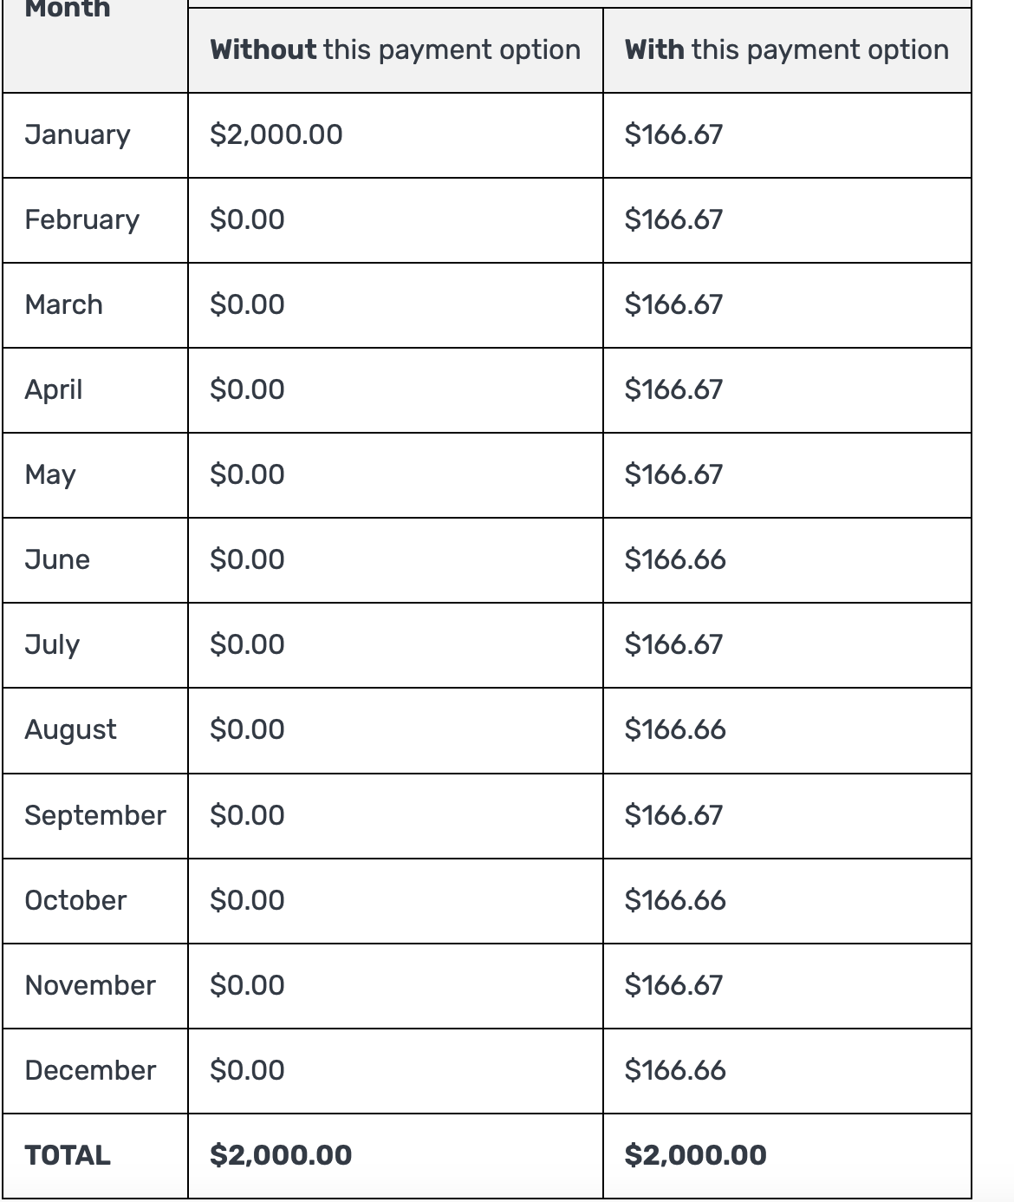
Opting in to M3P
Smooths payments over 12 months—vs. $2000 payment in January

Slide 20
A Special Word About Revlimid
Most pharmacy benefits managers (PBMs) are EXCLUDING brand name Revlimid from formularies for 2025 for many STAND-ALONE Medicare Part D prescription drug plans.
  “PBMs occupy a central role in the drug price supply chain as negotiators, administrators, and decision-makers about which drugs will be most accessible to consumers.”
Generic lenalidomide IS included in most formularies.
Yes, there is a potential shortage of lenalidomide.
  Resulting from litigation and quantity limits on distribution of generic lenalidomide.
  Expires 1/31/2026

Slide 21
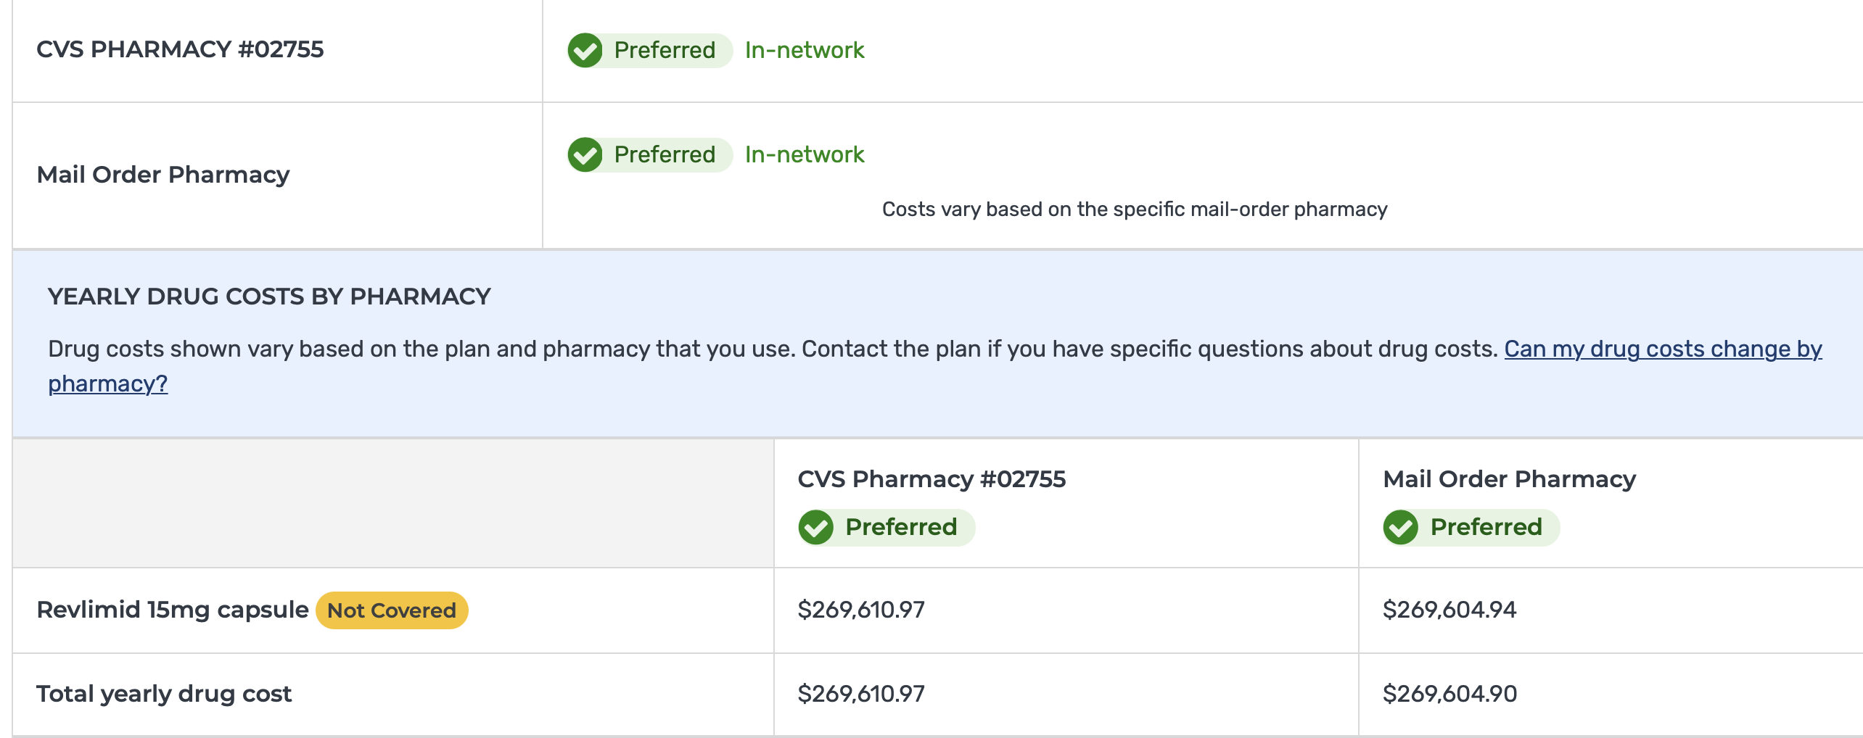
Case Example-Revlimid (brand) 15 mg-21 p/ month

Slide 22
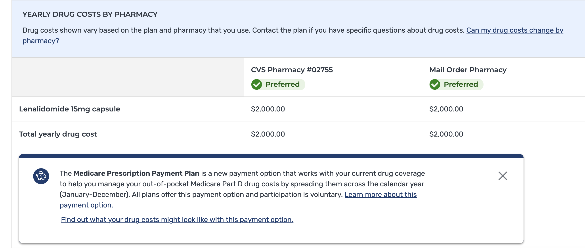
Case Example-lenalidomide 15 mg-21 p/ month

Slide 23
What should I do?
Talk to your provider NOW.
Fill Rx for Revlimid for end of year (stock up if possible).
If you are told by your specialty pharmacy that the GENERIC is NOT available, ask them to dispense the brand via override.
If this is DENIED by the plan; APPEAL.
BE SURE you provider is aware if you cannot get your medication
ADVOCATE. Call your reps, congressman ANY ONE and let them know of this problem.

Slide 24

What should you do during open enrollment?
Review all your medications with your provider AND on Medicare.gov
  Make sure they are covered under your plan.
  Do you need a different plan?
  Do you need to change medications? (ex. Formulation of insulin).
Do you get assistance from copay foundations (LLS, PANF, Healthwell)?
  Do you have funds available beginning in January 2025?
Opting-in to M3P may not be your best move.

Slide 25
Where Can I Get Help With My Medication Costs?

Slide 26
Low-Income Subsidy/Extra Help
Your situation | Income Limit (month/yea)r | Resources*
Individual | $1903/$22,590 | $17,220
Married Couple | $2575/$30,660 | $34,360
Can help pay for premiums, deductibles and co-insurance for Part D.
Drug costs: up to $4.50 generic/$11.20 brand
Resources= cash, money in bank/retirement accounts, real estate other than the home you live in, stocks, bonds, savings bond, mutual funds.
Medicare.gov
Notes:
Aimee

Slide 27
How do I apply for LIS?
Can apply anytime before or after you enroll in Part D.
Apply
Online at ssa.gov
Call Social Security 800-772-1213
You will be notified by mail of approval/denial in 3-4 weeks.
Notes:
Aimee

Slide 28
Co-Pay Assistance
Co-pay assistance is financial assistance for co-pays for patients WITH insurance - but who are considered underinsured.
Underinsured means that you have out of pocket costs that are not covered by the medical insurance plan which impact financial well-being and access to care.
Managed/administered by private foundations.

Slide 29
About Co-Pay Assistance
Each foundation has different rules for eligibility
  Income
  Diagnostic
Each foundation determines the amount of assistance available for each disease type.
Foundation programs open/close frequently.
Check with each foundation about what is covered.
  Premiums?
  Deductibles?
  Co-pays—is my treatment covered?

Slide 30

Co-Pay Programs for MM
LLS- open
Healthwell Foundation-open
Copays.org (PAF)-open

Slide 31
Pharmaceutical Assistance Programs (PAPs)
For uninsured and (SOME) underinsured individuals
All other means of financial assistance has been exhausted (ie copay funds are closed).
BUT---Pharma companies are imposing stricter guidelines.
Example XYZ company dropped their income eligibility from 600% of the FPL to 300% of the FPL.
  This means folks who were receiving drugs from the manufacturer who are at 301% of the FPL were suddenly no longer getting help AND no funds were open!

Slide 32
Manufacturer Patient Assistance Programs
(PAP or free drug programs)
Eligibility depends on rules established by the manufacturer.
Based on income.
Many have lowered the threshold for eligibility.
Some companies requiring:
Application and/or denial for LIS/Extra Help
Opt-in to the M3P AND monthly payments are unaffordable.
Proof that foundation funding is not available.
Notes:
Aimee

Slide 33
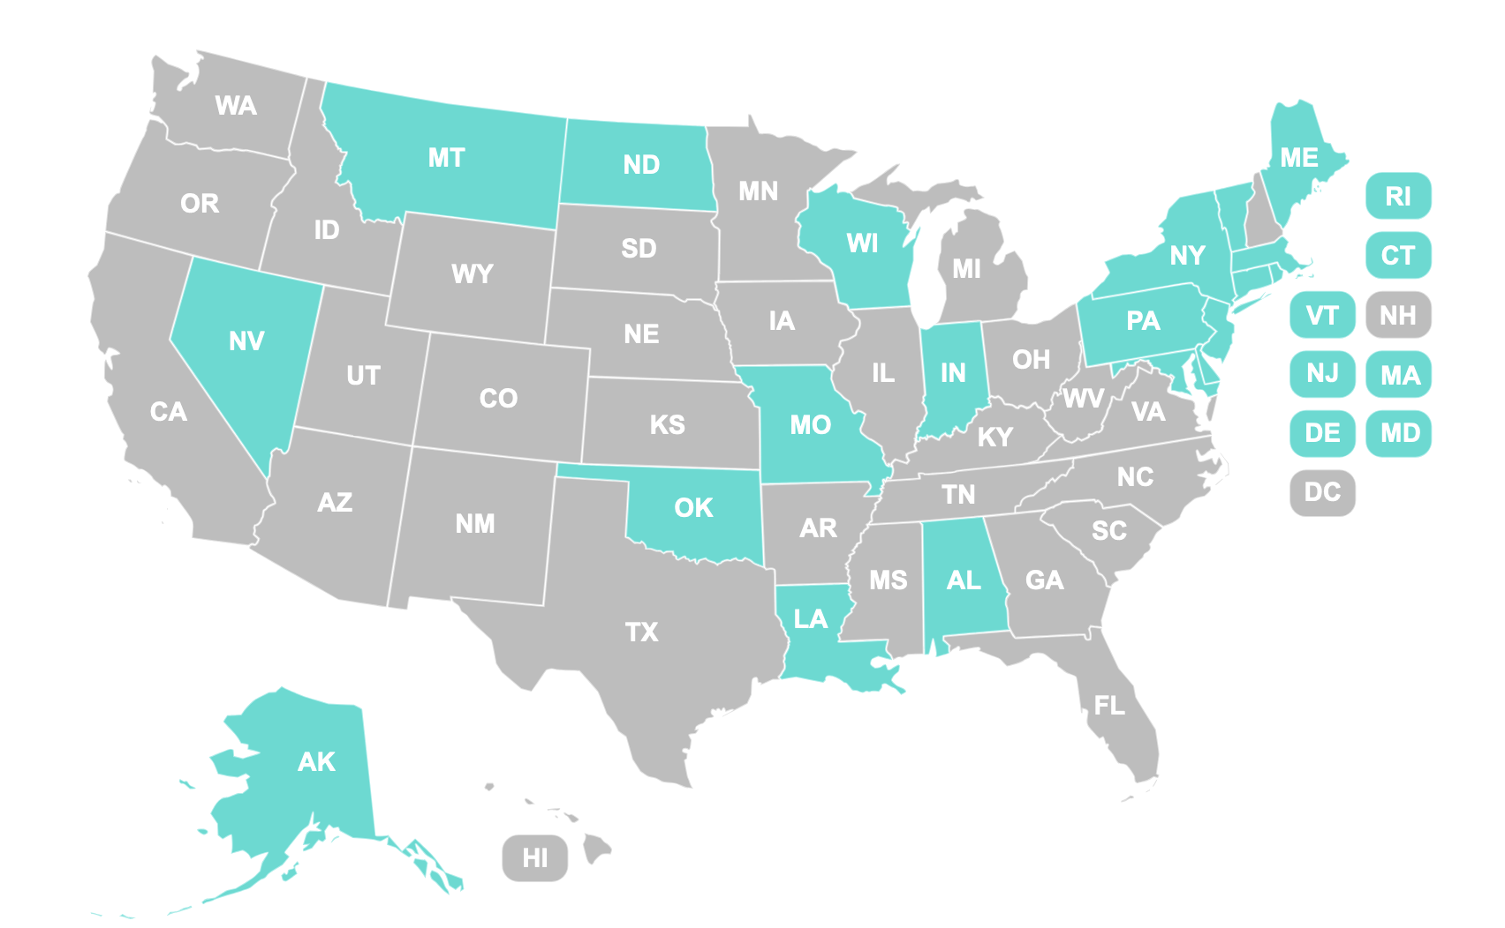
State Pharmaceutical Insurance Programs (SPAP)

Slide 34
Who Can Help Me Navigate My Health Insurance?
Financial Navigators/Advocates
Social Workers
State Health Insurance Assistance Programs (SHIP) Counselors
ACA Navigation Assistance
Private brokers (buyer beware!)

Slide 35
Resources
Cancer Support Community Helpline 888-793-9355
Medicare.gov 1-800-MEDICARE
SHIP Counselors 877-839-2675
Low-Income Subsidy/Extra Help: SSA 800-772-1213
OncoLink.org
State Pharmaceutical Assistance Programs www.ncsl.org/health/state-pharmaceutical-assistance-programs

Slide 36

Thank You!
Christina Bach, MSW, MBE, LCSW, OSW-C, FAOSW
Psychosocial Content Editor, Oncolink.org
Cancer Support Community Helpline
888-793-9355

