Slide 1

Miles 4 Myeloma 5k 2019
Putting the FUN in Fundraising!

Slide 2

Overview of the
Event
Saturday, April 27th, 2019
8:30am race start (registration opens at 7:15am)
Memorial Hall/Please Touch Museum (West Fairmount Park)
$30 for adults until April 24th, $35 day-of registration
$20 for kids 12 and under anytime
5k course through West Fairmount Park
Pre-event program with speakers, DJ, water stop on course, snacks and water after, awards, t-shirts, swag bags
BEAUTIFUL WEATHER!

Slide 3

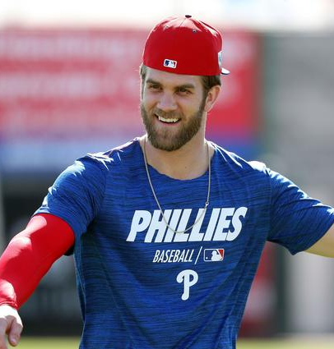
Incentive:
Fundraising Prize
The individual OR team that raises the most funds by April 20th will win an awesome Phillies package!
The package includes:
  4 Hall of Fame Club level tickets
  Cocktails and dinner prior to the game in the Phillies Executive Dining Room
  Preferred parking
Last year’s prize went to our own Joel Gottfried of the Wyndmoor Warriors who raised $10,600 – It can be done!

Slide 4
Team Registration versus
Individual Registration
Free registration for a team captain
Private tent for teams of 15+
Form a team
Encourage people to join or donate to your team

Slide 5
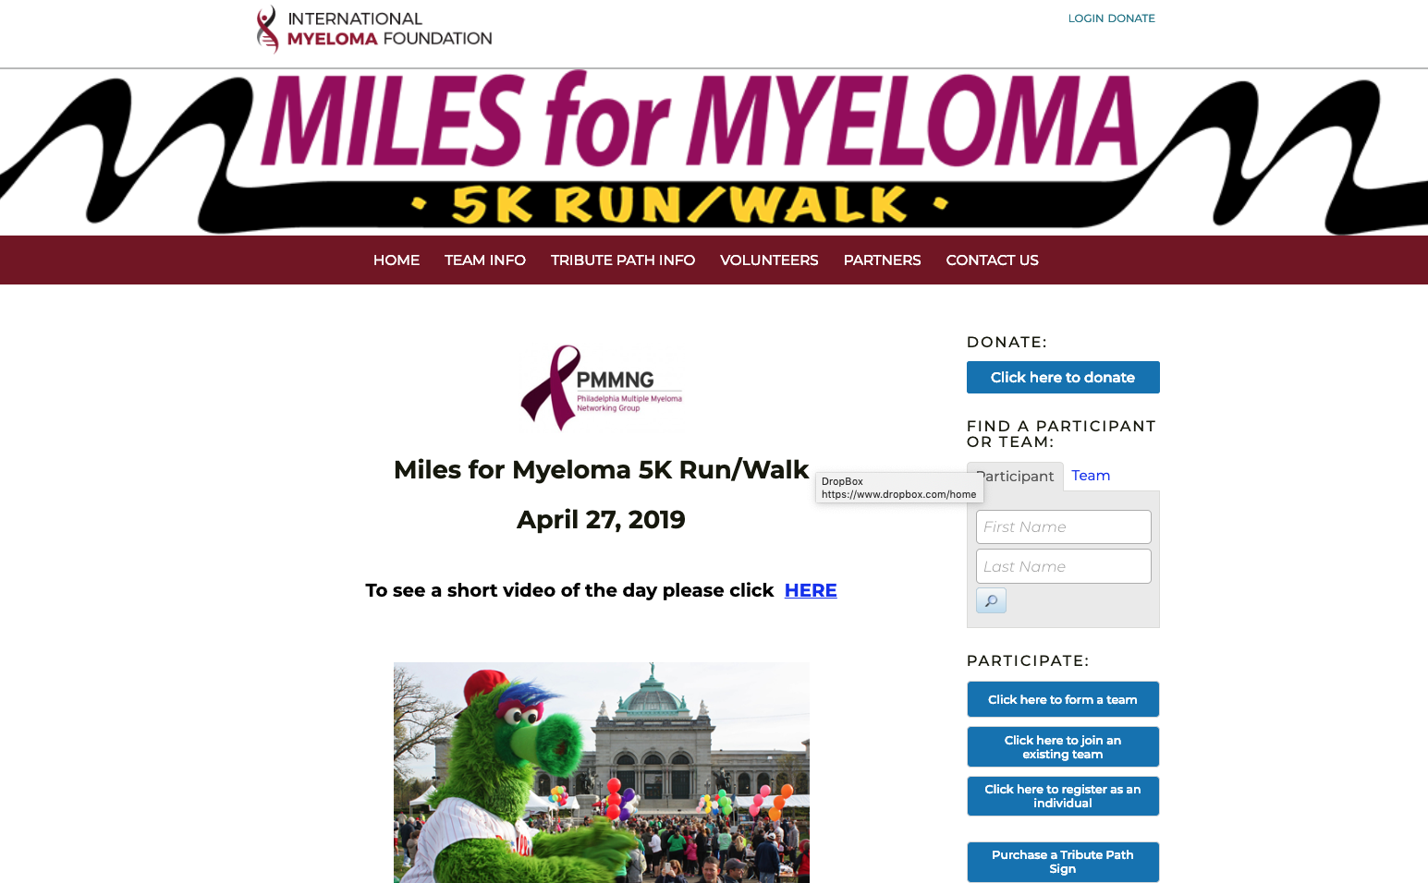



Slide 6
Individual Fundraising Asks – the “hard part”
  It doesn’t have to be intimidating
  Why fundraise through the registration site versus Crowdfunding sites or Facebook
  Set a goal, communicate it, keep people posted on your progress
  Make it personal – tell your story
  Themes
    Milestones - birthday, remission date
    Thresholds with fun/wacky prizes, gifts of service (chores for charity, other unique offerings you can make)
  Audiences:
    Family
    Friends
    Co-workers
    Corporate matches
    Alumni

Slide 7
Events
  Happy hours
  Training runs/walks
  50/50
  Facebook/Instagram Live

Slide 8

Registration Page
  As a reminder, the registration site can be found at:
  http://give.myeloma.org/milesformyeloma19
  You can also provide the offline donation form found at the bottom of the registration home page.
  Please share!

