Slide 1


OncoLife-PMMNG partnership: Improving survivorship care plans for chronic cancer survivors
Joseph Benci
March 10, 2018

Slide 2

What is a survivorship care plan?
Contains information on:
  Diagnosis and treatments
  Possible long-term side effects
  Continued screening recommendations
Chronic cancer survivors are less satisfied with care plans

Slide 3

How can we improve SCPs for chronic cancer survivors?

Slide 4
Part I – Online
What?
Fill out an OncoLife survivorship care plan – Patient version
  Special PMMNG URL: www.oncolink.org/pmmng
Read through your care plan
Complete a short online survey
When?
Today-April 15th 2018

Slide 5
Things to know before you go
If you underwent surgery, what procedures were done?
If you received chemotherapy, what medications were received?
If you received radiation therapy, what area of your body was treated?
DO NOT close the tab with your care plan in it before completing the survey
www.oncolink.org/pmmng

Slide 6

Part II – Focus groups
What?
10 person focus groups to discuss care plans
  Before and after the May PMMNG meeting
  ~1 hour
In-depth discussions on how to improve care plans
When?
May 12th, 2018

Slide 7
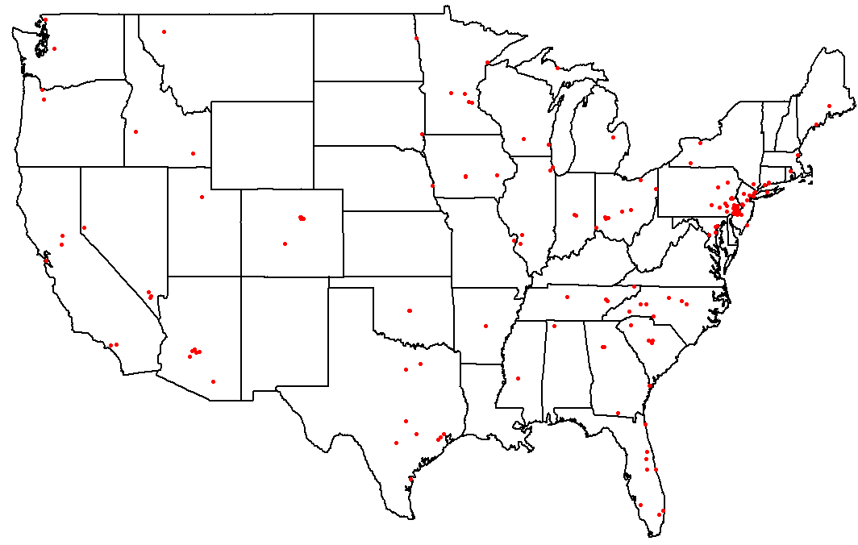

Why participate?
250+ multiple myeloma survivors from 44 states
Notes:
$15 for the first 50 people to do the online portion, those who are selected and come to the focus group will receive an additional $25 gift card.

