Slide 1

MMRF CureCloud
Presentation
PMMNG
January 29, 2022

Slide 2
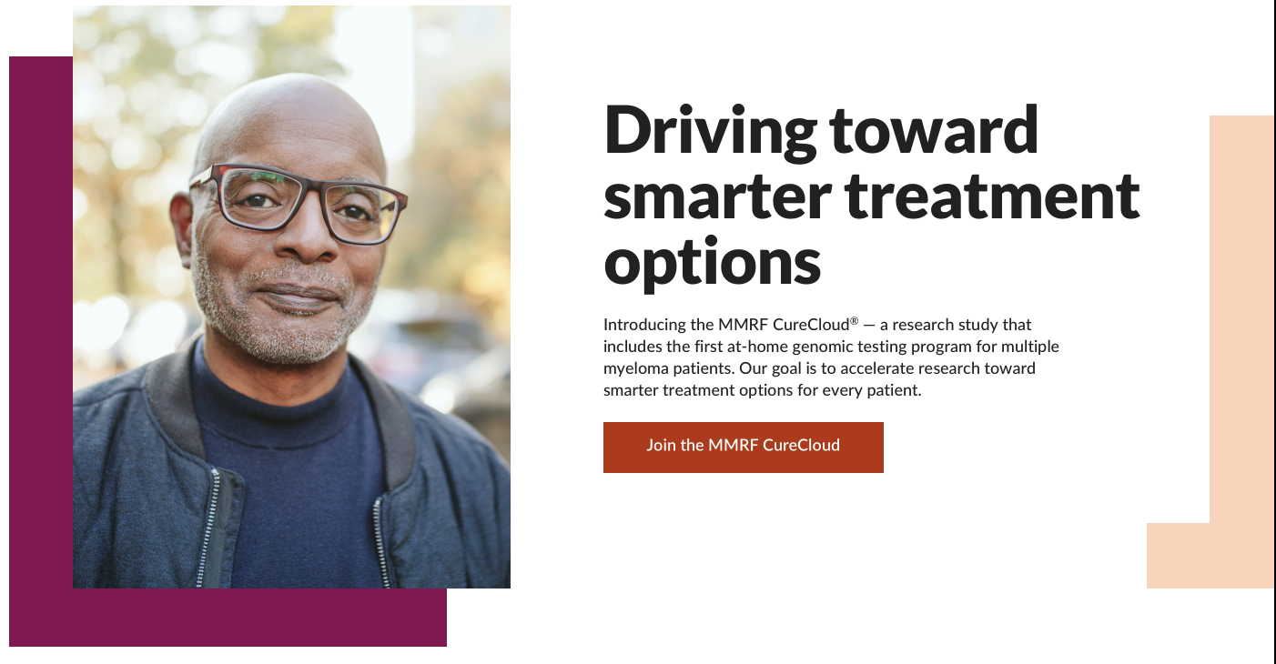
MMRF CureCloud® Impact
IRB-approved clinical trial that democratizes access to technology and data to transform patient care.
Direct-to-patient enrollment to accelerate enrollment and data capture
First CLIA liquid biopsy sequencing test for myeloma using proprietary 70-gene panel
Personalized dashboard and report with trials based on sequencing results
Our goal is to enroll 5000 patients to provide data to accelerate a cure

Slide 3
CureCloud - Process
Multiple Myeloma Research Foundation, Inc.

Slide 4
What is the MMRF CureCloud?
The CureCloud is a direct-to-patient registry; eligible patients may choose to join the IRB-approved CureCloud Research Study, where:
Patients receive genomic sequencing from a blood biopsy at no cost
Patient genomic data is connected to their clinical data collected from electronic health records, to provide a complete picture of each patient’s disease
Certain collaborators will have access to this data to help accelerate research into new therapies, and ultimately, cures for MM
Patients and their doctors will be able to access their own data and deidentified data from other patients

Slide 5
Why should patients join the CureCloud Research Study?
The more data we gather and make available to researchers, the more we accelerate research into cures for myeloma
Donating your data helps you and every myeloma patient
Joining the study, including genomic sequencing, incurs no cost to you or your doctor
You and your doctor will receive a report of your genomic sequencing results which may suggest clinical trials which might be appropriate for you
Through the visualization portal, you will be able to see your clinical data, gathered from your doctors, and also see deidentified data from other myeloma patients who look like you, which may be helpful to you and your doctor in making treatment decisions

Slide 6
Who is eligible to join the CureCloud Research Study?
Patients 18 years of age or older
Patients who live in the USA, except for those who live in AK, HI, or NY
Patients with active multiple myeloma, as defined by M-spike level and free light chain ratio*
Patients with smoldering myeloma who are already enrolled in the PCROWD or PROMISE studies and have received a CureCloud enrollment code
*patients in remission may join CureCloud and receive updates on the study; our Patient Navigators will contact them periodically and will help with resources and with enrollment into the research study if their disease becomes active

Slide 7
How do I enroll in the CureCloud Research Study?
Go to mmrfcurecloud.org/join
Enter in your name and where you live
Answer a few questions about your disease
If you are eligible, you will sign a consent and be asked to list the doctors you have seen and centers where you have received treatment
Your doctor must fill out and sign a blood draw form
You will receive a blood draw kit at your home via FedEx
Our mobile phlebotomist service will call you to set up a blood draw at your home; they will draw several tubes of blood and ship them out to our labs for analysis and storage

Slide 8
What happens after my sample is collected?
Some tubes of your blood are sent to the Broad Institute in Cambridge MA for genomic sequencing
Other tubes of your blood are sent to our Tissue Bank at the Mayo Clinic in Scottsdale AZ and stored for possible future studies, such as immune profiling
Our partners will gather your electronic health records from the doctors and care centers that you identify; these will be curated and connected to the results of your genomic sequencing to form a very complete picture of your myeloma. This process may take several months.
Your sequencing report will be delivered to you and to your doctor approximately 6 – 10 weeks after collection
At your next visit with your doctor, you can review and discuss the report together, and decide on next steps
You and your doctor may also review your data and data from other patients in our visualization portal, which also may help with treatment decisions

Slide 9
Personalized Reports
Personalized genomics reports designed to enhance doctor-patient communication.
MyGeneCounsel Report for Patients

Slide 10
Personalized Reports
Personalized genomics reports designed to enhance doctor-patient communication.
DFCI Report for Physicians

Slide 11
CureCloud - Patient Support
MMRF Patient Navigators are available to provide additional support; Facebook groups and Myeloma Mentors provide patients opportunities to connect with patients like them.
Multiple Myeloma Research Foundation, Inc.

Slide 12
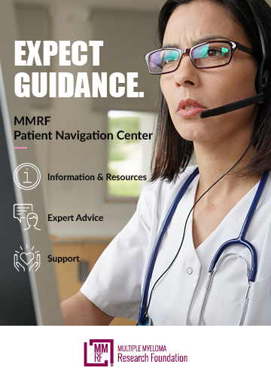
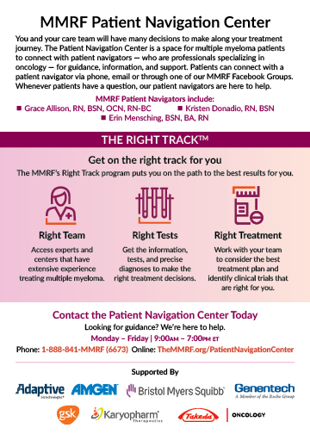
MMRF CureCloud Resources

Slide 13
CureCloud – Data Visualizations

Slide 14
Data Visualizations for the Public

Slide 15
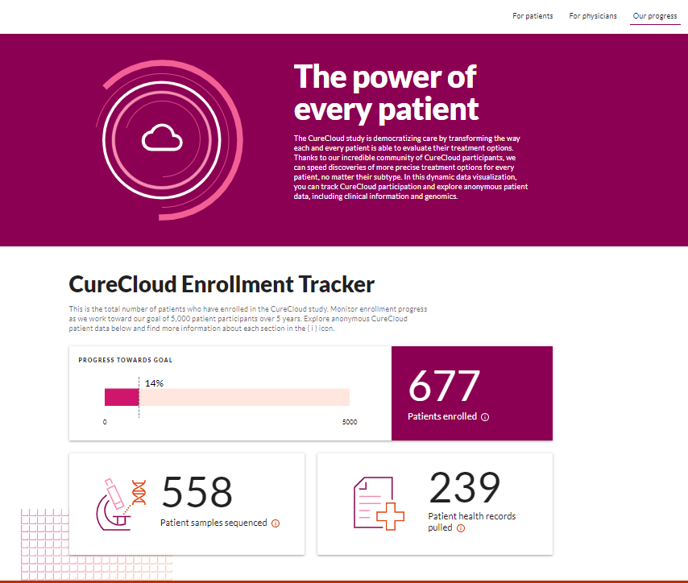
Data Visualizations for the Public
mmrfcurecloud.org
CureCloud Enrollment Tracker
Clicking on “Our progress” link reveals the current patient accrual metrics

Slide 16
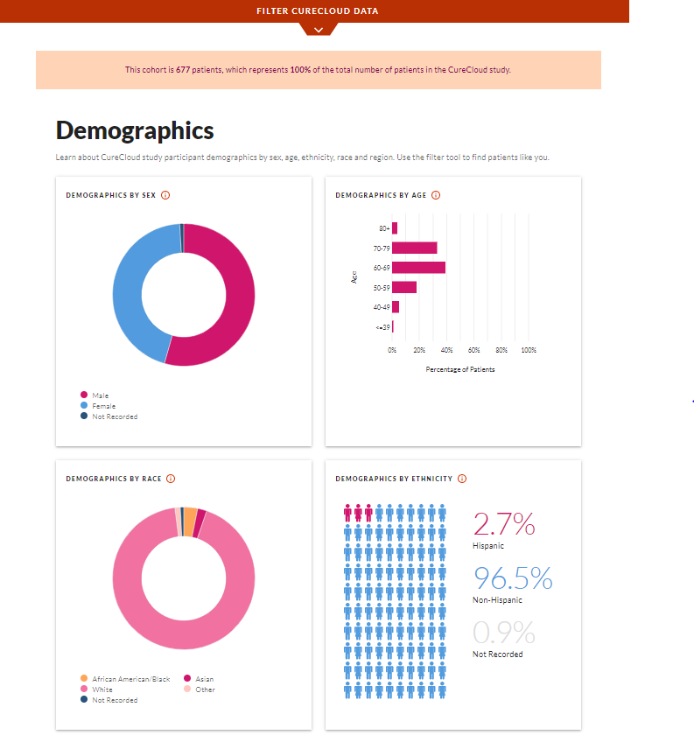
Data Visualizations for the Public
Aggregated Patient Data
Data Charts are the same as patient-facing charts WITHOUT individual patient data
Both demographic and clinical aggregated data are displayed for the CureCloud participants

Slide 17
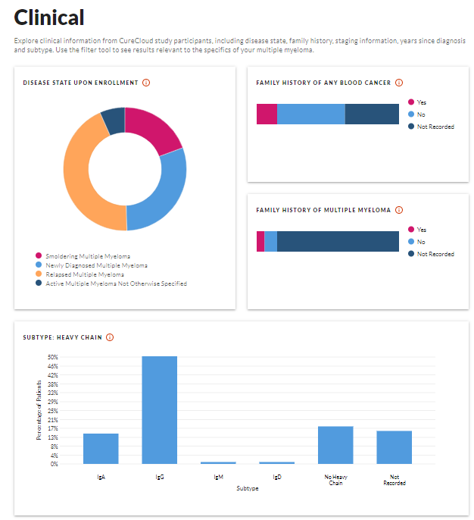
Data Visualizations for the Public
Aggregated Patient Data
Data Charts are the same as patient-facing charts WITHOUT individual patient data
Demographic, clinical, and treatment aggregated data are displayed for the CureCloud participants

Slide 18
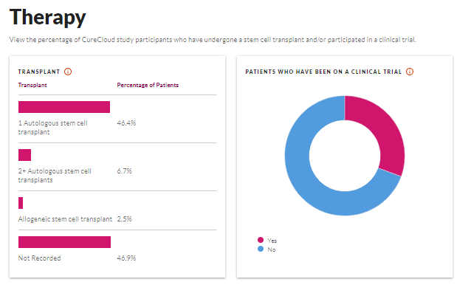
Data Visualizations for the Public
Aggregated Patient Data
Data Charts are the same as patient-facing charts WITHOUT individual patient data
Demographic, clinical, and treatment aggregated data are displayed for the CureCloud participants

Slide 19
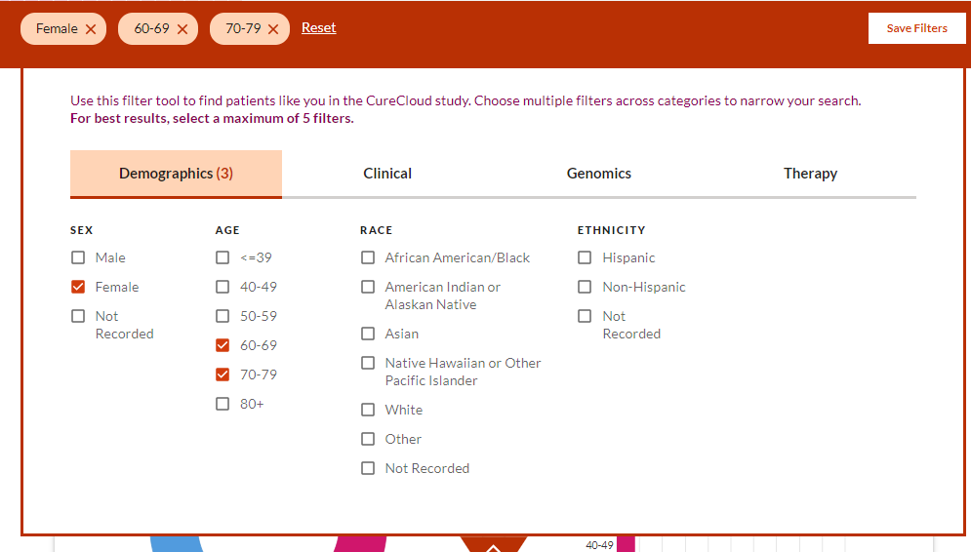
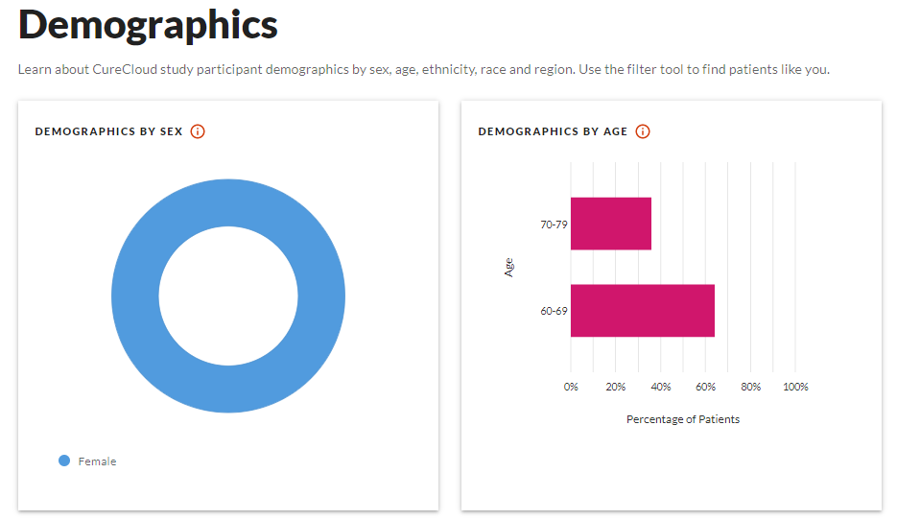
Data Visualizations for the Public
Aggregated Patient Data
Have ability to filter data to examine specific groups of patients
In this example, we have filtered to see data for women between 60 and 79 at diagnosis and all the charts are re-calculated.

Slide 20
Data Visualizations for Patients Enrolled in the CureCloud Research Study

Slide 21
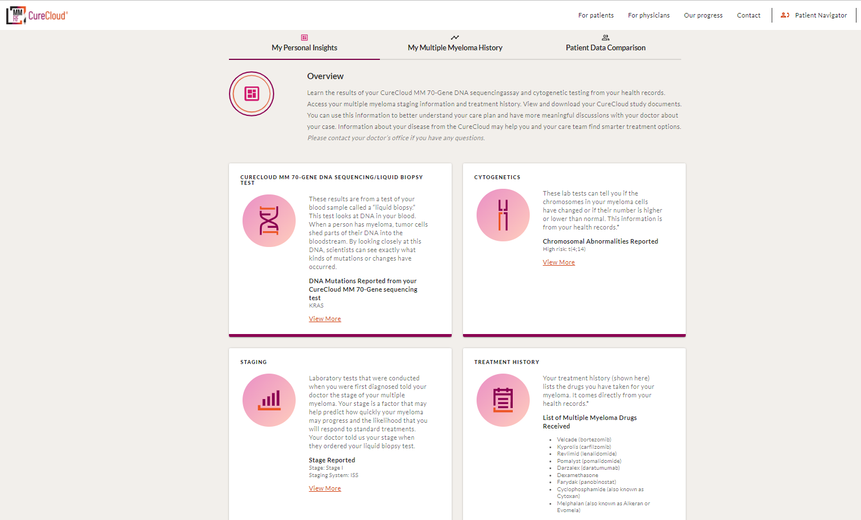

Slide 22
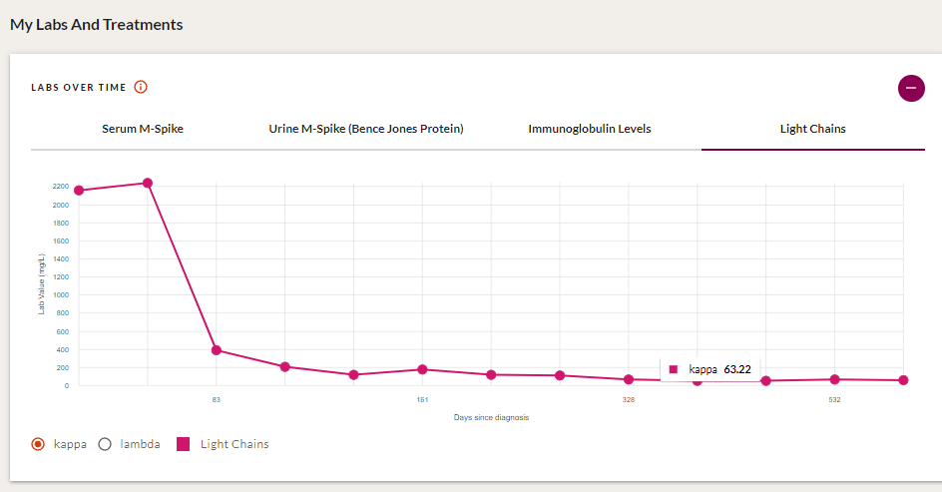
Patient’s Lab Values: EHR Data
Longitudinal view of levels
  Serum M-Spike
  Urine M-Spike
  Heavy Chain
  Light Chain

Slide 23
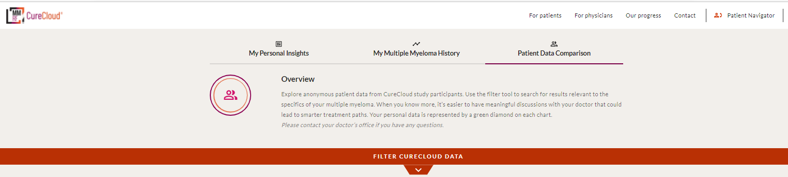

Slide 24
Data Visualizations for the Public
Aggregated Patient Data
Have ability to filter data to examine specific groups of patients
In this example, we have filtered to see data for women between 60 and 79 at diagnosis and all the charts are re-calculated.

Slide 25
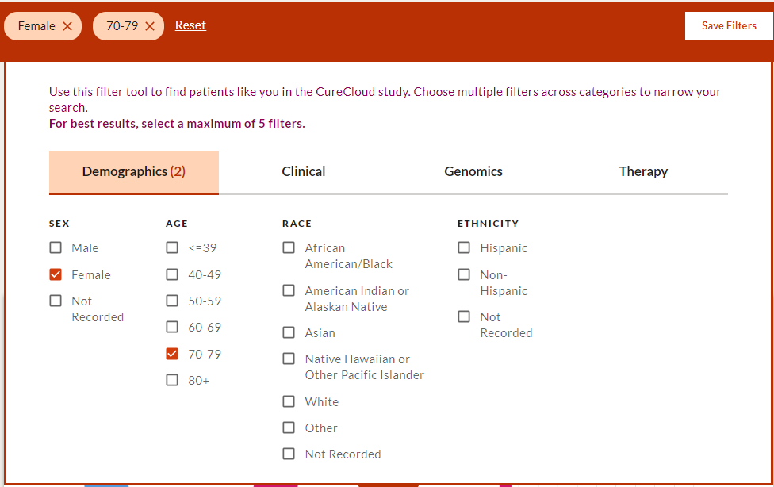
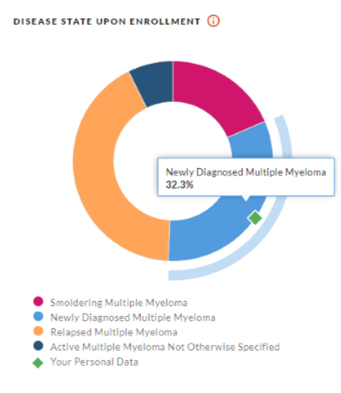
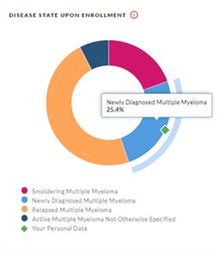
Patients Own
Data Compared to Other Patients
Clinical data with patient’s data represented (green diamond)
Patient can filter data by characteristics like age, sex, race to see patients like themselves
Not Filtered
Filtered

Slide 26
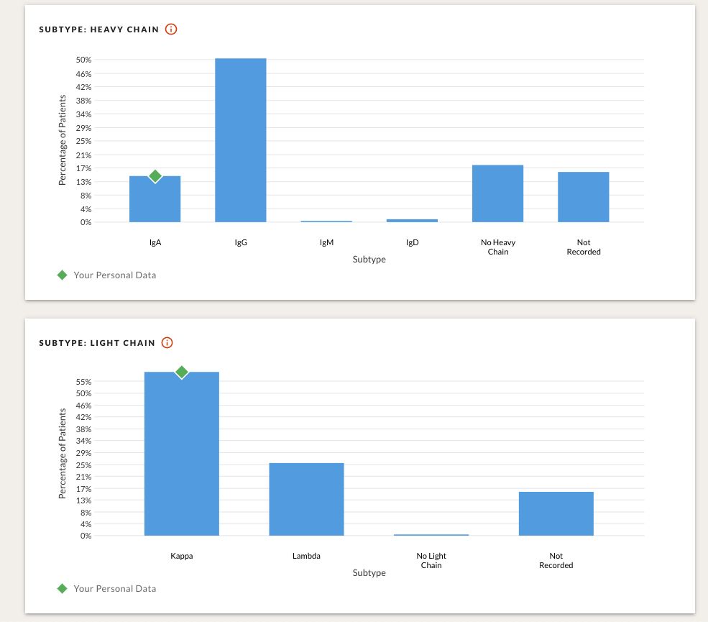
Patients Own Data Compared to Other Patients
Clinical data with patient’s data represented (green diamond)
Patient can filter data by characteristics like age, sex, race to see patients like themselves

Slide 27
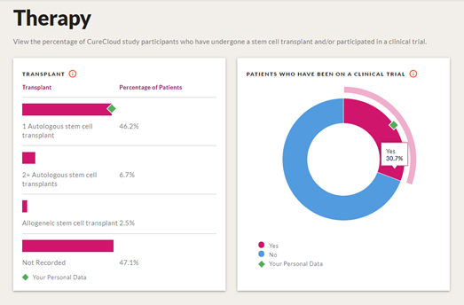
Patients Own Data Compared to Other Patients
Treatment data with patient’s data represented (green diamond)
Patient can filter data by characteristics like age, sex, race to see patients like themselves

Slide 28
Thank you!

