Slide 1
Palliative Care at HUP
Jill Farabelli MSW LCSW
Anessa Foxwell CRNP

Slide 2
Objectives
Define palliative care and hospice.
Review the role of the palliative care and hospice teams at HUP.
Discuss best practice for communicating with patients and families at the end of life.

Slide 3
What is Palliative Care?
Palliative care is specialized medical care for people with serious illnesses. This type of care is focused on providing patients with relief from the symptoms, pain, and stress of a serious illness - whatever the diagnosis.
The goal is to improve quality of life for both the patient and the family. Palliative care is provided by a team of doctors, nurses, and other specialists who work with a patient's other providers to provide an extra layer of support. Palliative care is appropriate at any age and at any stage in a serious illness, and can be provided together with curative treatment.

Slide 4
Palliative Care:
An Extra Layer of Support
Pain and symptom management
Psychosocial and spiritual support
Goals of care and end of life conversations
Complex care coordination

Slide 5
Who might benefit from palliative care?
Any patient who has a serious illness
In particular, palliative care may benefit patients with:
  Difficult to manage symptoms (pain, nausea, dyspnea, etc.)
  Existential or spiritual concerns
  Challenging coordination of care needs
  Complex medical decisions to make

Slide 6
When is palliative care available?
At any time during the course of a serious illness
Patients who receive palliative care can still:
  Have surgery, chemotherapy, radiotherapy
  Participate in clinical trials
  Have “Full Code” status

Slide 7
Palliative Care in the Health System
Inpatient consult service
Outpatient clinic for patients with cancer
    Appointment can be made by patient’s provider prior to discharge and coordinated with the days of their oncology appointments
    At the Perelman Center
Home palliative care
    Caring Way

Slide 8
HUP Palliative Care Team
MD (4)
CRNP (5)
Pharmacist (1)
Social workers (1.5)
Spiritual care provider (1)
Triage Nurse (1)
Learners (rotating)
We are an acute in-patient consultation service. Primary teams consult for assistance with pain management, symptom management, psychosocial distress, spiritual distress, goals of care discussion, and/or end-of-life issues. We make recommendations to the primary team in these 6 domains.

Slide 9
Requesting a Palliative Care Consult
Consults placed by patient’s primary team
  Provider pages PC team with information about patient & reason for the consult and enters a palliative care order into Sunrise.
  Anyone, including bedside nurse, can request consult from the patient’s primary team or contact the Palliative Care Service, however PC needs to discuss with primary team for official order.

Slide 10
Hospice

Slide 11

How Does Palliative Care
Differ From Hospice?
Non-hospice palliative care:
  Appropriate at any point in a serious illness
  Provided at the same time as life-prolonging treatment
  No prognostic requirement, no need to choose between treatment approaches
Hospice is a form of palliative care:
  Provides care for those in the last weeks/few months of life
  Patients must have a 2 MD-certified prognosis of <6 months + give up insurance coverage for curative/life prolonging treatment in order to be eligible
Copyright 2008 Center to Advance Palliative Care. Reproduction by permission only.
Notes:
11

Slide 12

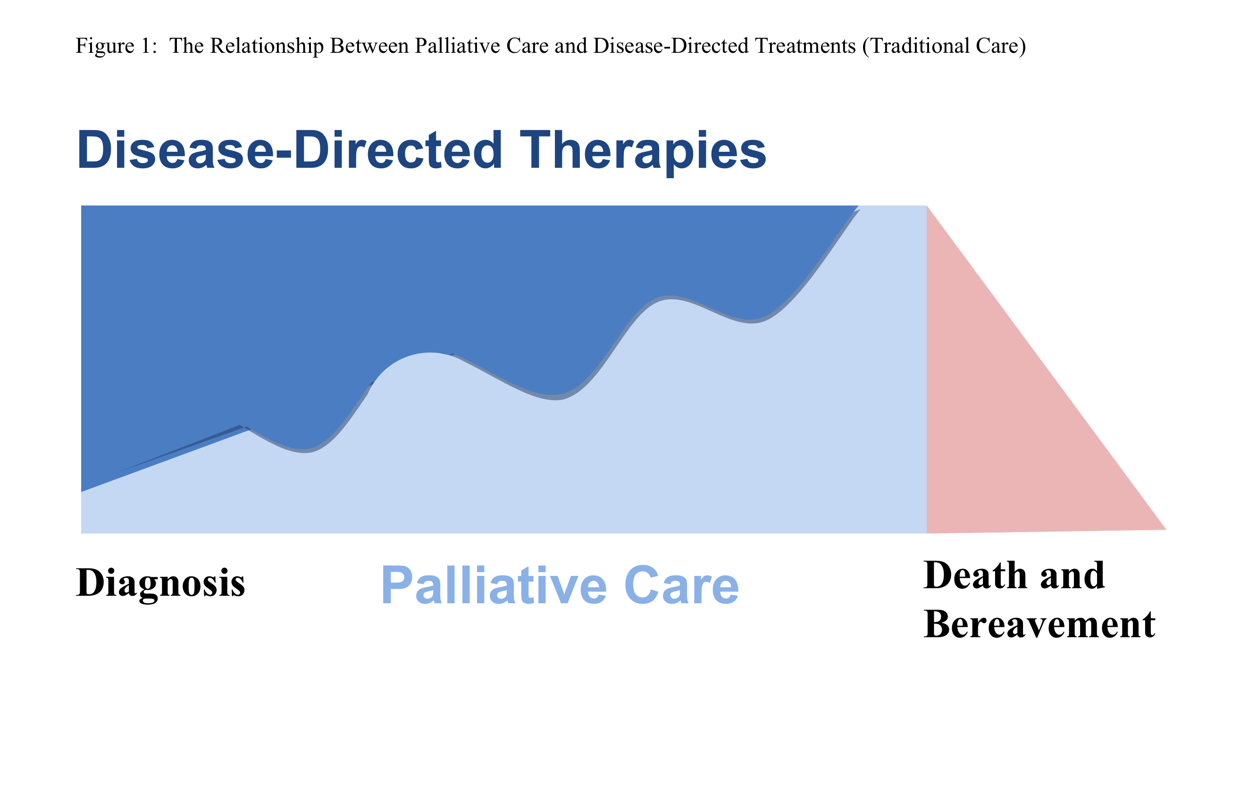
Palliative Care Versus Hospice
Palliative care aims to improve
quality of life for any patient with
a serious illness - not just for
those who need end of life care

Slide 13
Locations for Hospice
Home
Residential
  Keystone House
  Sacred Heart Home
Nursing home w/ hospice care (LTC)
General in-patient hospice (GIP)
  In-patient units (ex. Penn Hospice at Rittenhouse)
  Hospital
Notes:
With hospice care in a nursing home, the family is responsible for room & board

Slide 14
Palliative Care Resources
http://www.getpalliativecare.org/ (Info for patients & families)
www.hpna.org (Hospice & Palliative Nurses Association)
www.capc.org (Center to Advance Palliative Care)
www.aahpm.org (American Academy of Hospice and Palliative Medicine)

Slide 15
Questions?

