Slide 1
Insurance Essentials for Navigating Open Enrollment
Christina Bach, MBE, MSW, LCSW, OSW-C
Educational Content Specialist and Psychosocial Content Editor, OncoLink
www.oncolink.org

Slide 2

Health Insurance 101: What Is It?
Financial protection against medical expenses if you have an accident or major illness.
Insurance is a contract between you (the insured) and the insurance company.
Typically, the provider of the service submits a claim to the insurance company (the payer) for the services provided.
With some plans or services, the patient will pay out of pocket for the visit/procedure, submit supporting documentation to the insurance company for the claim and then be reimbursed for the expense.

Slide 3
Why Have Health Insurance?
Accidents and sickness happens all the time.
Medical debt is the number one cause of personal bankruptcy.
Insurance helps us have access to networks of doctors and hospitals as a group negotiate lower costs with insurance companies.
Health insurance acts to safeguard our quality of life, and physical and financial well-being.
Currently, you can be penalized if you do not have health insurance.

Slide 4
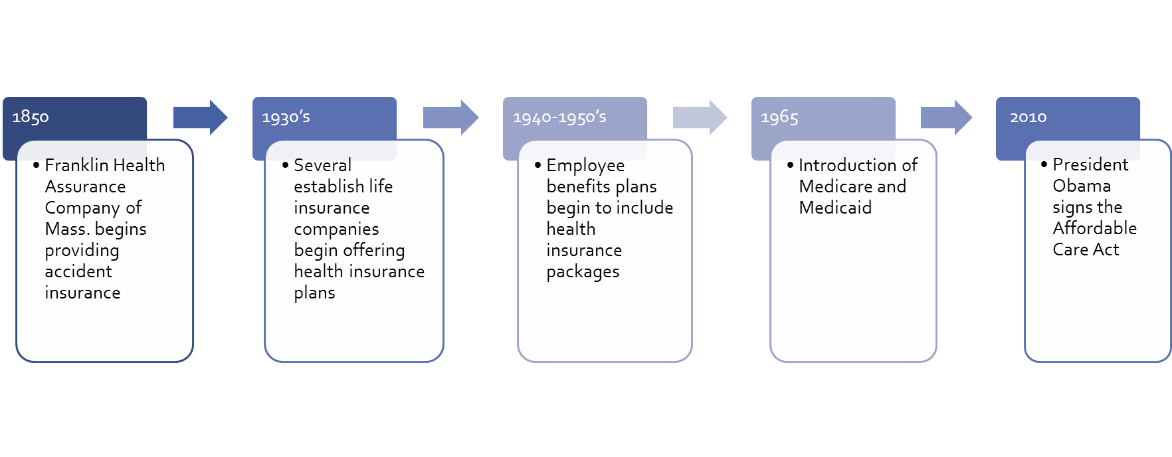
How Did We Get Here: A Brief History Of Health Insurance In The United States

Slide 5
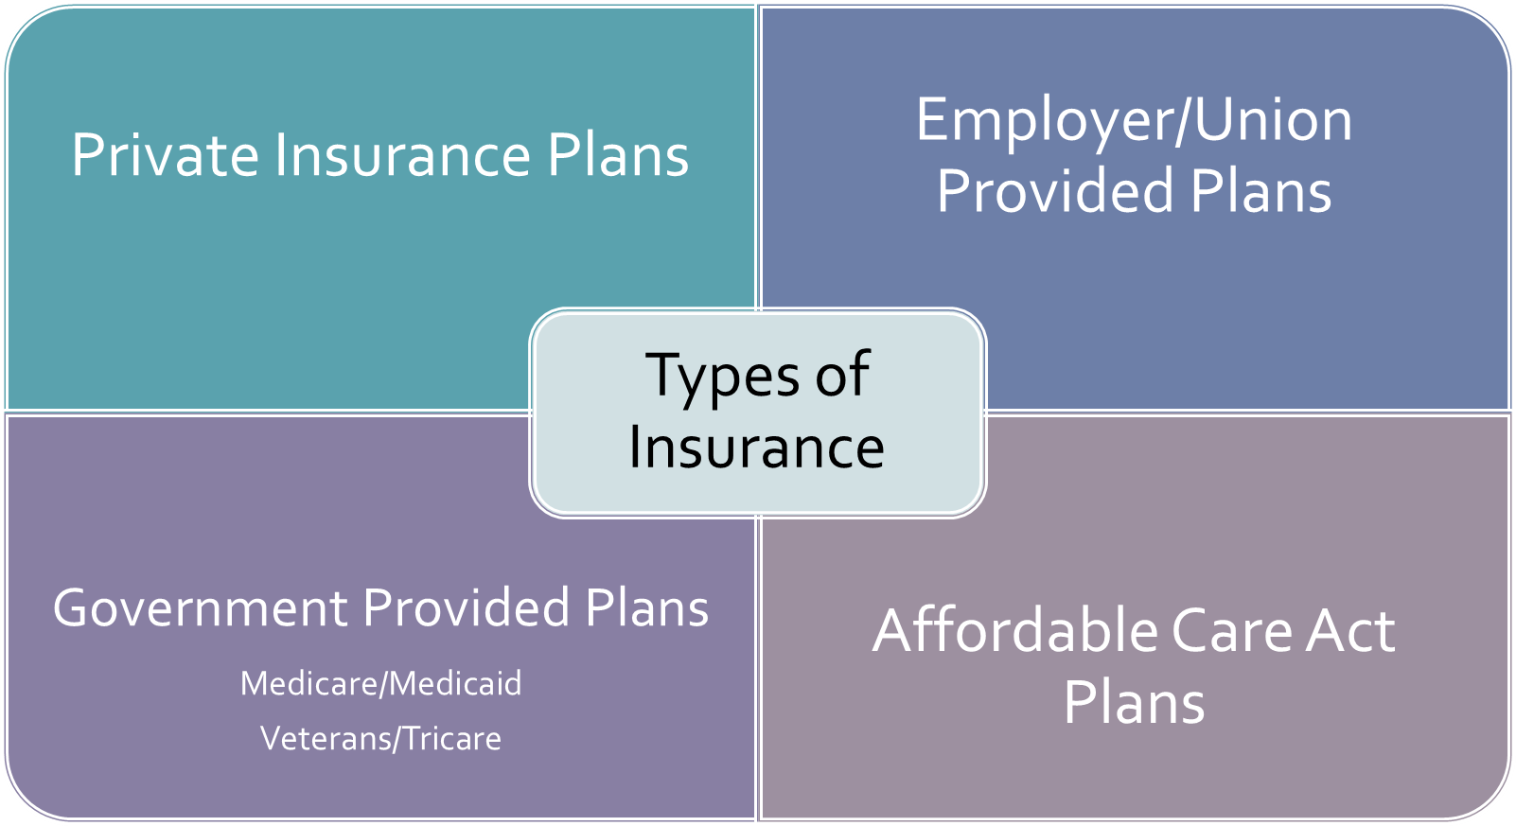

Slide 6
Other Types Of Insurance
Health care ministries
Indian Health Services
Medigap supplementary coverage
Affiliated group plans (ex: Order of the Moose)
Concierge medicine

Slide 7
Special Notes About Medigap Plans
These policies fill the gap by covering costs/expenses left by traditional Medicare part A and B coverage.
These polices are sold by private insurance companies.
You are responsible for monthly Medigap premiums.
Your plan cannot be cancelled UNLESS you do not pay.
You cannot purchase a gap plan if you do not have Medicare part B.

Slide 8
Special Notes About Medigap Plans
Cost of plan is dependent on the type of plan elected as well as pre-existing conditions and medical underwriting.
Does not ALWAYS include Part D/prescription coverage (some plans bundle Medigap and Part D).
It is always best to purchase a gap plan when first eligible (initial coverage period).
Federal law does not require insurance companies to sell Medigap policies to individuals under 65; thought some state laws trump the Federal mandates.

