Slide 1
Antibodies, BiTEs, and CARs: the new ABC’s of Myeloma Therapy
Adam D. Cohen, MD
Director, Myeloma Immunotherapy
Assistant Professor, Medicine
Abramson Cancer Center
University of Pennsylvania
June 6, 2019

Slide 2
Outline
Background
Antibodies and antibody-drug conjugates
CAR T cells
BiTEs and other bispecific antibodies

Slide 3
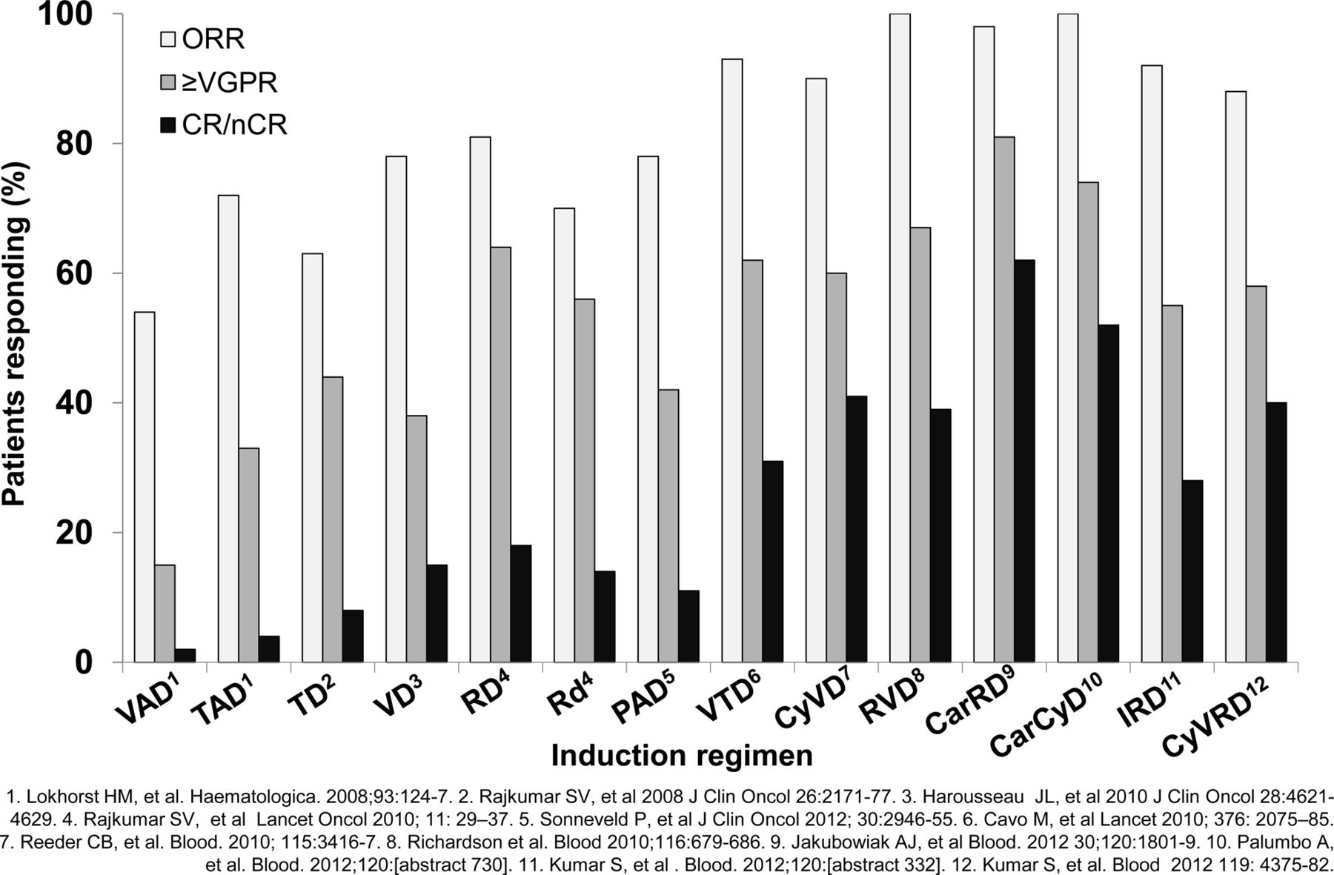
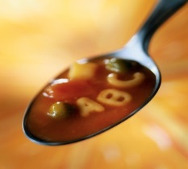
Therapeutic landscape of myeloma
Proteasome inhibitors
Bortezomib (Velcade)
Carfilzomib (Kyprolis)
Ixazomib (Ninlaro)
IMiDs
Thalidomide (Thalomid)
Lenalidomide (Revlimid)
Pomalidomide (Pomalyst)
Corticosteroids
Dexametha-sone
Prednisone
“Classic” Chemo
Melphalan
  autoSCT
Cyclophos-phamide
Doxorubicin
Antibodies
Daratumumab (Darzalex)
Elotuzumab (Empliciti)
HDAC inhibitors
Panobinostat (Farydak)
New approaches
Venetoclax
Isatuximab
Selinexor
Antibody-drug conjugates
Bispecific antibodies
CAR T cells
McCarthy P L , and Hahn T, Hematology 2013

Slide 4
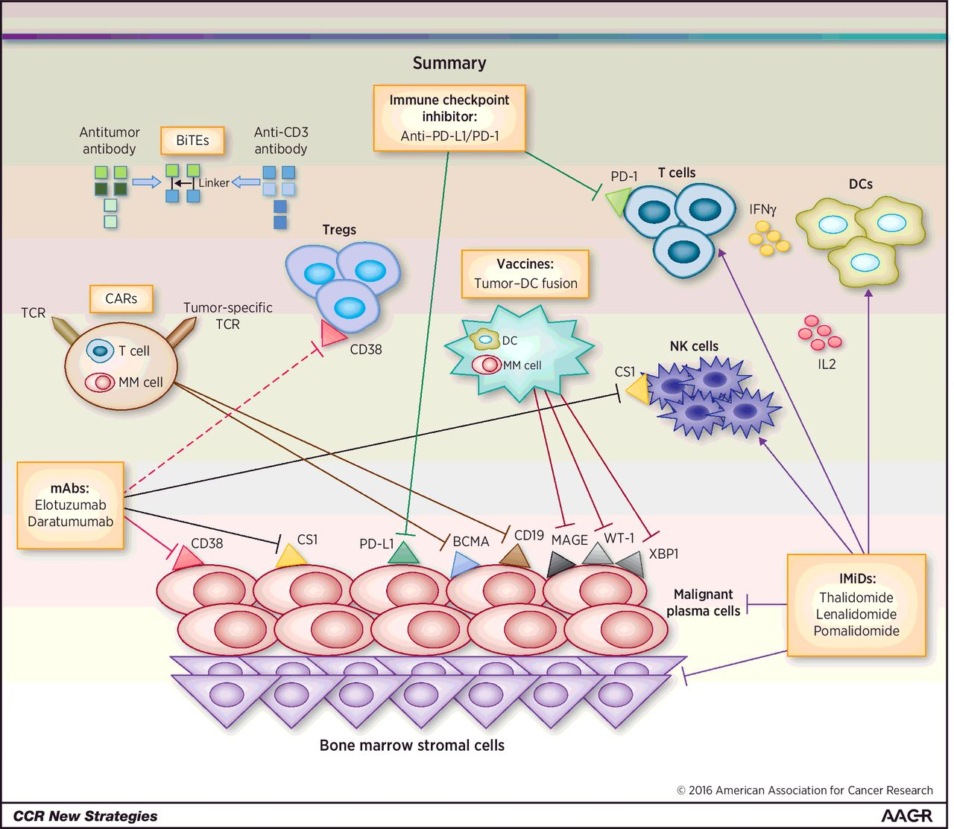
Immunotherapy for MM: Targets and Tools
ADCs
GSK2857916
Neri et al, Clin Can Res 2016

Slide 5
Daratumumab (Darzalex)
Targets CD38 on myeloma cells
Long intravenous (IV) infusion
FDA approved for relapsed myeloma:
  Single agent
  Combinations with:
    Revlimid/dexamethasone (DRd)
    Velcade/dexamethasone (DVd)
    Pomalyst/dexamethasone (DPd)
FDA approved for newly-diagnosed myeloma:
  Combination with Velcade/Melphalan/Prednisone (D-VMP)

Slide 6
MAIA trial: DRd vs Rd for newly diagnosed MM
Not transplant candidates, median age 73
Facon et al, New Engl J Med 2019

Slide 7
MAIA trial: DRd vs Rd for newly diagnosed MM
Neutropenia (57% vs 42%), Infections (86% vs 73%), Fatigue (40% vs 28%), Infusion reactions (41% vs 0%)
Facon et al, New Engl J Med 2019

Slide 8
CASSIOPEIA: D-VTd vs VTd for newly diagnosed MM
Median age 58, all got autologous stem cell transplant
Moreau et al, Lancet 2019

Slide 9
CASSIOPEIA: D-VTd vs VTd for newly diagnosed MM
2nd randomization to dara maintenance vs. no maintenance ongoing
Subcutaneous (SQ) dara coming soon…
Moreau et al, Lancet 2019

Slide 10
Elotuzumab/Pomalyst/Dex vs Pom/dex for relapsed MM
Elotuzumab (Empliciti) targets SLAMF7 (CS1)
FDA-approved in combo with Revlimid/dex
Median 3 prior therapies, including Velcade and Revlimid. No prior daratumumab
Dimopolous et al, New Engl J Med 2018

Slide 11
Elotuzumab/Pomalyst/Dex for relapsed MM
Neutropenia (23% vs 31%), Infections (65% vs 65%), Constipation (22% vs 11%), Diarrhea (18% vs 9%), Infusion reaction (5% vs 0%)
Dimopolous et al, New Engl J Med 2018

Slide 12
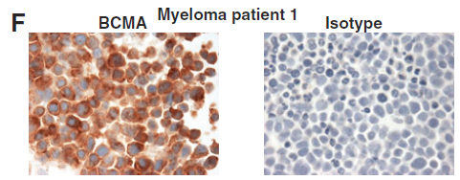
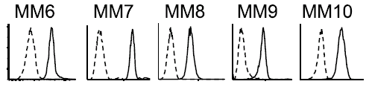
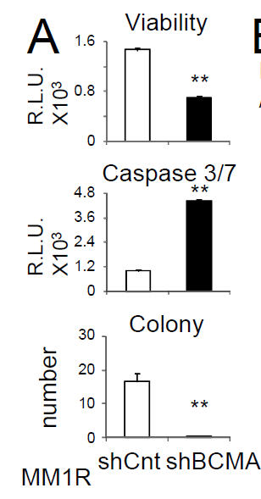
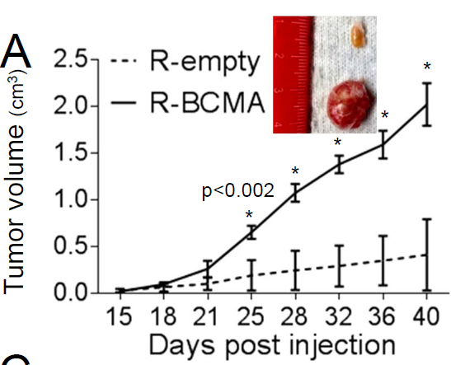
BCMA (B-cell Maturation Antigen)
Expressed on normal plasma cells
Highly expressed on myeloma cells
Soluble BCMA in patient serum
Promotes MM growth and survival
Multiple approaches targeting BCMA
Frigyesi et al, Blood 2014; Tai et al, Blood 2014; Carpenter et al, Clin Can Res 2013; Tai et al, Blood 2016

Slide 13
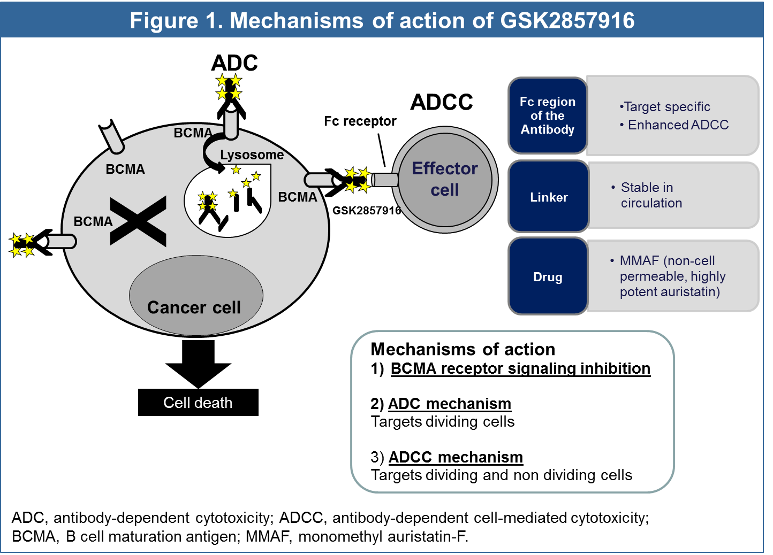
Anti-BCMA antibody-drug conjugate (ADC)
Anderson et al, AACR 2016, #CT034

Slide 14
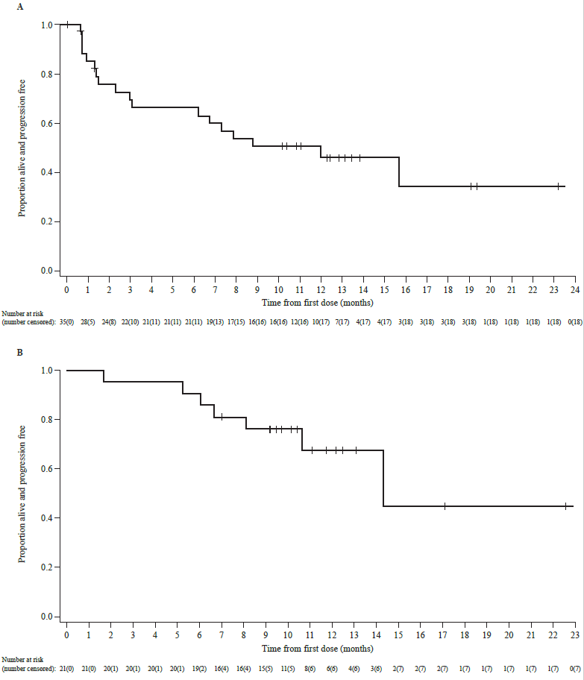
GSK2857916 (anti-BCMA-MMAF ADC)
Part 2 expansion (n=35)
3.4 mg/kg IV every 3wks
Med 5 prior therapies
89% PI/IMID-refractory; 34% dara-ref
Med PFS 12 mos
ORR 60% @ 3.4 mg/kg
PI/IMID/Dara-ref (n=13)
ORR 39%, PFS 6 mos.
Med DOR 14 mos
Trudel et al, Lancet Onc 2018; Blood Cancer J 2019

Slide 15
DREAMM-1 Part 2: Adverse Events
n (%) | N=35
 | Any grade | ≥Grade 3*
Any event | 35 (100) | 28 (80)
Thrombocytopenia | 20 (57) | 12 (34)
Vision blurred | 16 (46) | 0
Dry eye | 12 (34) | 1 (3)
Anemia | 10 (29) | 5 (14)
AST increased | 10 (29) | 2 (6)
Cough | 9 (26) | 0
IRR | 8 (23) | 3 (9)
Nausea | 8 (23) | 0
Photophobia | 8 (23) | 0
Pyrexia | 8 (23) | 0
Chills | 8 (23) | 0
Fatigue | 7 (20) | 0
Most frequent ≥Grade 3 AEs were thrombocytopenia (34%) and anemia (14%)
SAEs occurring in ≥2 patients included IRR (n=2) and lung infection (n=2)
AEs leading to study treatment discontinuation:
  Two patients discontinued: one due to Grade 3 thrombocytopenia, one due to Grade 3 thrombocytopenia and Grade 2 CPK increase
Any ocular tox = 63%
AE, adverse event; AST, aspartate aminotransferase; CPK, creatinine phosphokinase; IRR, infusion-related reaction; SAE, serious AE
AEs for ≥20% of patients
*Grouped term includes thrombocytopenia and platelet count decreased
Trudel et al, ASH 2017, Lancet Onc 2018

Slide 16
Antibody-drug conjugates: what’s happening in 2019
GSK2857916 (Balantamab mafadotin)
  Phase 2 registration trial in PI/IMID/Dara-refractory
  Phase 1/2 combos with vel/dex, rev/dex, pom/dex in RRMM
  Phase 1 combos with pembro, novel immune agonist Abs
  Phase 3: GSK’916 vs Pom/dex in PI/IMID-refractory
  Phase 3: GSK’916/Pom/dex vs Vel/Pom/dex in ≥1 prior
  Phase 3: GSK’916/Vel/dex vs Dara/Vel/dex in ≥1 prior
  Compassionate use program
Multiple phase 1/2 of novel ADCs
  BCMA
  CD48
  CD46
  CD38

Slide 17
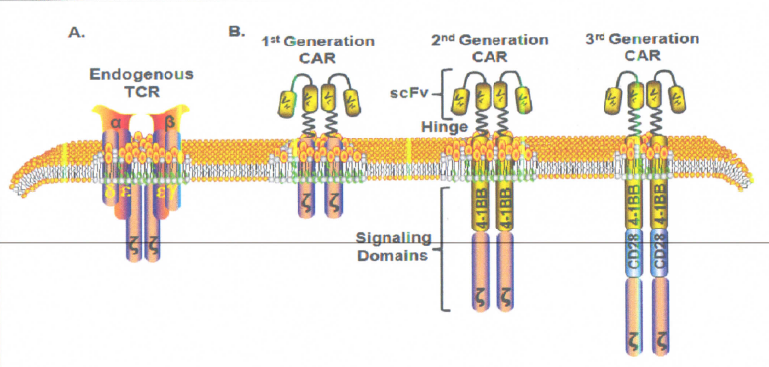
Chimeric antigen receptors (CARs) - background
Combines recognition domain of antibody with signaling domain of T cell
Uses gene transfer (eg. lentiviral vector) to stably express CAR on T cells → confers novel antigen specificity
Addition of co-stimulatory domains (CD28, 4-1BB/CD137) augments proliferation and survival
Garfall et al, Discovery Med 2014

Slide 18
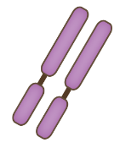





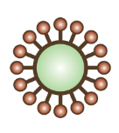


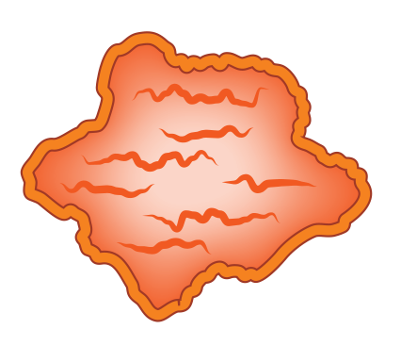

Building CAR T cells
T cell
CTL019 cell
Lentiviral vector
Cytotoxicity
Cytokine production
Long-term memory
Native TCR
Anti-CD19
CAR construct
CD19
Dead tumor cell
Tumor cell

Slide 19
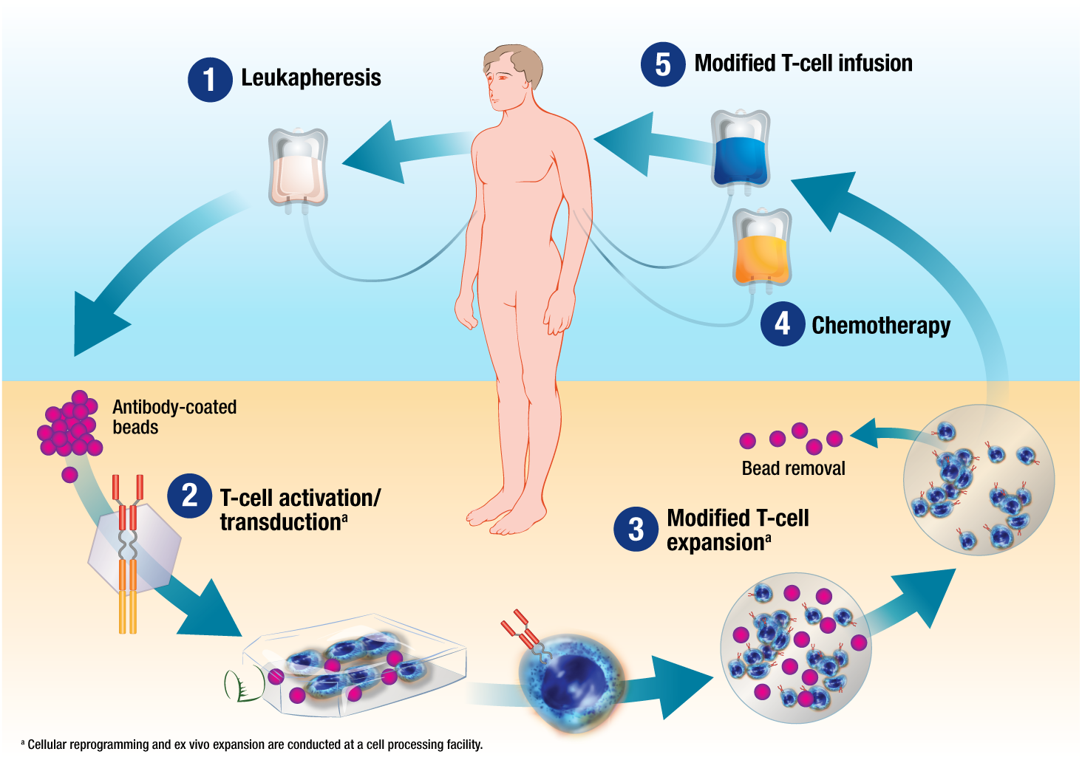
Overview of CAR T cell therapy
Courtesy of D. Porter

Slide 20
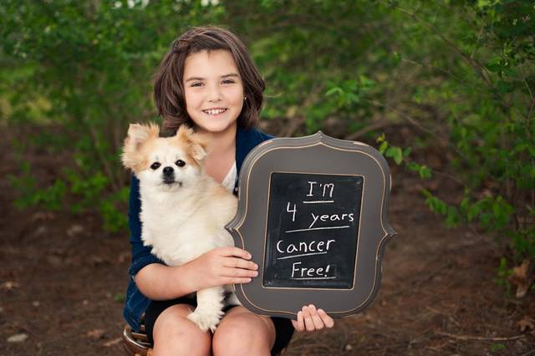
CD19-targeted CAR T cells for B cell malignancies
Responses seen in heavily-pretreated CLL, ALL, and B-cell NHL
  Responses in 40-50% in CLL and NHL
  80% in ALL
    FDA approved 2017
  some durable CRs > 7 years
Toxicities:
  Tumor lysis syndrome
  B cell aplasia / hypogammaglobulinemia
  Cytokine release syndrome (CRS)
    very high IL6, also IFN-gamma, TNF
    tocilizumab (anti-IL6 receptor mAb) can abrogate CRS
  Neurotoxicity/encephalopathy
    Headache, delirium, obtundation, seizure, aphasia
    Rare cerebral edema
Davila et al, Science Trans Med 2014; Porter et al, Sci Trans Med 2015; Maude et al, NEJM 2014

Slide 21
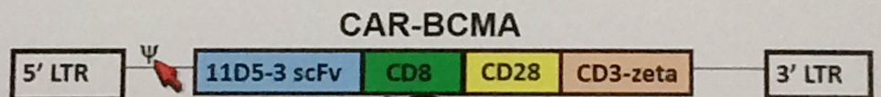
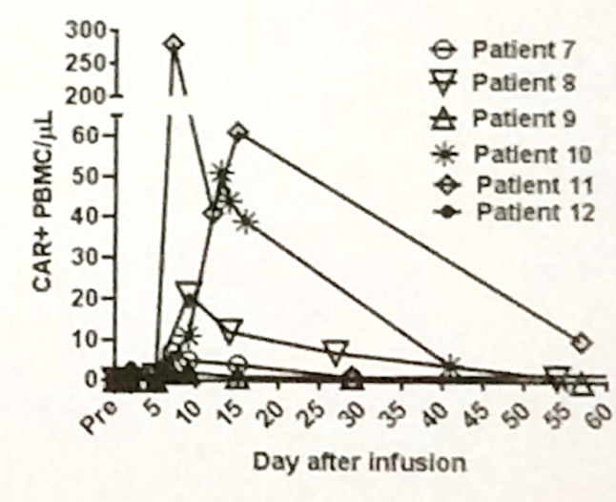
NCI BCMA-specific CAR in rel/ref MM
*Dose escalation of
CAR+ T cells/kg
0.3 x 10⁶
1.0 x 10⁶
3.0 x 10⁶
9.0 x 10⁶
Cyclophosphamide 300 mg/m²
Fludarabine 30 mg/m²
QD for 3 days
CAR-BCMA T cells*
Single infusion
Responses in 4/12 pts.
  PR (2wks), VGPR (8wks), sCR (17wks), VGPR (26+ wks)
Associated with CART expansion
Ali et al, ASH 2015, LBA #1; Blood 2016.

Slide 22
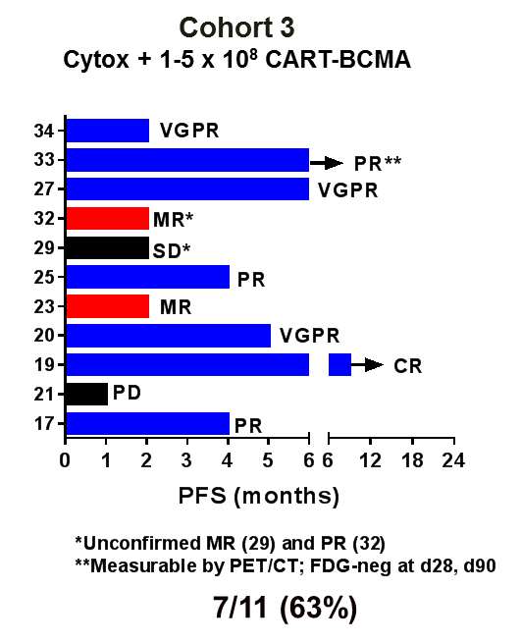
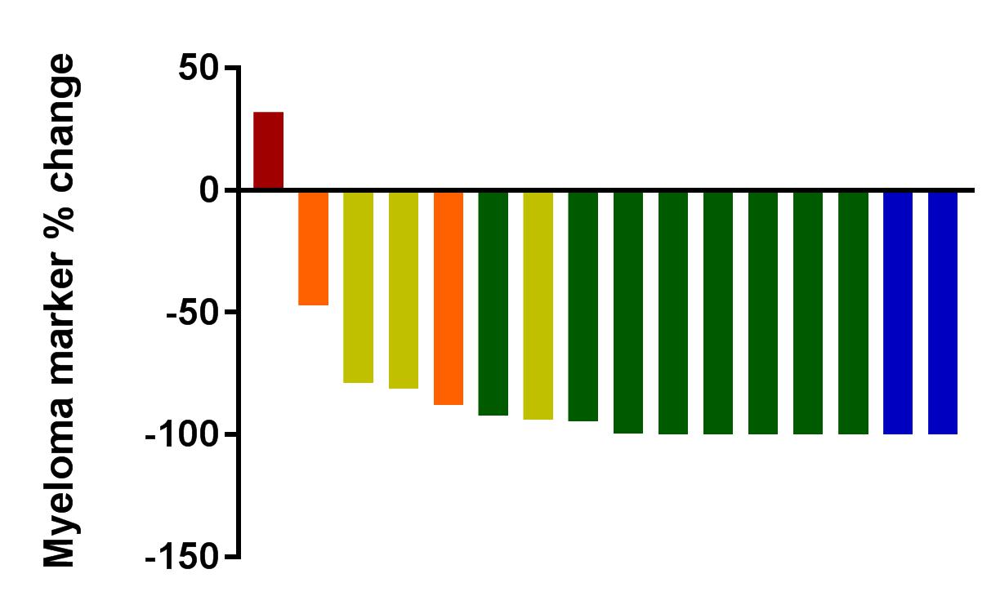
BCMA-specific CAR T cells
NCI trial
Penn trial
13/16 (81%) ORR
Bruno et al, J Clin Oncol 2018; Cohen et al, J Clin Invest 2019

Slide 23
BCMA-specific CAR T cells
Bluebird bb2121 trial: ORR 85% (45% CR)
Raje et al, NEJM 2019

Slide 24
BCMA-specific CAR T cells
Legend Biotech trial
ORR 88%
CR 68%
Raje et al, NEJM 2019

Slide 25
Cytokine release syndrome (CRS)
When CAR T cells get activated, release factors in bloodstream called cytokines, can mimic severe infection
Usually within first 1-2 weeks after CART infusion
High fevers, chills, malaise, headache, muscle aches, fatigue, appetite loss
  Treatment is supportive: tylenol, fluids, rest, close monitoring
Can become severe: hypotension, low oxygen, organ damage (kidney, liver), low blood counts
Neurologic toxicity: confusion, delirium, lethargy, seizures
Can treat with steroids/immune suppressing meds but risk killing CAR T cells, so…

Slide 26
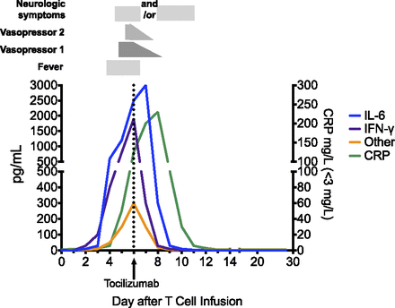
Tocilizumab (anti-IL6 receptor antibody)
“Antidote” for severe CRS
Blocks IL-6 involved in fevers, hemodynamic instability
Rapid improvement
Does not appear to harm CAR T cells or impact efficacy
Ongoing study of early/preventive tocilizumab in CART19 for pediatric ALL
Lee et al, Blood 2016

Slide 27
BCMA CAR T cell issues
Toxicities:
  Cytokine release syndrome
  Neurotoxicity/encephalopathy
    Maybe abrogate with earlier use of tocilizumab? Suicide genes?
Resistance:
  BCMA-negative/low relapses
Logistics
  Limited access
  Delays for manufacturing
  Cost

Slide 28
CAR T cells for MM– what’s next?
BCMA CAR T cells
Bluebird/Celgene – phase 2, 3
Legend/Janssen – phase 2
MSKCC/Seattle/Juno/Celgene – phase 1
Poseida – phase 1/2
Multiple Chinese companies – phase 1/2
CART-BCMA + CART-19 combo (Penn)
Earlier treatment
  1-3 priors
  Consolidation in high-risk
Allogeneic/off-the-shelf CAR T cells
Other cellular therapy targets
  CD38
  CD138
  NY-ESO1 (transgenic TCR)

Slide 29
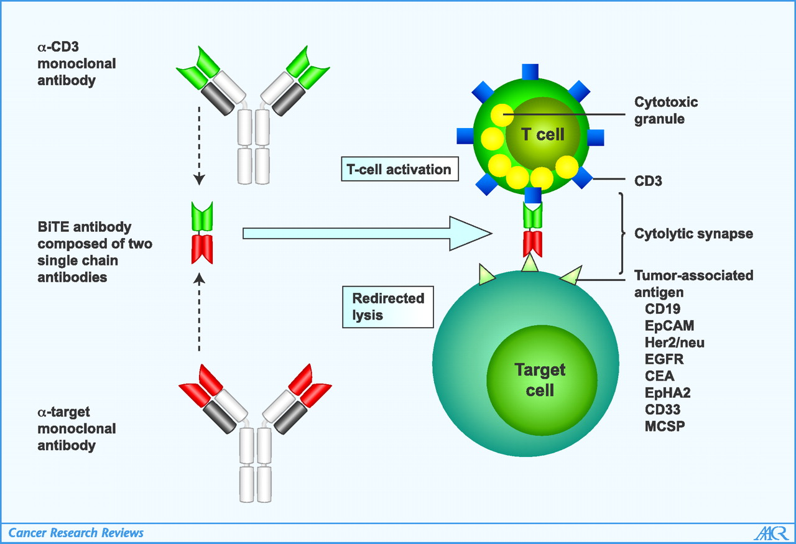
BiTE (bispecific T cell engager)
Blinatumumab FDA-approved
Baeuerle, Cancer Res 2009

Slide 30
BCMA BiTE: AMG 420
Topp et al, ASH 2018, #1010

Slide 31
AMG 420 phase 1
n=42 (median 4 prior therapies)
  31% PI/IMID-ref; 21% dara-ref
11 responders (median 6 cycles)
  7/10 (70%) @ 400 µg/day (4 with MRD-neg sCR)
Topp et al, ASH 2018, #1010

Slide 32
AMG 420: toxicities
2 dose-limiting toxicities (polyneuropathy gr3, CRS gr3 + polyneuropathy gr3)
5 line infections
Topp et al, ASH 2018, #1010

Slide 33
Other Bispecific Antibodies for MM
BiTEs
 | IgG-like molecules | Non-IgG-like molecules
Fc domain | Yes | No
Half-life | Long | Short
AMG701 (BCMA)
PF-06863135 (BCMA)
JNJ-64007957 (BCMA)
EM801 (BCMA)
CC-93269 (BCMA)
REGN5458 (BCMA)
HPN217 (BCMA)
TNB-383B (BCMA)
AFM26 (BCMA)
BFCR4350A (FcRH5)
GBR1342 (CD38)
JNJ-64407564 (GPRC5D)
AMG420 (BCMA)
Blinatumumab (CD19)

Slide 34
Comparison of immunotherapy approaches
 | ADCs | CARs | BiTEs
Off-the-shelf | Yes | Not yet | Yes
Ease of administration | ++++ | + | + to ++
Repeated dosing required | Yes | No | Yes
Dependent on patient T cell “fitness” | No | Yes | Yes
Toxicities | IRR, Toxin-dependent | CRS, neuro | CRS, neuro
Toxicity duration | Ongoing | ~14-21 days | Ongoing
Durable clinical activity seen | Yes | Yes | Yes

Slide 35
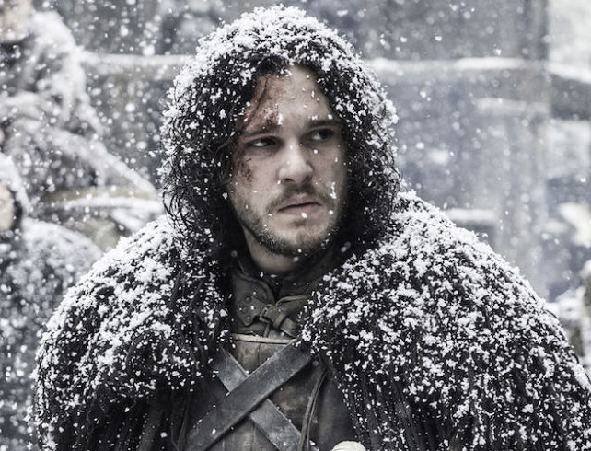

Conclusions
Immunotherapy is coming
Daratumumab moving to front-line
BCMA most promising target
  CAR T cells, BiTEs and antibody-drug conjugate with high response rates
  FDA approval 2020?
Many questions/challenges
  Optimal patient populations
  Managing toxicities
  Sequencing/Combining with current therapies
Deeper and durable responses→CURE??

