Slide 1
Diagnosis of Multiple Myeloma
Traditional criteria: Monoclonal plasma cells + attributable “CRAB” features
  Calcium > 1 mg/dL above ULN or 11 mg/dL
  Hemoglobin >2 g/dL below LLN or <10 g/dL
  ≥1 osteolytic lesion
  CrCl < 40 mL/min or serum Cr >2 mg/dL
2014 Update to IMWG Criteria include the following as “myeloma-defining events” even in absence of CRAB:
  >60% bone marrow plasma cells
  Serum free light chain ratio >100
  >1 focal lesion on total body MRI

Slide 2
Choice of Initial Therapy
Regimen | Overall RR | Studies
Len + Dex | 72% 75% | S0777 (Durie, Lancet, 2016) FIRST (Benboubker, NEJM, 2014)
Bort + Dex | 73% | UPFRONT (Niesvizky JCO 2015)
CyBorD | 82% | EVOLUTION (Kumar Blood 2012)
Len + Bort + Dex | 82% | S0777 (Durie, Lancet, 2016)
Car + Cy + Dex | 95% | Bringhen, Blood, 2014
Car + Len + Dex | 98% | Jakubowiak, Blood, 2012 Roussel, ASH, 2016
Car + Len + Dex + Dara | 100% | Jakubowiak, ASCO 2017
More toxic
Less convenient
Is there a long-term benefit to more intensive up-front therapy?

Slide 3
Summary: Initial therapy
Based on S0777 results, RVD is our standard first-line therapy
  Standard regimen is twice-weekly Velcade, 21-day cycles
  Consider once weekly Velcade, 28-day cycles, lenalidomide dose-reduction
Carfilzomib does not yet have long-term comparative data for up-front usage
  Mayo guidelines recommend this for high-risk patients
  ECOG E1A11: phase 3 study KRd vs VRd for transplant ineligible, standard-risk patients.
Special populations
  Renal insufficiency (CrCl <30): CyBorD (start ASAP to salvage renal function)
  Velcade contraindications: daratumumab + lenalidomide + dexamethasone
Consider maintenance therapy for transplant-ineligible patients
  Clear PFS benefit
  Uncertain OS benefit

Slide 4
Summary: Transplant and maintenance
High-dose melphalan + ASCT prolongs PFS/OS
  All subsets appear to benefit
  Transplant in first line is standard; delay to second line may have similar OS.
  No clear role for tandem transplant
  Similar safety/benefit in patients with renal impairment
Post-ASCT lenalidomide maintenance prolongs PFS and overall survival.
  PFS/OS benefit is apparent across subgroups with possible exception of high-risk subjects.
  Increased risk of second malignancies with lenalidomide, but not more death due to second malignancies
  Optimal duration of therapy is uncertain; DFCI/IFM 09 studies and ECOG E1A11 study may address this.

Slide 5
Bone therapy: outstanding questions
What is the optimal duration of therapy?
Is there benefit in patients with no lytic bone disease or osteopenia/osteoporosis?
Is monthly denosumab superior to every-three-month denosumab?
Recently published ASCO guideline (Anderson JCO 2018):
  No strong position on bisphosphonate vs denosumab
  Therapy is recommended in all patients
  Consider less frequent dosing in patients with responsive/stable disease
  Duration: up to two years, resume with relapse or new bone lesions
  Monitor albuminuria on bisphosphonate, discontinue if >500 mg/24h, resume cautiously
  Dental precautions

Slide 6
Imids
thalidomide
lenalidomide
pomalidomide
PIs
bortezomib
carfilzomib
ixazomib
Cytotoxics
cyclophosphamide
melphalan doxorubicin
bendamustine
Steroids
Dexamethasone
Prednisone
HDACi
panobinostat
MoAbs
elotuzumab
daratumumab
Notes:
<number>

Slide 7
Trials at Penn for first-line therapy
CAR T cells as consolidation of first-line therapy for high-risk myeloma
  High-risk: R-ISS stage 3 or complex karyotype or <PR/progression to RVD or PCL
  Enroll during first-line therapy → collect T cells → collect stem cells → receive CAR T cells
  Randomized CART-BCMA +/- CART19
SWOG 1803 [coming soon]
  Post-ASCT maintenance randomized lenalidomide +/- daratumumab
  MRD negative patients after 2Y randomized +/- continuous maintenance

Slide 8
Choosing triplets for relapsed myeloma
Limited data comparing triplets or sequencing
General principles
  Most patients should receive triplets
  Carefully assess treatment history
    What worked?
    What caused side effects?
  Consider pace of progression and symptom burden
  Include cost and convenience in the decision
My favorite triplets
  Any proteasome inhibitor / Imid combination
  Daratumumab combinations
  Cyclophosphamide / proteasome inhibitor combinations
Triplets to consider later on
  Elotuzumab with lenalidomide or pomalidomide
  Panobinostat with bortezomib or carfilzomib
Notes:
<number>

Slide 9
Summary
Most patients should receive triplet combinations
  Daratumumab
  PI/Imid
  Cyclophosphamide/PI
  Elotuzumab or panobinostat
Subcutaneous daratumumab is coming
Off-label approved agents may be reasonable:
  Venetoclax alone [in t(11;14)] or with a proteasome inhibitor [all patients]
New agents are promising
  Selinexor with dexamethasone
  TAK-573 (anti-CD38 / attenuated interferon)
  Immunotherapy

Slide 10
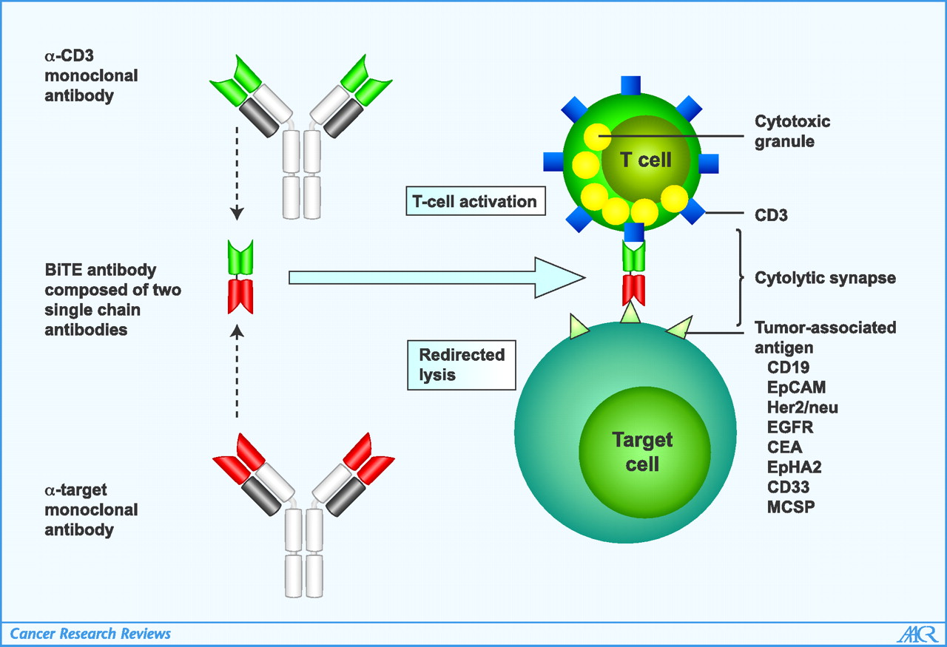
BiTE (bispecific T cell engager)
Blinatumumab FDA-approved
Baeuerle, Cancer Res 2009

Slide 11
Immunotherapy targets for myeloma
The classics:
  CD138
  CD38
  CD56
  kappa light chain
  (CD19)
The new models:
  Lewis Y
  CD44v6
  MAGE A3
  NY-ESO-1
  CS1/SLAMF7
  BCMA
  Integrin beta 7
  FcRH5
  CD48
  CD46
  CD229
  GPRC5D

Slide 12
Cellular therapy in MM: what’s happening in 2019
BCMA CAR registration trials in rel/ref MM
  Ongoing ph 1/2 for next-gen CAR products
BCMA CAR trials for less-heavily treated patients
  1-3 priors
  Post-induction in hi risk
    CART-BCMA +/- CART-19 (PI: Al Garfall)
BCMA CAR combo trials
  CART-19, IMiDs, checkpoint inhibitors?
  Post-autoSCT
CAR T cells against CD38, SLAMF7, GPRC5D
Gene-edited T cells
  “Off-the-shelf” allogeneic CAR T cells
  PD-1 deficient NY-ESO1 TCR T cells

Slide 13
Comparison of immunotherapy approaches
 | ADCs | CARs | BiTEs
Off-the-shelf | Yes | Not yet | Yes
Ease of administration | ++++ | + | + to ++
Repeated dosing required | Yes | No | Yes
Dependent on patient T cell “fitness” | No | Yes | Yes
Toxicities | IRR, Toxin-dependent | CRS, neuro | CRS, neuro
Toxicity duration | Ongoing | ~14-21 days | Ongoing
Durable clinical activity seen | Yes | Yes | Yes

Slide 14
Conclusions and challenges
Unprecedented single-agent response rates (60-95%, including MRD- CRs) in heavily-pretreated MM pts with BCMA-targeted therapies
  CAR T cells
  Antibody-drug conjugate
  Bispecific Ab
  FDA approval in late 2019/early 2020?
Challenges for CAR T cells
  Logistics, Toxicity, Durability
  Next-gen CAR products now in trials
How to sequence/combine with other agents?
  Road to a cure??

